Slide 1
Unit 6 An old man tried to move the mountains.
Section A 1a —2d
WWW.PPT818.COM

Slide 2
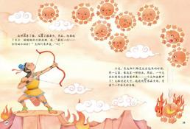
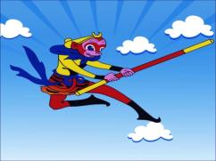
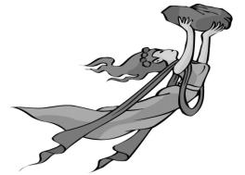
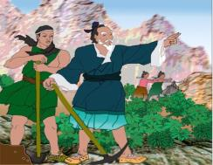
1a Match the story titles with the pictures [a-d].
a
b
c
d
b
d
_____Journey to the West
_____ Yu Gong Moves a Mountain
a
c
_____ Hou Yi Shoots the Suns
_____ Nu Wa Repairs the Sky

Slide 3
1b Listen and check (√) the facts you hear.
____ The two mountains were very high and big.
____ A very old man tried to move the mountains.
____ A man told Yu Gong that he could never do it.

Slide 4
Summary
1. 故事的六要素：时间、地点、人物、起因、经过和结果。这些要素都可以通过who, what, when, where, why, how等问题来引出。
例如：
(1) When and where did the story happen? (时间和地点)
(2) Who is the main character? (人物)
(3) How does the story begin? (起因)
(4) What happened next? Why did that happen? (经过)
(5) What is the end of the story? (结果)
2. 故事开头的几种描述：Once upon a time, long long ago, one day…
故事结尾：概括主要内容，阐述道理，感受，评价……
3. 注意故事名，书名的书写规范。
（1）书名、故事名等，单词首字母要大写；
（2）名称中有介词、虚词、冠词无需大写；
（3）印刷体中名称要用斜体

Slide 5
Make a movie
Imagine you are the director (导演), you make a movie about this story with your group. Then choose the best group to act it out and that group will win “the Oscar prize” in our class.

Slide 6
1c Discuss the questions with your partner.
How does the story begin?
What happened next?
Where would they put all the earth and stone from the mountains?

Slide 7
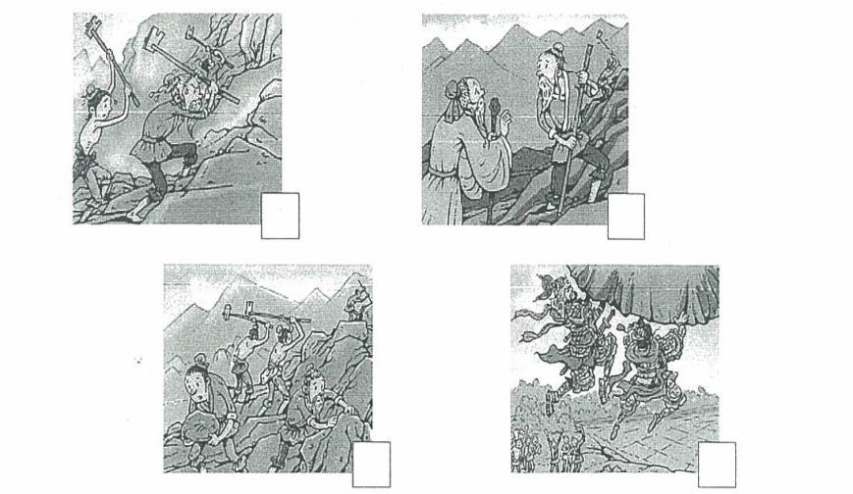
2a Listen and number the pictures [1-4] in order to tell the story.

Slide 8
2c Look at the pictures in 2a and tell the story in your own words.
Maybe you can use:
Once upon a time
There was an old man…
Move the mountains
Keep trying
Never give up

Slide 9
2d Role-play the conversation.
Role-play it.
What is your opinion about the story?
Do you agree Yu Gong’s idea or not?
Why?

Slide 10
Key Points
1. a little bit + adjective
eg. I was a little bit busy at that time yesterday.
昨天那个时候我有一点儿忙。
2. give up+n./pron./v.-ing…
eg. Don’t give up the test.
不要放弃考试。
Please tell me some similar phrases with “up” which we have learned.
3. instead of
eg. I went out for a walk instead of staying at home.
我出去散步了而不是待在家里。
(It means I didn’t stay at home; I went out for a walk instead.)

Slide 11
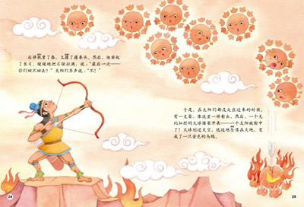
1. In Yao time, there were 10 suns at the same time in the sky, it caused the earth to burn , people can’t stand the heat (热度) and crops can’t be grown. Because the extreme hot weather, it was able to injure people in every place. Emperor Yao, the Emperor of China, asked Hou Yi to use his archery skill to shoot down all but one of the suns.

Slide 12
2. It is said that there were no men when the sky and the earth were separated (被分开). In an ancient time, the sky could not cover all the things under it, nor could the earth carry all the things on it. A great fire was caught and would not die out; a fierce flood raced about and could not be stopped. Then Nuwa melted rocks of five colors and used them to mend the cracks in the sky. Thus the sky was mended, Nuwa's deeds benefited the heavens above and the earth below. Her name was remembered by later generations.

Slide 13
3. Journey to the West is a historical novel that is considered one of the four classics from the Ming Dynasty. It was written by Wu Cheng’en. It is about a Buddhist (佛教的) monk and his disciples, Sun Wukong, Zhu Bajie and Sha wujing who are a few animals with human characteristic. They have magical powers to protect them from the evils. They travelled to the west to India to find Buddhist scriptures (佛经).

Slide 14
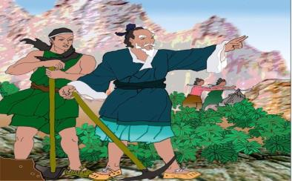
4. There were two high mountains. Both of the mountains were very high. Just to the north of the mountains lived an old man called Yu Gong. With the two high mountains just in front of his house, his family and he had to walk a long way around the mountains whenever they had something to do on the other side of the mountains. One day, Yu Gong called all his family together to talk about how to move the two mountains to other places. A man saw them working and tried to stop them, saying, "You are so silly! You're so old and weak that you can't move the high mountains." "You're wrong," Yu Gong said with a sigh. "Look, my sons can continue my work after my death. When my sons die, my grandchildren will continue. So generations after generations, there's no end. But the mountains can't grow higher. Do you still say I can’t move them away?" Later the Heaven God, upon learning of Yu Gong’s story, was moved. He then ordered another god to come down and take the two high mountains away.

Slide 15
Homework
Make a survey about your classmates.
Ask what they know about Chinese folktales.
Say a few story titles and tell something about the story.
Then fill in the blanks.
Name | Title | Outline | Feeling

