Slide 1
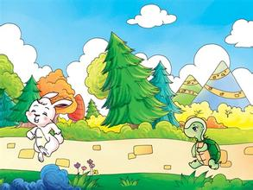
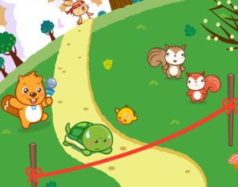
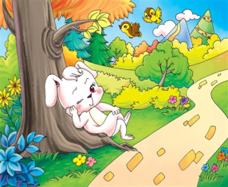
Unit 1
Slow and steady wins the race
WWW.PPT818.COM

Slide 2
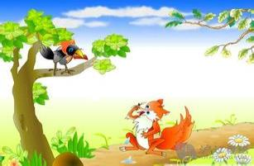
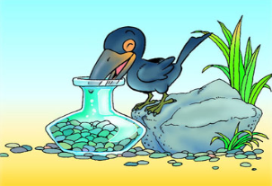
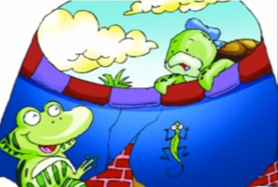
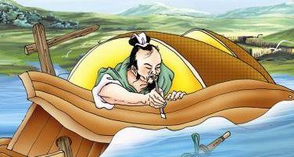
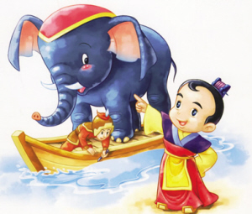
Free talk.
What are these stories about?
The Fox and the Crow
The Crow and the Pitcher
The Frog in the Well
Cao Chong Weights
the Elephant
Making His Mark
The Little Match-Girl

Slide 3
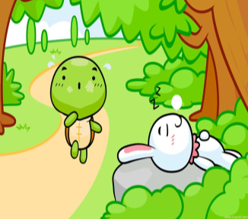
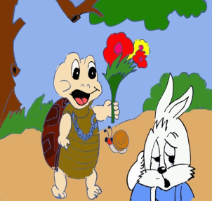
Free talk.
What's this story about ?
The Tortoise and the Hare

Slide 4
Let's learn.
Slow and steady wins the race.
The Tortoise and the Hare

Slide 5
Let's talk.
Don't ...
We should ... / Be...
Don't be proud.
Be patient.
Be careful.
...
The Tortoise and the Hare

Slide 6
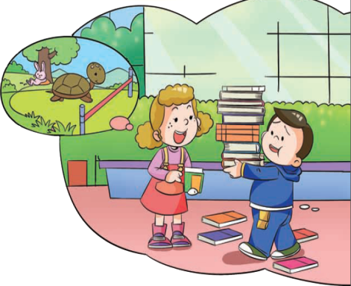
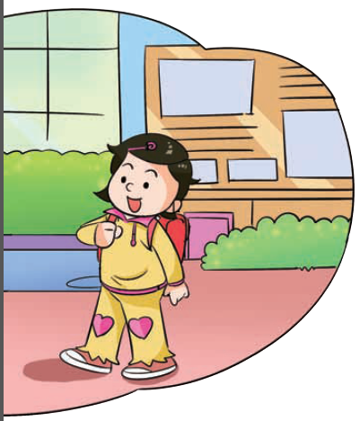
Let's talk.
Look, what's Jiamin doing?
Jiamin is carrying the books.

Slide 7
Listen and answer.
Some books are on the floor, what happened?

Slide 8
Let's read and judge.
1.( ) Jiaming tried to carry all the books beacuse he thought the books were not heavy.
2.( ) Xiaoling thinks Jiamin is like the silly tortoise.
3.( ) In the story The tortoise and the Hare, the slow but careful tortoise won the race.
4.( ) Finally, Jiamin knows that he should be quick and careful if he wants to do something well.
F
didn't want to go back to the classroom again.
F
hare
T
F
patient

Slide 9
Let's read.
Follow the tape.
Read in groups/together.
Read in roles.

Slide 10
Let's recite.
Janet: Jiamin, are you OK?
Jiamin: I tried to carry all the books. I didn't want to go back to the classroom again.
Xiaoling: Why are you in such a hurry? You are like that silly hare.
Jiamin: Hare? What do you mean?

Slide 11
Let's recite.
Xiaoling: You know... the old story about the tortoise and the hare.
Janet: Yes. One day a tortoise and a hare had a race. The hare was sure he would win so he took a rest. He was so proud and careless. The slow but careful tortoise won the race.

Slide 12
Let's recite.
Jiamin: Ahh. I understand now.
If I want to do something well,
I should be careful and patient.
Janet: That's right. Remember,
Slow and steady wins the race.

Slide 13
Let's recite.
Janet: Jiamin, are you OK?
Jiamin: ________________________. I didn't want to go back to the classroom again.
Xiaoling: ________________________? You are like that silly hare.
Jiamin: Hare?____________________ ?
I tried to carry all the books
Why are you in such a hurry
What do you mean
the story about the tortoise and the hare.
Xiaoling: You know... ______________________.

Slide 14
Let's recite.
Janet: Yes. One day a tortoise and a hare had a race.
__________________________________________ . _________________________The slow but careful tortoise won the race.
The hare was sure he would win so he took a rest
He was so proud and careless.
Jiamin: Ahh. I understand now. ________________
__________________________________________.
Janet: That's right. Remember, ____________________.
If I want to do something well,
I should be careful and patient.
Slow and steady wins the race.

Slide 15
Fill in the blanks.
careless，careful，silly，slow，
steady，proud， patient
1. Why are you in such a hurry? You are like that ___________ hare.
2. The hare was sure he would win so he took a rest. He was so ______ and____.
3. The slow but _________ tortoise won the race.
4. If I want to do something well, I should be _________ and _________.
5. Remember, ___________ and ____________ wins the race.
silly
proud
careless
careful
careful
patient
slow
steady

Slide 16
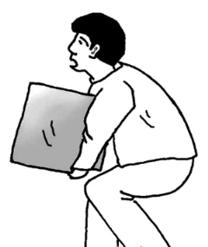
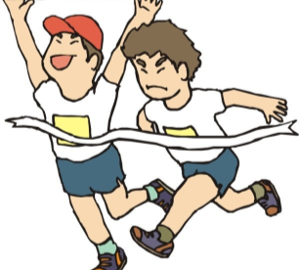
Let's practise.
try to do something=try one's best to do something
尽自己最大能力做某事 ( try-tries-tried)
Mr. Wang ___ ____ ___ the heavy box.
tried to carry
tried their best to run
The boys ___ ____ ____ ___ ___ fast.

Slide 17
Let's practise.
want to do something 想做某事
eat the pizza
I am so hungry,I want to ___ ___ _____.
wanted to go
We _____ ____ _____ to the Disneyland
last Sunday, but it was rainy, so we stayed
at home.

Slide 18
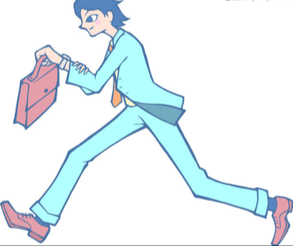
Let's practise.
in a hurry （名词）
hurry（动词） to do something 急忙做某事
He was afraid of being late, so he ___________________ .
went to work in a hurry

Slide 19
Let's practise.
The hare was sure he would win the race.
I am not sure I will pass the test because
it is very difficult.
Make your own sentences：
I am (not) sure________________________.

Slide 20
Let's match.
If you want to do something well,
you shoud keep a good diet.
If you want to speak good English,
you shoud listen and speak more.
If you want to be healthy,
you should be careful and patient.
If you want to win the race,
you should try to run very fast.
Make your own sentences:
If you want to ______, you should _________.

Slide 21
Homework
听读背Unit 1课文
抄写《活动手册》P78-P79单词表

