Slide 1
Unit 3 What Will You Do This Summer?
Lesson 18 Three Kites in the Sky
WWW.PPT818.COM

Slide 2
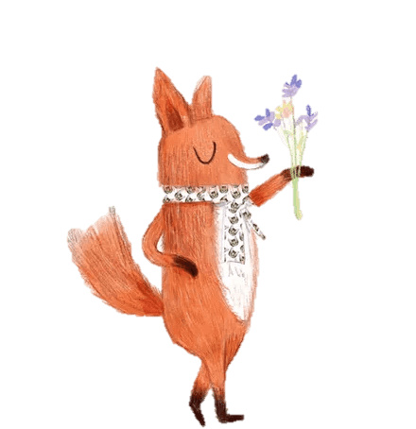
Warm-up
Greetings
Sing a song together: Summer is coming.

Slide 3
Review
yesterday | today | tomorrow
 | can
 | swim
 | visit
could
swam
will swim
visited
will visit

Slide 4
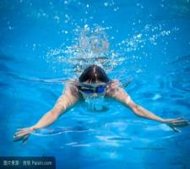
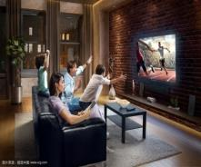
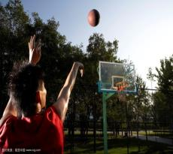
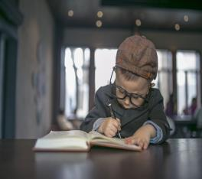
What can you do?
Will you…

Slide 5
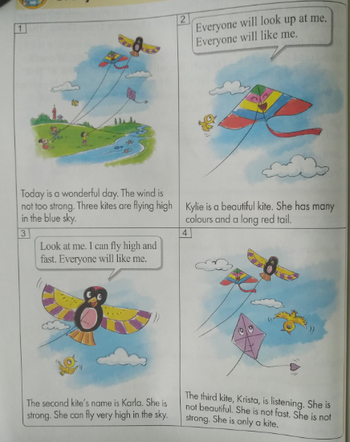
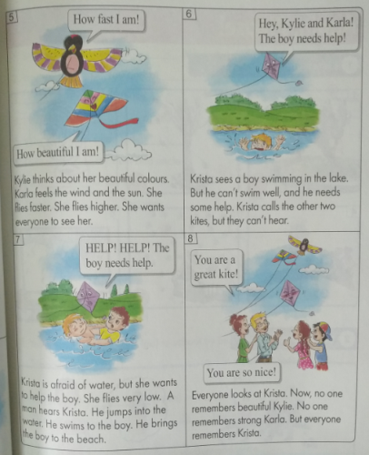
Presentation
Story time

Slide 6
Questions:
Is wind too strong?
No, it isn’t. The wind is not too strong.
What does Kylie have?
She has many colours and a long red tail.

Slide 7
What is the second kite’s name?
The second kite’s name is Karla.
What does Karla feel?
Karla feels the wind and sun.
Does Krista want to help the boy?
Yes, she wants to help the boy.

Slide 8
Practice
以“你最喜欢哪只风筝” 为题进行小组间的讨论，然后互评。

Slide 9
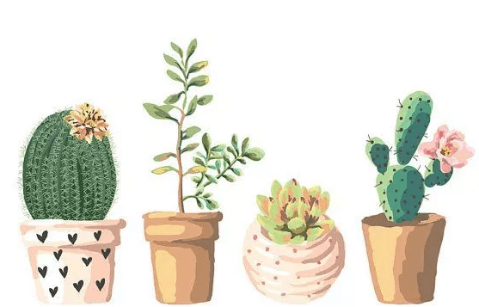
Homework
1.学生相互讨论改编故事的结尾。
2.做完相应的配套练习题。

Slide 10
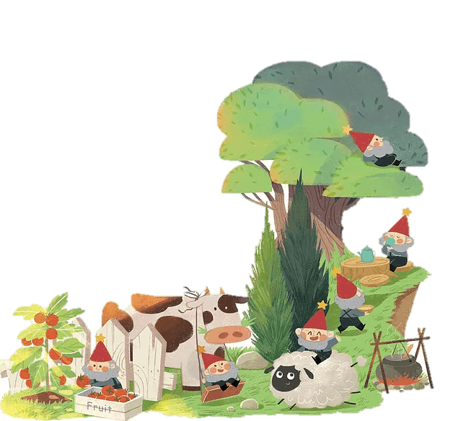
THANK YOU!

