Slide 1
初中英语仁爱版七年级下
Unit5 Topic3
My school life is very interesting
Section A
WWW.PPT818.COM

Slide 2
Warm-up
1
Presentation
2
Summary
3

Slide 3
Warm-up
A: What day is it today?
B: It’s …
Sunday
Tuesday
Thursday
Saturday
Monday
Wednesday
Friday
S
M
T
W
T
F
s

Slide 4
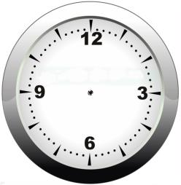
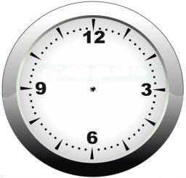
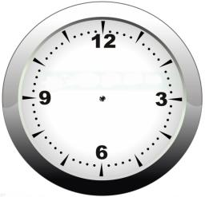
Presentation
Tell the time
nine thirty
half past nine
four fifteen
eleven forty
a quarter past four
twenty to twelve

Slide 5
New Words
What are they doing?
They're ...
physics
geography
have a physics class
have a geography class

Slide 6
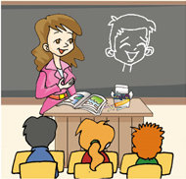
New Words
What are they doing?
They're ...
P.E.
art
have a P.E. class
have an art class

Slide 7
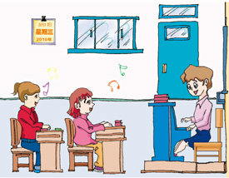
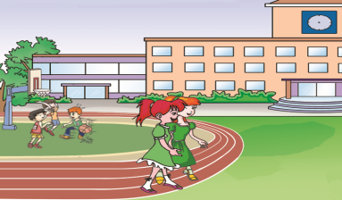
Listen to 1a and fill in the blanks.
Jane and Helen are talking about their favorite day. Jane likes _________ very much because she has a _______ class on that day. The students are having an _________ class now. The class is over at __________________ and the next class begins at _________.
Wednesday
music
English
twenty to eleven
ten fifty
P17 1a 图1

Slide 8
Work in pairs and practice 1a
Helen: What day is it today?
Jane: Wednesday. It’s my favorite day.
Helen: Why?
Jane: Because we have a music class on Wednesday.
I like it very much.
Helen: Listen! What class are they having?
Jane: They are having a music class.
Helen: No. I think they are having an English class.
Jane: You are right.
Helen: What time is the class over?
Jane: At twenty to eleven.
Helen: What time does the next class begin?
Jane: At ten fifty.

Slide 9
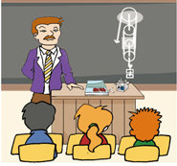
Make up conversations with the information.
A: What day is it today?
B: It’s…
A: What class are they having?
B: They’re…
A: What time does the class begin?
B: At …
A: What time is it over?
B: At …
Monday
Physics
15:20-16:00

Slide 10
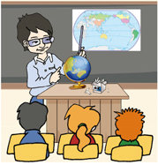
A: What day is it today?
B: It’s…
A: What class are they having?
B: They’re…
A: What time does the class begin?
B: At …
A: What time is it over?
B: At …
Tuesday
Geography
10:00-10:40

Slide 11
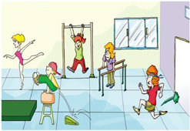
A: What day is it today?
B: It’s…
A: What class are they having?
B: They’re…
A: What time does the class begin?
B: At …
A: What time is it over?
B: At …
Thursday
P.E.
10:50-11:30

Slide 12
A: What day is it today?
B: It’s…
A: What class are they having?
B: They’re…
A: What time does the class begin?
B: At …
A: What time is it over?
B: At …
Friday
Art
14:30-15:10

Slide 13
Some other subjects
computer science
history

Slide 14
Some other subjects
math
politics
biology

Slide 15
Wen Wei's Timetable
 |  | Monday | Tuesday | Wednesday | Thursday | Friday
1 | 8:00—8:40 | English | Chinese | English | Chinese | English
2 | 8:50—9:30 | Chinese | English | Math | English | Computer science
3 | 10:00—10:40 | History | Geography | Music | Math | Math
4 | 10:50—11:30 | Math | Art | Biology | P.E. | Chinese
5 | 14:30—15:10 | Geography | P.E. | Politics | History | Art
6 | 15:20—16:00 | Biology | Math | Chinese | Biology | Class meeting
Outdoor activities
Subject
Day
Period
Time

Slide 16
Look at Wen Wei's timetable and answer the following questions.
How many lessons does he have every weekday?
How many English lessons does he have every week?
What lessons does he have on Wednesdays?
4 Does he have a history class on Tuesdays?
It’s 10:20 on Thursday morning now. What class is he having?
He has six lessons every weekday.
He has five English lessons every week.
He has English, Math, Music, Biology, Politics and Chinese.
No, he doesn’t.
He is having a math class.

Slide 17
Make your own timetable in English.
 | Monday
8:00- ?

Slide 18
Listen and read the sounds and words aloud.
T
h
a
n
k
y
o

Slide 19
T
h
a
n
k
y
o

Slide 20
Listen and check (√) the word you hear in each group.
√
1. | A. bear | B. hear | C. near | D. dear
2. | A. cheer | B. dear | C. wear | D. fear
3. | A. laugh | B. fight | C. cough | D. enough
4. | A. early | B. learn | C. earth | D. pear
√
√
√

Slide 21
Summary
New words about subjects.
2. How to make a timetable.
3. Some useful expressions:
What class are they having?
They are having a music class.
what time does the next class begin?
At ten fifty.
How many English lessons does he have every week?

Slide 22
Homework:
1 Make your ideal timetable in English and talk about it.
2 Write a passage about your own school life.

