Slide 1
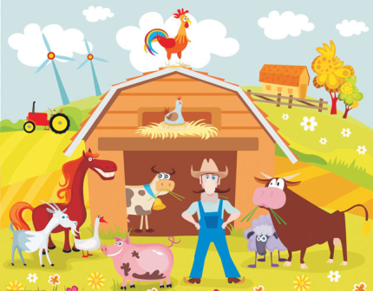
A day on the farm
第二课时
WWW.PPT818.COM

Slide 2
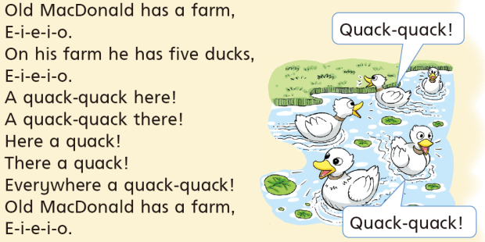
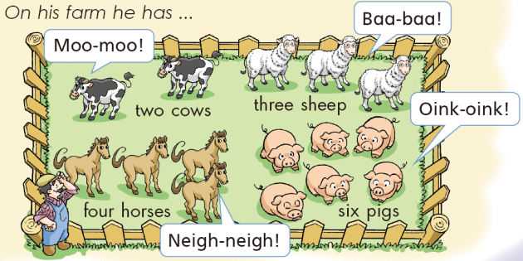
Notes:
2

Slide 3
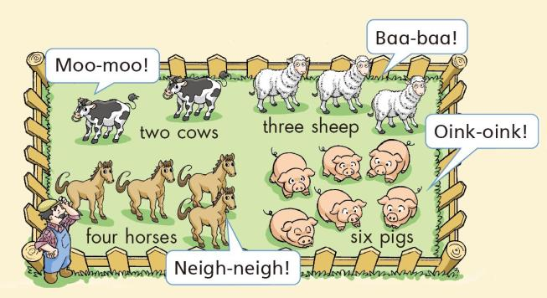
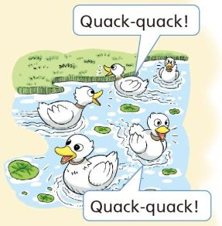
Ask and answer
What do you hear on the farm?
I hear cows. They go “Moo-moo!”
I hear ... They go “…”
Notes:
3

Slide 4
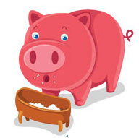
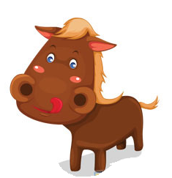
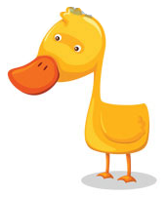
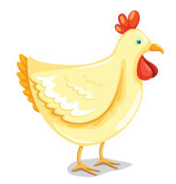
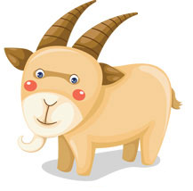
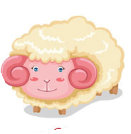
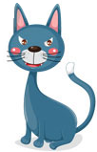
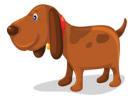
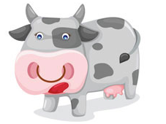
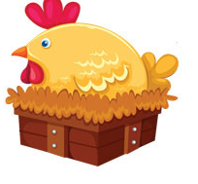
Clap and say
Notes:
4

Slide 5
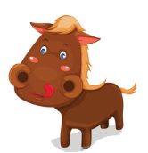
Read and match
cow
sheep
horse
duck
pig
Notes:
5

Slide 6
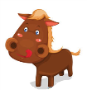
Look and say
cow cows
pig pigs
duck ducks
horse horses
sheep sheep
Notes:
6

Slide 7
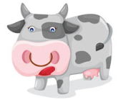
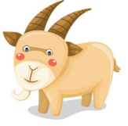
Look and say
Animals
on the farm
Notes:
7

Slide 8
Choose and say
What do you like?
Notes:
8

Slide 9
Choose and say
I like pigs.
They are pink.
They are fat.
They are cute.
They can eat fast.
I like ...
They are ...
Notes:
9

Slide 10
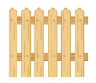
Look and say
What does it mean?
Don’t litter.
Don’t throw stones.
Rules on the farm
Don’t walk on the grass.
Don’t open the gate.
Notes:
10

Slide 11
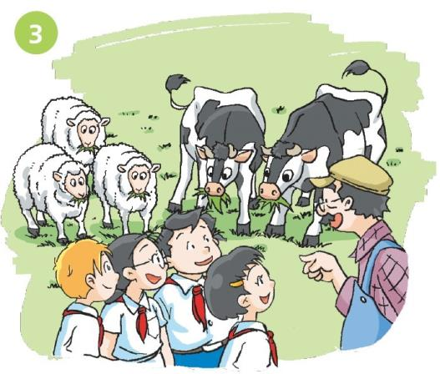
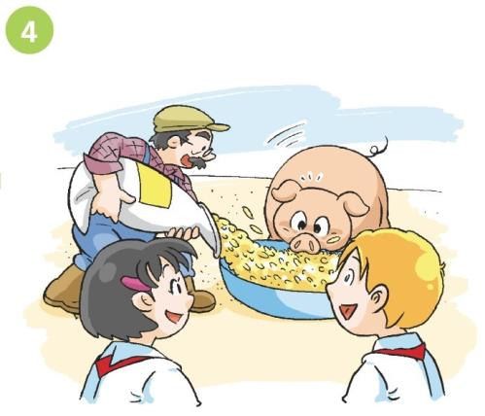
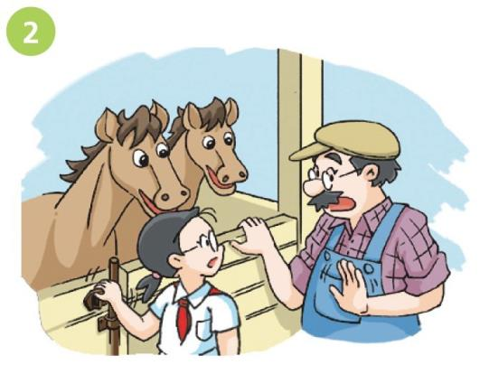
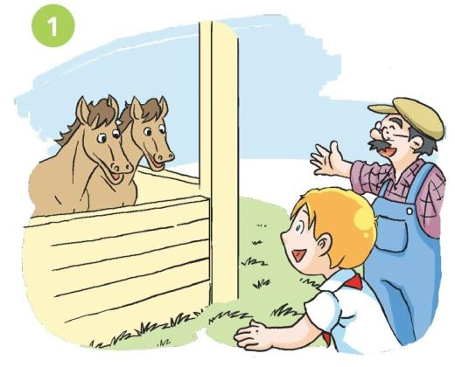
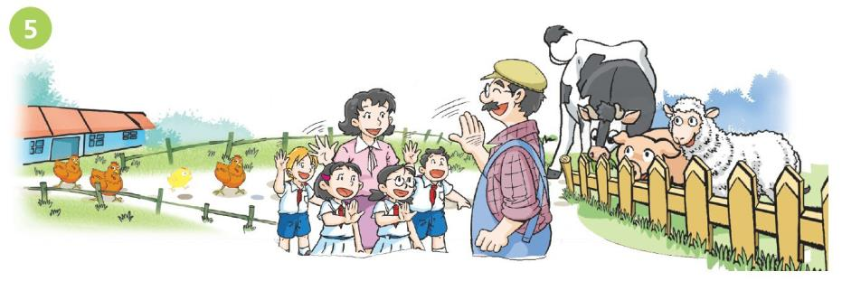
Notes:
11

Slide 12
These are my horses.
I love horses!
Notes:
12

Slide 13
Don’t open the gate.
I’m sorry, Mr MacDonald.
Notes:
13

Slide 14
These are my cows and sheep. They like grass.
Notes:
14

Slide 15
This is my pig.
Wow! It’s fat!
Notes:
15

Slide 16
Thank you, Mr MacDonald. Goodbye.
You’re welcome.
Bye.
Notes:
16

Slide 17
Act it out
Notes:
17

Slide 18
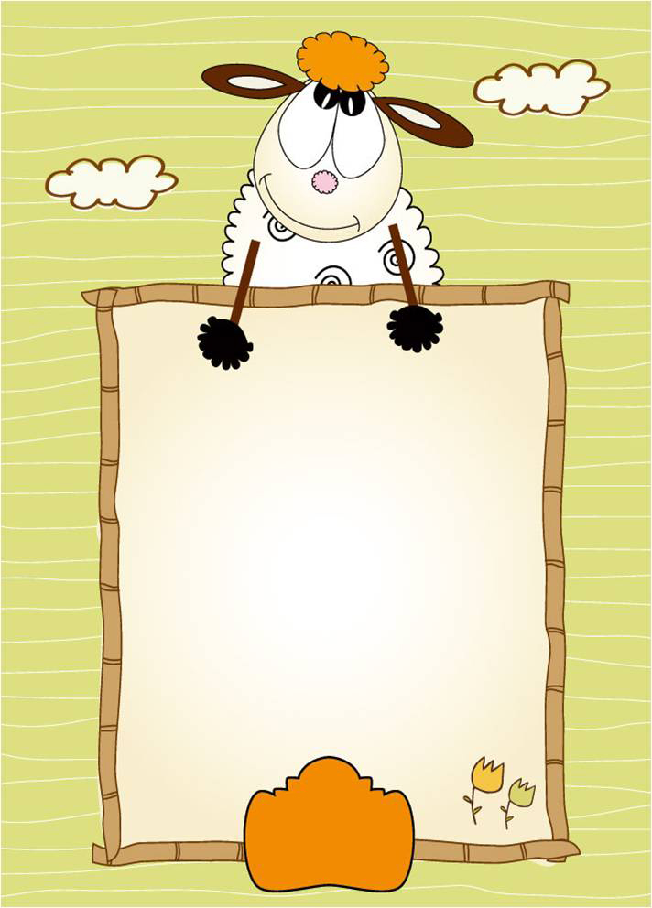
Homework
1 Read and act Say and act.
2 Make your farm and introduce it.
Notes:
18

