Slide 1
初中英语外研版八年级下
Module5 Cartoons
Unit2
Tintin has been popular for over eighty years.
WWW.PPT818.COM

Slide 2
Warm-up
1
Presentation
2
Language Points
3
Exercise
4

Slide 3
Warm-up
Work in pairs. Answer the questions about the cartoon characters.
Which of them do you know?
Which of them do you like? Why?

Slide 4
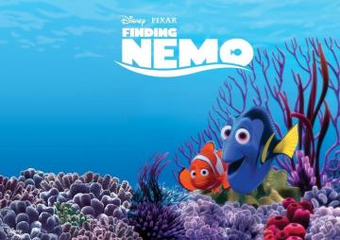
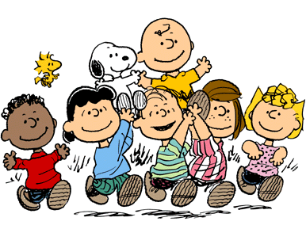
Presentation
Learn some new words
orange-and-white
Nemo
Snoopy

Slide 5
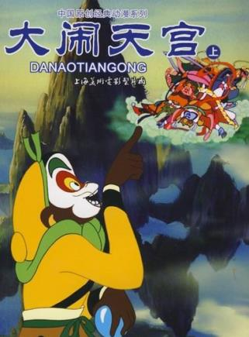
heaven
Monkey King
Monkey King is very clever.
adj. 聪明的; 机灵的

Slide 6
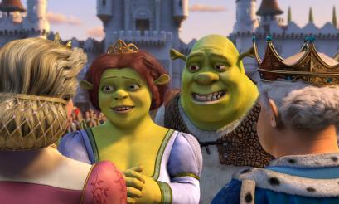
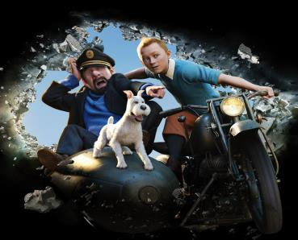
ugly
Shrek
Tintin

Slide 7
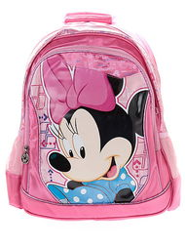
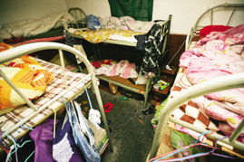
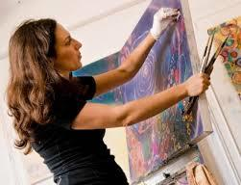
schoolbag
mess
artist

Slide 8
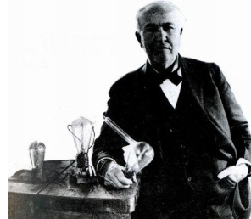
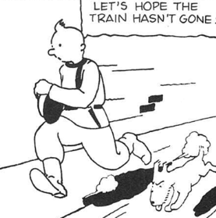
invent
black-and-white

Slide 9
2
Read the passage and choose a sentence that best summarizes it.
Cartoon heroes are popular all over the world, and some are more than eighty years old.
The most popular cartoons come out as books and not as films.
Many children read cartoons today.
Many foreign cartoons have become very popular in China.

Slide 10
Read the passage again and finish the following tasks.
一、本课以卡通为话题，介绍了5 个著名的卡通形象，它们分别是________ _________________________________。
二、课文共有4 个自然段，请选出各段的大意，并把字母编号填写在横线上。
Nemo,
Shrek, Monkey King, Tintin, Snoopy

Slide 11
A. a cute dog that lives in his private world
B. a favourite cartoon hero, and he works for a newspaper
C. he is the hero of Havoc in Heaven
D. two cartoon heroes are popular with
young people all over the world
1. 第一段: _______ 2. 第二段: _______
3. 第三段: _______ 4. 第四段: _______
D
C
B
A

Slide 12
三、请根据课文内容判断正(T)误(F)。
( )1. Nemo and Shrek are green animals.
( )2. The Monkey King has celebrated his 60th birthday.
( )3. The Monkey King is brave, humorous and clever.
( )4. An artist invented Tintin in the 1980s.
( )5. Snoopy and his friends satisfy older
people and children.

Slide 13
3
Complete the notes.
Nemo and Shrek
Nemo is a ______ orange-and-white fish and Shrek is an ______ green animal.
2 Both Nemo and Shrek have won the hearts of ________ people all over the world.
cute
ugly
young

Slide 14
the Monkey King
3 He is the ______ of a story called Havoc in Heaven.
4 He leads a group of _________ against the Emperor of Heaven and his men.
hero
monkeys
Tintin
5 He has _______ hair and a small ______ dog.
6 He works for a ____________ and has lots of _________ experiences.
red
white
newspaper
exciting

Slide 15
Snoopy
7 He lives in his own _________ world
and finds real life _________ to understand.
8 Charles Schulz drew the cartoons to satisfy ______ people as well as children.
private
hard
older

Slide 16
4
Complete the sentences with the correct form of the words in the box.
copy invent lead private
satisfy schoolbag ugly
1. Cartoon heroes – even Shrek the ______ green man – are everywhere, on desks, __________ and computer screens.
ugly
schoolbags

Slide 17
2. The Monkey King _______ a group of monkeys against the Emperor of Heaven and his men.
3. Herge _________ Tintin and his stories have sold about 200 million ________.
4. Snoopy lives in a(n)________ world. Charles Schulz created Snoopy and his friends to _______ older people as well as children.
leads
invented
copies
private
satisfy

Slide 18
Language points
1. But both of them have won the hearts of young people all over the world.
win the heart of sb. /win sb’s heart 意为“赢得某人的喜欢”。
e.g. The play won the hearts of the audience.
2. He leads a group of monkeys against the Emperor of Heaven and his men.
lead v. (led, led) 领导; 率领
lead sb. against … 表示“带领某人反对…”。
e.g. Mr Clare led his workmates against the cruel boss.

Slide 19
3. They always expect to see more the Monkey King cartoons.
expect + n. / pron. 期待某人或某物”
expect + to do sth. 期待去做某事
expect + sb. to do sth. 期望某人做某事
e.g. I’ll expect your idea.
I expect to find you there.
Do you expect me to stay after the holiday?
4. Ever since the artist Herge invented him in 1929.
ever since 表示“自从”，所引导的时间状语从句用一般过去时，主句用现在完成时。

Slide 20
5. Fans have bought about 200 million copies of Tintin’s stories in more than fifty languages.
copy n. (一)本; (一)份
e.g. Have you got a copy of yesterday’s newspaper?
We are offering a free gift with each copy you buy.
6. … , and drew the cartoons to satisfy older people as well as children.
satisfy v. 满足; 使满意
e.g. The result of the test satisfied the teachers.

Slide 21
Exercise
I. 根据句意及首字母提示补全句中所缺单词。
1. Jenny took a book from her s________ and showed it to her mother.
2. Mr Smith is a famous a_____. Many of his works are famous.
choolbag
rtist

Slide 22
3. Who i________ the mobile phone? Do you know?
4. I will send you a c_____ of the report.
5. The little boy is very c_________ and he can always solve the difficult problems.
nvented
opy
lever

Slide 23
II. 根据汉语意思完成英语句子, 每空一词。
1. 最后他赢得了那个女孩的心。
At last he _____ ____ _____ ____ that girl.
2. 我爷爷刚刚庆祝了他的70岁生日。
My grandfather ________ just _________ his seventieth birthday.
won the
heart of
has
celebrated

Slide 24
3. 孩子们期盼明天去野餐。
The children ________ ________ ________a picnic tomorrow.
4. 这条橙白相间的鱼是这个故事的主人公。
The __________________ fish is the ________ of the story.
5. 她的分数总能令父母满意。
Her marks always ________ her parents.
expect to
have
orange-and-white
hero
satisfy

Slide 25
Homework:
Write a passage about your father’s favourite cartoon.

