Slide 1
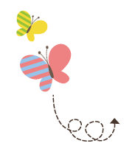
111111111111111111111111111111111111111111111111111111111111111111111111111111111111111111111111111111111111111111111111111111111111111111111
Unit 2 Good Health to You
六年级下册
Lesson 12 Helen Keller
WWW.PPT818.COM

Slide 2
Do you know who is the author of the book?

Slide 3
Story time
Helen Keller was born in the U．S. in 1880.When she was 18 months old, she fell ill and became deaf and blind.
Her parents loved her very much, but they did not know how to help her.
She couldn’t see anything. She couldn't hear anything. She couldn’t speak at all. Helen often got angry. Sometimes, she threw her food from the table.
In 1887, her parents met a teacher, Anne Sullivan. Anne became Helen’s friend. She wanted to teach Helen words. But it was very hard.

Slide 4
Story time
One day, Anne took Helen’s hand and let her feel the water. She wrote the word “water” on the back of Helen’s hand. And Helen got it.
From that day on, Helen Keller began to study every day. She worked very hard. Helen learned many new words every day.
She learned to speak, read and write. When she was 20 years old, she went to university. Later, she became a great writer.
One of her famous books is The Story of My Life . Helen’s story gives everyone hope.

Slide 5
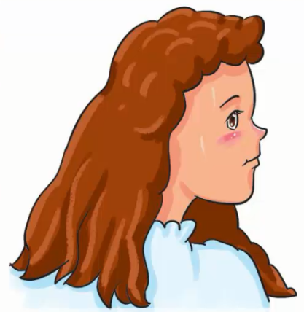
Story time

Slide 6
本部分是一则关于海伦•凯勒的故事，讲述了她的成长经历。在安妮老师的帮助下，海伦•凯勒，一个暴躁易怒的小女孩，最终成为了一个伟大的作家。

Slide 7
能听懂和理解这个简单的故事，并根据故事进行简单的问答活动
完成配套的课后作业，见《典中点》P25页或
课后作业课件。

