Slide 1
Unit6 Topic3
Which is the way to the hospital?
Section A
WWW.PPT818.COM

Slide 2
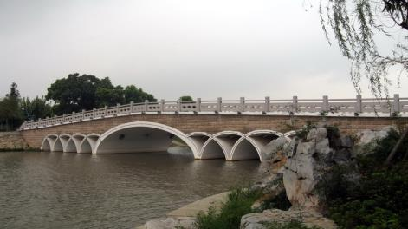
bridge

Slide 3
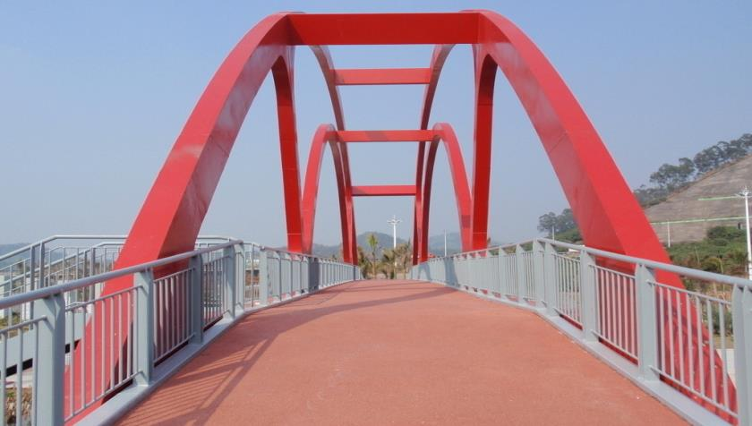
Go across the bridge.
bridge

Slide 4
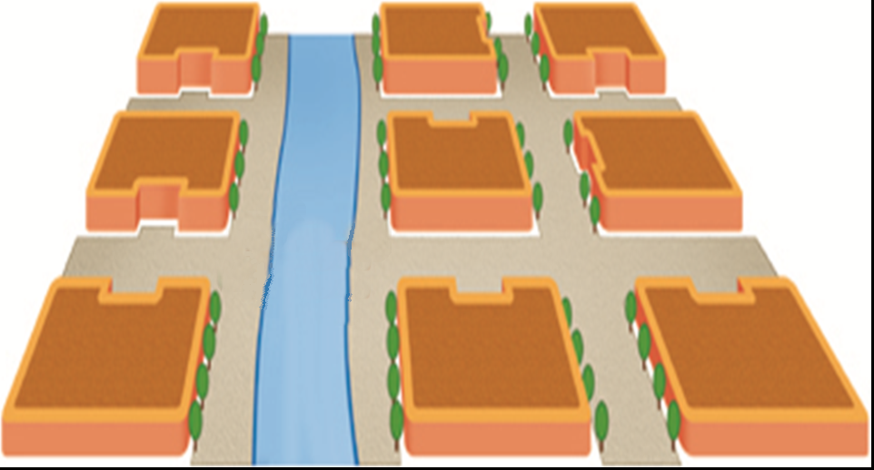
Go along the street.

Slide 5
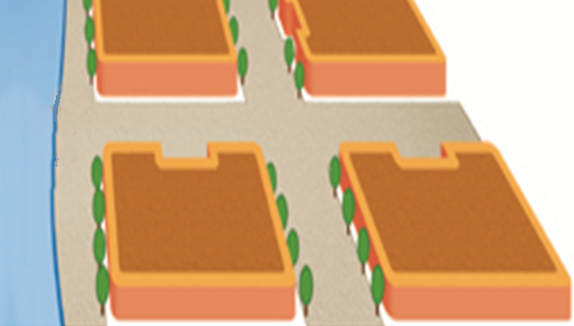
turn left

Slide 6
turn right

Slide 7
Listen to 1a and choose the picture for each conversation.
P43 1b
图1
P43 1b
图2
P43 1b
图3
2
（ ） （ ） （ ）
3
1

Slide 8
Hospital
Post Office
1
Bank
Bridge
Xinhua Street
Bookstore
Park
Library
Zhongshan Road
Shengli Road
School
Restaurant
Supermarket
A
A: Excuse me, is there a bank near here?
B: Yes. Go up Xinhua Street to the end, and
you’ll find it on your left.

Slide 9
Hospital
Post Office
2
Bank
Bridge
Xinhua Street
Bookstore
Park
Library
Zhongshan Road
Shengli Road
School
Restaurant
Supermarket
A
A: Excuse me, how can I get to the library?
B: Go along Xinhua Street and turn right at the first crossing. It's about twenty meters along on the left.

Slide 10
Hospital
Post Office
3
Bank
Bridge
Xinhua Street
Bookstore
Park
Library
Zhongshan Road
Shengli Road
School
Restaurant
Supermarket
A
A: Excuse me, which is the way to the hospital?
B: Go along Xinhua Street and turn left at the second crossing. Go across the bridge. It's on your right.

Slide 11
Key points
Asking the way
Excuse me, is there a (an) … near here?
Excuse me, how can I get to …?
Excuse me, which is the way to …?
Giving directions
Go up/along Xinhua Street to the end, and …
Turn left/right at the first/second crossing.
Go across the bridge.
It’s about … meters along on the left.
在左前方约20米处。

Slide 12
Hospital
Post Office
Bank
Bridge
Xinhua Street
Bookstore
Park
Library
Zhongshan Road
Shengli Road
School
Restaurant
Supermarket
A
Look at the map in 1a. Suppose you are standing at A. Make up new conversations with your partner.

Slide 13
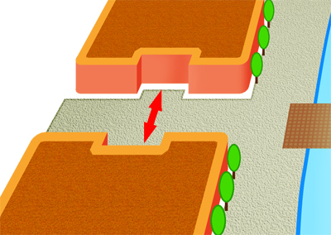
The bookstore is ______________ the school.
across from
Bookstore
Shengli Road
School

Slide 14
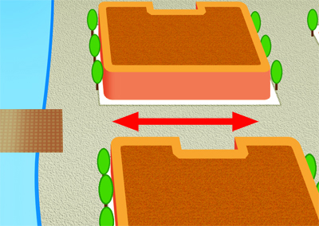
The restaurant is ______ Zhongshan Road, near the bridge.
on
The park is …
Park
Bridge
Zhongshan Road
Restaurant

Slide 15
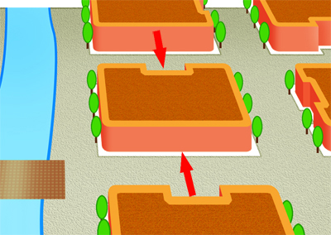
There is a park ________ the bank ________ the restaurant.
between and
Bank
Park
Restaurant

Slide 16
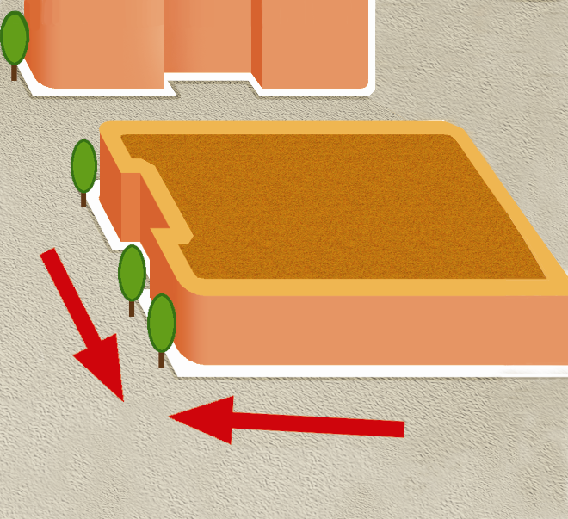
The library is _______________ Xinhua Street and Zhongshan Road.
on the corner of
Library
Xinhua Street
Zhongshan Road

Slide 17
Say the positions of the buildings, using on/across from/between...and.../on the corner of .
P44 2b 图

Slide 18
Listen to the conversation and find the way to Jane's home.
P44 2b 图

Slide 19
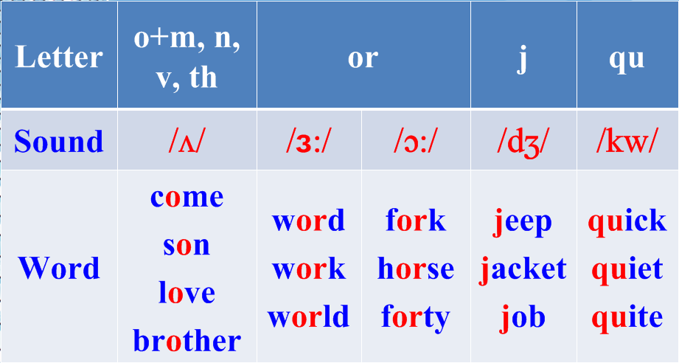
Listen and read the sounds and words aloud.

Slide 20
Read the words by yourself. Then listen,check ( √ ) and repeat.
some cover money other month
Japan queen joke born word

Slide 21
Summary
Asking the way
Excuse me, is there a (an)…near here?
Excuse me, how can I get to…?
Excuse me, which is the way to…?
Giving directions
Go up/along this street to the end, and…
Turn left/right at the first crossing.
It’s about…meters along on the right.
Go across the bridge.
Prepositional phrases
on, on the corner of, across from, between…and…

Slide 22
Homework
1. Suppose you are standing at A in the picture. Make up new conversations of asking the way and giving directions. And then write them down.
A
2. Preview Section B.

