Slide 1
Unit6 Would you like to take a trip?
人教精通版四年级下册
WWW.PPT818.COM

Slide 2
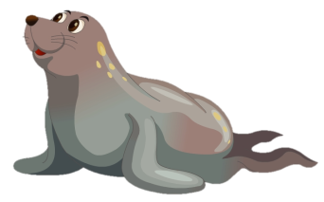
Review
—What’s that in English?
—It’s a …
seal
dolphin
hippo

Slide 3
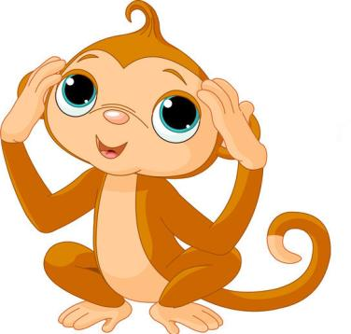
Lead-in
Guessing game
What’s this in English?
It’s a monkey.

Slide 4
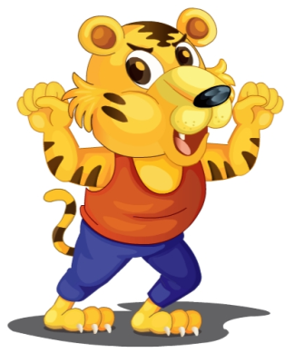
Lead-in
Guessing game
What’s this in English?
It’s a tiger.

Slide 5
Lead-in
Guessing game
What’s this in English?
It’s a dog.

Slide 6
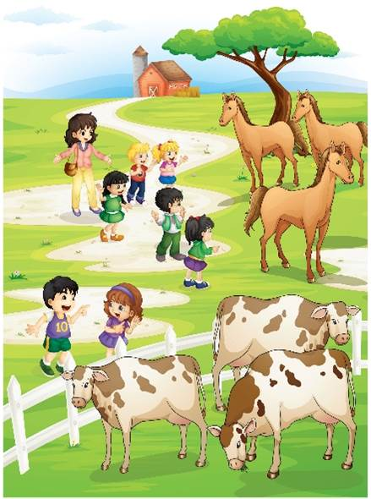
Presentation
Here’s the Happy Farm. What a big farm!
Do you like them?

Slide 7
Presentation
What animals can you see in the farm?

Slide 8
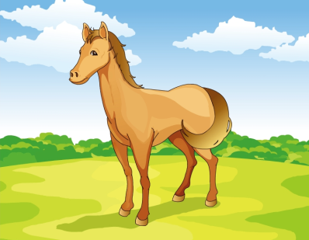
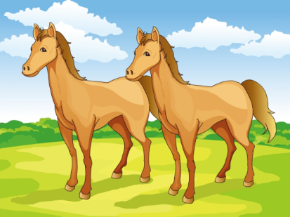
Presentation
Let’s learn
a horse
horses

Slide 9
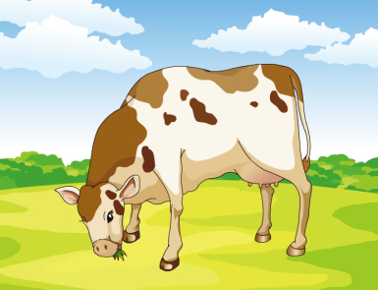
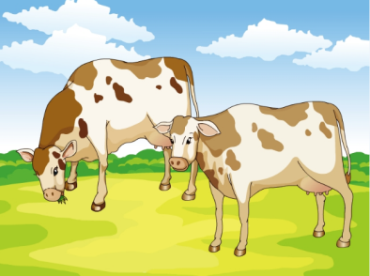
Presentation
Let’s learn
a cow
cows

Slide 10
Presentation
Listen and say
What are they talking about?

Slide 11
Presentation
Let’s learn
1
Here’s the farm, boys and girls!
2
Oh! What a big farm!
Oh! What a big farm!
3
Look here! What are these in English?
5
What are these in English?
4
They’re horses.
6
They’re cows.

Slide 12
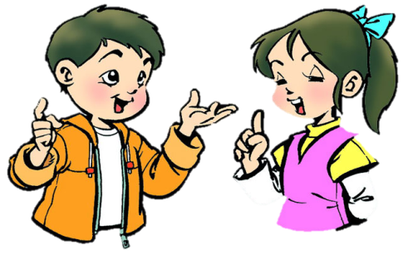
Practice
Role-play
分角色朗读对话，注意模仿语音语调。
小组合作，试着表演出来吧。

Slide 13
Practice
Read it by groups for one minute .
小组读对话一分钟。
一分钟倒计时
60
Learning tip :
50
10
10
四人一组，比赛读句子，看谁能在一分钟内读完，并且读得准确、流利！
20
20
40
30
30
开始

Slide 14
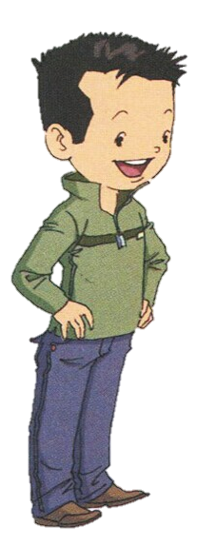
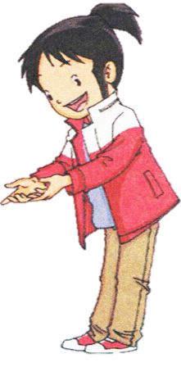
Presentation
What’s this in English?
It’s a horse.

Slide 15
Presentation
What are these in English?
They’re horses.

Slide 16
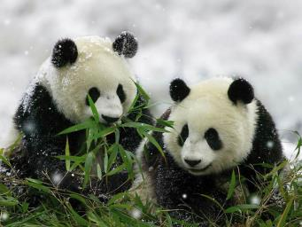
Practice
Look and say
What’re these in English?
They’re pandas.

Slide 17
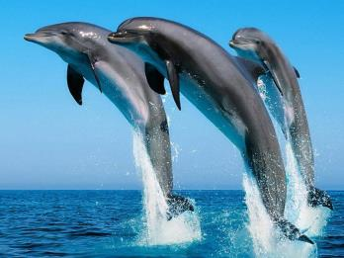
Practice
Look and say
What’re these in English?
They’re dolphins.

Slide 18
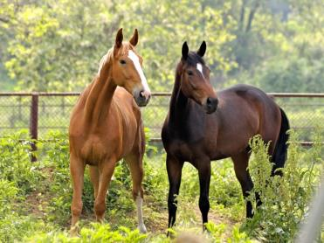
Practice
Look and write
A: What’re these in English?
B: _____________.
They’re horses

Slide 19
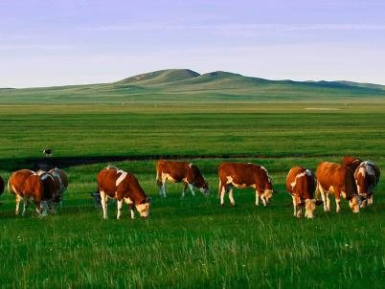
Practice
Look and write
A: What’re these in English?
B: _____________.
They’re cows

Slide 20
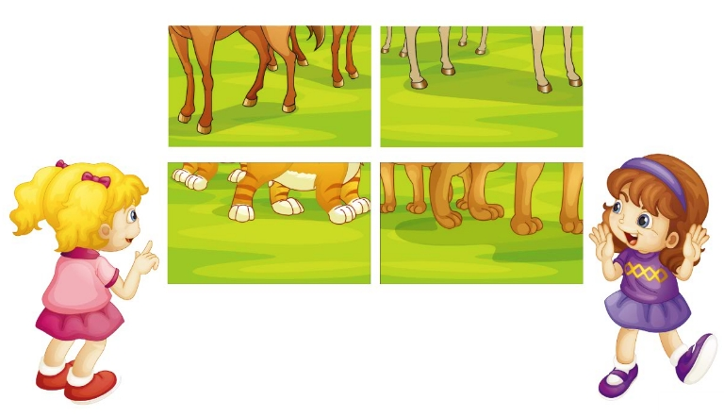
Practice
Let’s play
Guess the animals.
What are these in English?
They’re cats.

Slide 21
Summary
本课学到的重点词汇：
a horse
horses
a cow
dog
cows

Slide 22
Summary
本课学到的重点句型：
—What’re these in English?
—They’re …

Slide 23
Homework
1. 跟读课文Just talk部分的录音，注意语音、语调。
2. 运用本课学到的知识，向你的父母或朋友询问你见到的动物。
3. 预习Lesson 35。
Close

