Slide 1
Unit 3 What Will You Do This Summer?
Lesson14 Tomorrow We Will Play
WWW.PPT818.COM

Slide 2
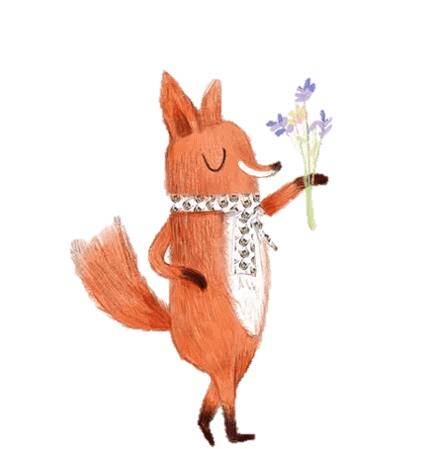
Warm-up
Listen a song of If you are happy...

Slide 3
Review
Guess Game
What is she/he doing?

Slide 4
Be going to...
What are you going to do tomorrow?
I am going to…

Slide 5
Presentation
I am going to get up at 7:00 in the morning.
I will get up at 7:00 in the morning.

Slide 6
Say sentences with“will”
I will play basketball.
I will have my breakfast at 7:00.
I will go to school at 7:30.

Slide 7
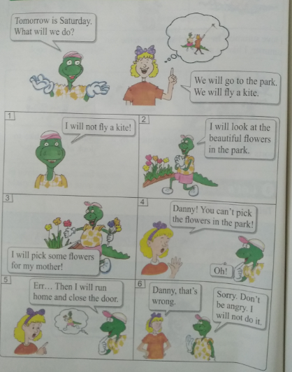
What will you do tomorrow?

Slide 8
Questions:
What will Danny do in the park?
He will look at the beautiful flowers in the park.
What will Jenny do in the park?
She will fly a kite in the park.

Slide 9
Will Danny pick the flowers for his mother?
Yes, he will.
What does Jenny tell Danny?
Jenny tells Danny not to pick the flowers in the park.

Slide 10
Practice
Let’s do it!
1.a. will b.will c.will not d.will not
2.a. play basketball;will listen to music
b. This Saturday, I will fly a kite.
This Sunday, I will read a book.
Keys:

Slide 11
Fill in the chart and talk with your friend!
Who? | What will you do?

Slide 12
Homework
1.小组合作以明天为内容组织对话，进行表演。
2.做完相应的配套练习题。

Slide 13
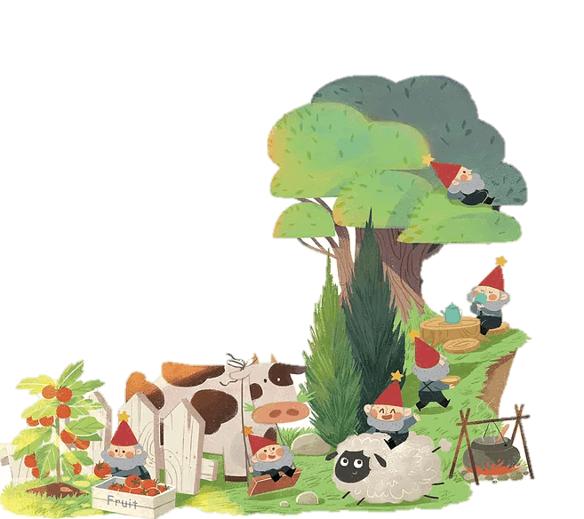
THANK YOU!

