Slide 1
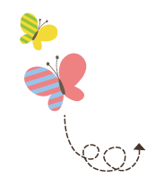
Unit 3 What Will You Do This Summer?
六年级下册
Lesson14 Tomorrow We Will Play
WWW.PPT818.COM

Slide 2
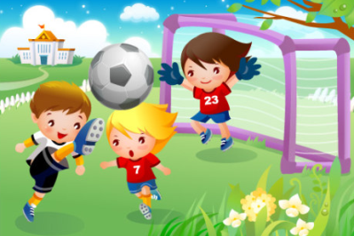
What will you do this weekend?

Slide 3
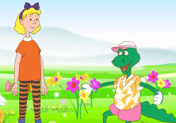
1. What will you do tomorrow?
Danny: Tomorrow is Saturday. What will we do?
Jenny: We will go to the park. We will fly a kite.
Danny: I will not fly a kite! I will look at the beautiful flowers in the park. I will pick some flowers for my mother!
Jenny: Danny! You can’t pick the flowers in the park!
Danny: Oh! Err...Then I will run home and close the door.
Jenny: Danny, that’s wrong.
Danny: Sorry. Don’t be angry.

Slide 4
知识点1
We will go to the park. 我们将要去公园。
主语＋will ＋动词原形＋其他.
句型结构：
He will play football with Jenny tomorrow.
明天他将和詹妮一起踢足球。
例句：

Slide 5
（1）这是一个一般将来时的句子，表示在将来某一时间将要发生的动作或存在的状态。
考向
易错点
提示
一般将来时常与表示将来的时间状语连用，如：tomorrow， the day after tomorrow，next week/month等。

Slide 6
拓展
一般将来时的构成还可以用be going to结构，其句型结构为：主语＋be (am/is/are)going to＋动词原形＋其他.
I’m going to clean my bedroom tomorrow.
明天我打算打扫我的卧室。
例句：

Slide 7
（2）由will构成的一般将来时的其他句式：
考向
①否定句：主语＋ won't (will not的缩写)＋ 动词原形 ＋其他.
例句：He won't play football with Jenny tomorrow.
明天他不和詹妮一起踢足球。

Slide 8
②一般疑问句：Will ＋主语＋动词原形＋其他？
肯定回答：Yes, 主语＋ will.
否定回答：No, 主语＋won't.
例句：—Will he play football with Jenny tomorrow?
明天他将和詹妮一起踢足球吗？
—Yes, he will.是的，他会的。/
No, he won't.不，他不会。

Slide 9
③ 特殊疑问句：特殊疑问词＋will ＋主语＋动词原形＋其他？
例句：What will he do with Jenny tomorrow?
明天他要和詹妮一起做什么？
用所给词的适当形式填空。
My father _______________________(play)ping­pong with me tomorrow.
典例
will play/ is going to play

Slide 10
知识点 2
close /kləʊz/ v. 关；闭
Please close the door. 请关上门。
例句：
字母o的发音是/əʊ/。
发音：
open v．打开
反义词：

Slide 11
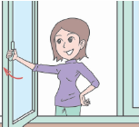
close(原形)→ closes (第三人称单数) →closing(现在分词)→closed(过去式)
词形变化：
close (动词)→ closed (形容词＜关着的＞)
词性变化：
对比记忆法：
open the window close the window

Slide 12
知识点 3
Don’t be angry. 不要生气。
否定祈使句
否定祈使句有四种形式：
(1) Don’t ＋行为动词原形＋其他！
例句：Don’t close the door! 不要关门！
(2) Don’t ＋ be ＋ 形容词＋ 其他！
例句：Don’t be angry with me! 不要生我的气！

Slide 13
(3) Let ＋ 宾语＋ not ＋ 动词原形＋其他！
例句：Let him not play on the computer!
不要让他玩电脑了！
(4) Never ＋动词原形＋其他！
例句：Never be late for school! 永远不要上学迟到！

Slide 14
angry /'æŋɡri/ adj. 发怒的；生气的
My mother is angry.我妈妈生气了。
例句：
字母a的发音是/æ/。
发音：
be angry with sb.生某人的气
短语：
angry(形容词)→angrily(副词)
词性变化：

Slide 15
魔法记忆：
肚子hungry（饥饿的）心情angry（生气的）。
根据汉语提示完成句子。
Is your father ________ (生气的)now?
典例
angry

Slide 16
2. Let's do it!
1. Look and write “will” or “will not”．
a. They ________ go on a trip next week.
b. Summer is coming. It ________ be hot soon. I need a fan.
c. It's rainy. I ________ go to the zoo today. I don't want to get wet.
d. Next Spring Festival, I ________ go to Harbin. It's too cold.
will
will
will not
will not

Slide 17
2. Let’s do it!
2. Look, draw and write.
 | Jenny | Li Ming | Me
Saturday | play basketball | fly a kite
Sunday | listen to music | read a book
a. This Saturday，I will______________.
This Sunday, I will _________________.
b. _________________________________
_________________________________
c. _________________________________
_________________________________
play basketball
will listen to music
This Saturday, I will fly a kite.
This Sunday, I will read a book.
This Saturday, I will go to the park.
This Sunday, I will watch TV.

Slide 18
句子接龙游戏
同学们分成几个小组，组长先问What will you do this Saturday? 组内一名同学用I will…句型回答问题，然后问下一名同学同样的问题。轮到组长时，组长回答完问题后，开始下一轮提问：What will you do this Sunday?

Slide 19
一、按要求完成下列各题。
（1）I am going to get up at 7:10 tomorrow morning.(改为同义句)
I ________ ________ up at 7:10 tomorrow morning.
（2）My sister will fly a kite next Sunday.(改为一般疑问句)
________ your sister ________ a kite next Sunday?
will get
Will fly

Slide 20
（3）They will play sports next Saturday.(就画线部分提问)
________ ________ they ________ next Saturday?
（4） My mother will buy some vegetables this afternoon.(改为否定句)
My mother ______ buy ______ vegetables this afternoon.
What will do
won’t any

Slide 21
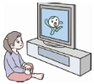
二、仿照例句，根据图片和所给提示写句子。
示例： （I, play with my friends）
I will play with my friends.
(1) （he, play ping-pong）
________________________________
(2) （she，watch TV）
_________________________________
（3） （they，have breakfast）
_________________________________
He will play ping-pong.
She will watch TV.
They will have breakfast.

Slide 22
本节课我们学习了以下知识，请同学们一定加强巩固，以便能和同学们进行灵活交流哦！
重点词汇：close, angry
重点句式：We will go to the park.
Don’t be angry.

Slide 23
1 熟记本节课所学的句型、和单词，必须会听、说、读、写。
2 将What will you do tomorrow?的内容朗读流利。
3 完成配套的课后作业。

