Slide 1
Unit 4 My day Comic strip and Welcome to the unit
WWW.PPT818.COM

Slide 2
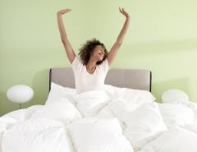
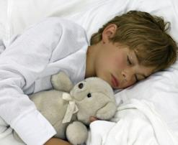
Let’s learn
wake up
get up
wake up the boy
wake the boy up
wake him up
Please ____________ at 7 o’clock in the morning.
Don’t ____________.
wake up Tom
wake Tom up
wake him up
Notes:
2

Slide 3
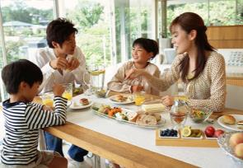
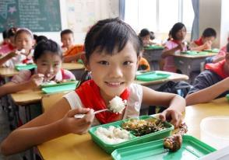
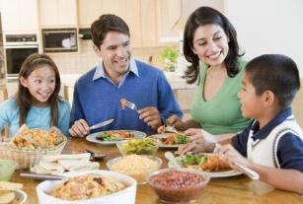
Let’s learn
have breakfast
have lunch
have supper
have dinner
It’s my birthday today. My family are going to
___________ outside in the evening.
have dinner
Notes:
3

Slide 4
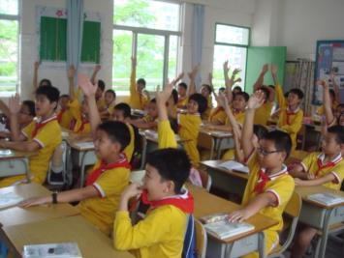
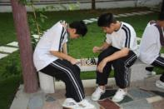
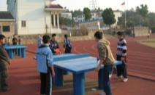
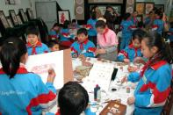
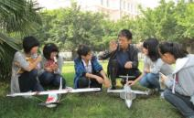
Let's learn
have lessons
do after-school activities
activity
start to have lessons
We _________________ at 8 a.m. every school day.
We _____________________________ after school.
do different after-school activities
Notes:
4

Slide 5
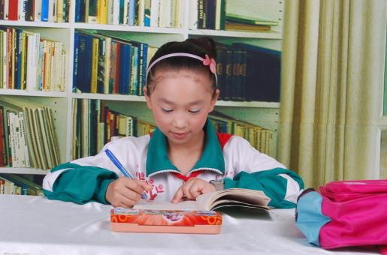
Let's learn
do homework
The girl is ______________________________.
doing her homework very carefully
Notes:
5

Slide 6
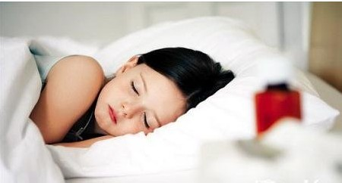
Let's learn
go to bed
go to sleep
—Stop watching TV, Amy. It’s time __________.
—Please, Mum, I just can’t _________.
to go to bed
go to sleep
Notes:
6

Slide 7
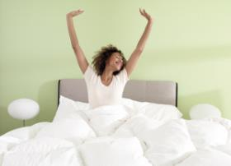
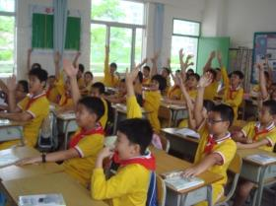
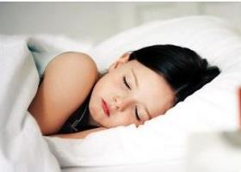
Let's learn
Notes:
7

Slide 8
Eddie's day Watch and complete
Eddie’s day
Morning | Have ________, ________
Noon | Have ________
Afternoon | Need a good ________
… | …
Notes:
8

Slide 9
Eddie's day Watch and complete
Eddie’s day
Morning | Have ________, ________
Noon | Have ________
Afternoon | Need a good ________
… | …
breakfast
sleep
lunch
rest
Notes:
9

Slide 10
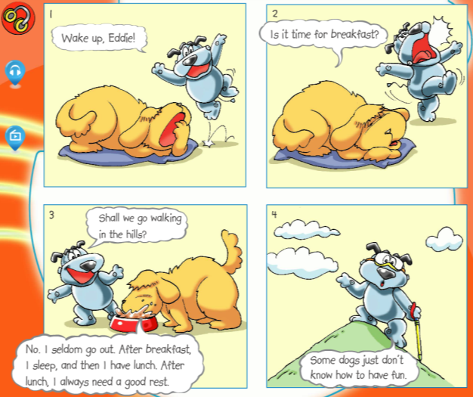
Eddie's day Read and learn
Shall we do …?
Let’s do …
Why not do …?
What/How about doing …?
go shopping
go swimming
go fishing
Eddie just doesn’t know how to have fun.
need sth
need to do sth
seldom: not often
Notes:
10

Slide 11
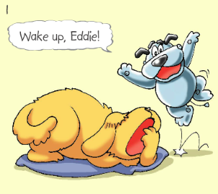
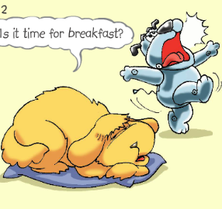
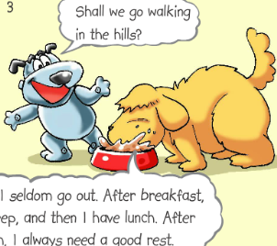
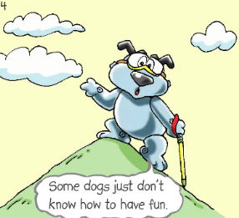
Eddie's day Play roles
Notes:
11

Slide 12
Eddie's day Act out
Notes:
12

Slide 13
Eddie's day Say more
Eddie’s day
Morning | Have ________, ________
Noon | Have ________
Afternoon | Need a good ________
… | …
breakfast
sleep
lunch
rest
Notes:
13

Slide 14
Eddie's day Complete the story
One day, Hobo _____ up Eddie in the morning. He wants to go walking in the ____ with Eddie. But Eddie says he ______ goes out because he is always very busy at home. After ______ up in the morning, he needs to have ________ and have another sleep. Then it’s time for _____. In the afternoon, he needs a good ________ again. What do you think Eddie does in the evening and at night? Yes, he has ____________ and sleeps. Oh, Eddie is busy eating and _______ all day! Doesn’t he know how to have ___?
wakes
hills
seldom
getting
breakfast
lunch
rest/sleep
supper/dinner
sleeping
fun
Notes:
14

Slide 15
Millie's day Listen and complete
Millie’s day
6:30 a.m. | Get up
7:00 a.m. | Have breakfast
_________ | Go to school
8:00 a.m. | Do morning exercises
_________ | Have lessons
… | …
7:20 a.m.
8:15 a.m.
Notes:
15

Slide 16
Millie's day Read and learn
Millie, when do you go to school every day?
I usually go to school at 7:20. I’m never late for it.
Good. What time do you start lessons?
At a quarter past eight.
Do you enjoy school, Millie?
Yes. I enjoy it very much.
Notes:
16

Slide 17
Millie's day Make a longer conversation
Millie, when do you go to school every day?
I usually go to school at 7:20. I’m never late for it.
Good. What time do you start lessons?
At a quarter past eight.
When do you do morning exercises?
We do morning exercises at 8 o’clock.
Oh, you do morning exercises before you start lessons. When do you have lunch?
I have lunch at 11:50.
What time do you go home?
At half past four.
Do you enjoy school, Millie?
Yes. I enjoy it very much.
Notes:
17

Slide 18
Millie's day Complete the passage
gets
Millie is a hard-working student. She ____ up early in the morning. She goes to _____ at 7:20. She’s _____ late for school. Before the first lesson starts, Millie and all her classmates do morning ________. She has lunch at ten to ______. The school finishes at four ______ in the afternoon. Then it’s time for after-school ________. She always has fun. In the evening, Millie watches TV for ____ an hour. It’s her favourite time of the day. Then she needs to do her __________. She always does it carefully. She usually goes to ____ at 9:30.
school
never
exercises
twelve
o’clock
activities
half
homework
bed
Notes:
18

Slide 19
My day
Complete the table
Time | Activity | Time | Activity
Notes:
19

Slide 20
My day
Practise reporting
Hello, everyone. I’d like to tell you something about my day. I usually get up at … because I think getting up early is good for health.
…
I always enjoy my day!
Notes:
20

Slide 21
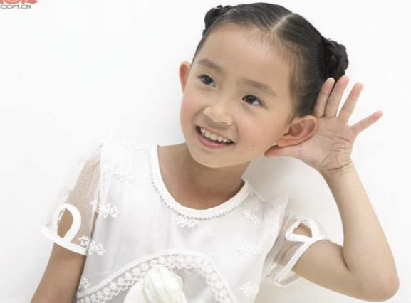
My day
Be a good listener
Notes:
21

Slide 22
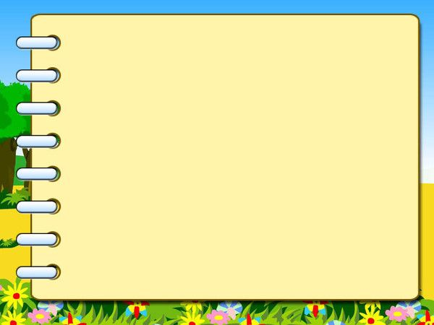
Homework
1. Practise talking about
your daily activities with
a new partner.
2. Finish the exercises in
Period 1 of Unit 4 in the
workbook.
Notes:
22

