Slide 1
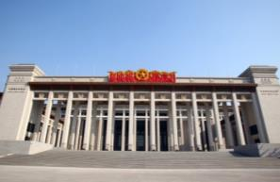
初中英语外研版七下
Module6 Around town
Unit 1 Could you tell me how to get to the National Stadium?
WWW.PPT818.COM

Slide 2
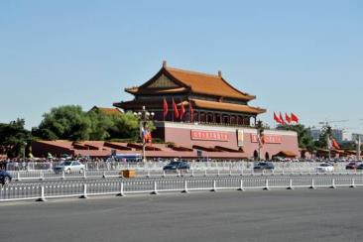
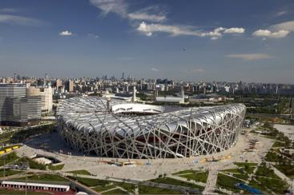
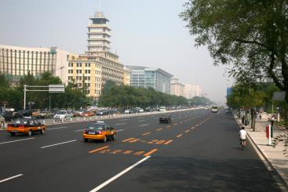
Module6 Unit1
01
Warm-up—热身导入
02
Presentation—新知呈现
03
Language Points—知识讲解
04
Exercise—当堂小练

Slide 3
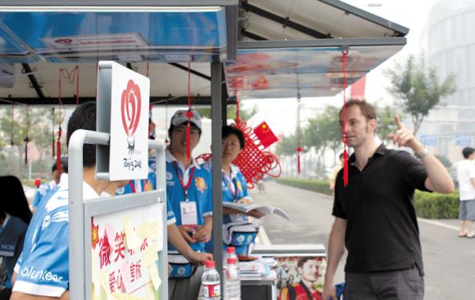
Warm-up
Ask and answer
Where is he?
He is in China.

Slide 4
What is he doing in the street?
He is asking the way.

Slide 5
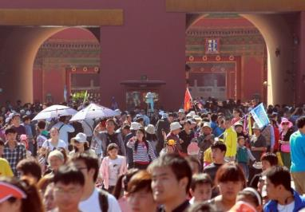
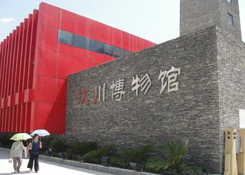
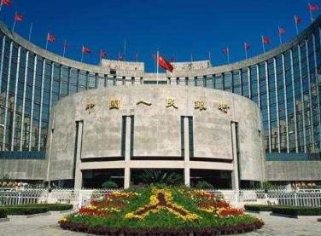
Presentation
比一比，看谁能快速说出下面的单词。
tourist
museum
bank
street

Slide 6
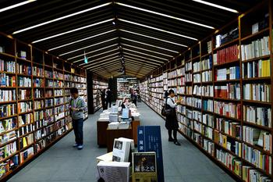
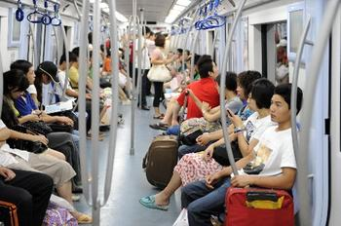
guidebook
bookshop
underground

Slide 7
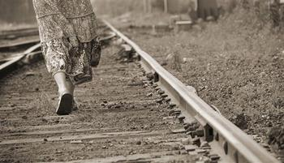
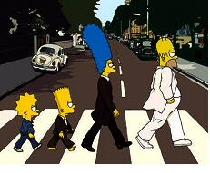
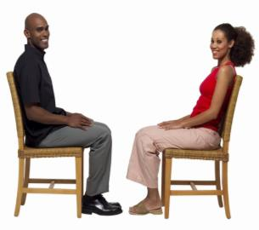
Find and say
请说出下面图片中的方位介词
along
across
opposite

Slide 8
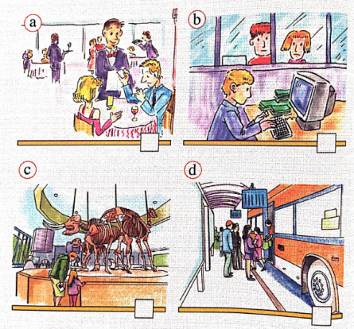
1
Match the words from the box with the pictures.
bank
b
museum
c
restaurant
a
station
d

Slide 9
Now listen and number the places as you hear them.
bank
2
museum
1
restaurant
3
station
4

Slide 10
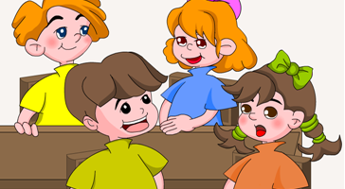
Pair work
Work in pairs. Say which places in Activity 1 you can find in your home town and where they are.
along across cross opposite

Slide 11
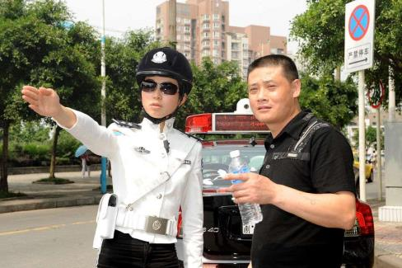
3.Listen and read
Listen and answer the question.
Can the tourist go to the Wangfujing Dajie?
Yes, he can.

Slide 12
3.Listen and read
Read the dialogue and answer the questions.
1. How will the tourist get to Wangfujing Dajie from Tian’anmen Square?
Go across Dong Chang’an Jie, go along the street and turn left the third street on the left.

Slide 13
2. Where is the bookshop?
The bookshop is just along Xi Chang’an Jie, on the right, opposite the bank.
3. Who does the tourist ask for the way to the National Stadium?
A policeman.

Slide 14
Language points
1. opposite prep. 在……的对面
◆. . . , on the right, opposite the bank.
……, 在右边，银行的对面。
◆My idea is opposite to yours.
我的想法与你的相反。
◆Black and white are opposites.
黑白是对立物。

Slide 15
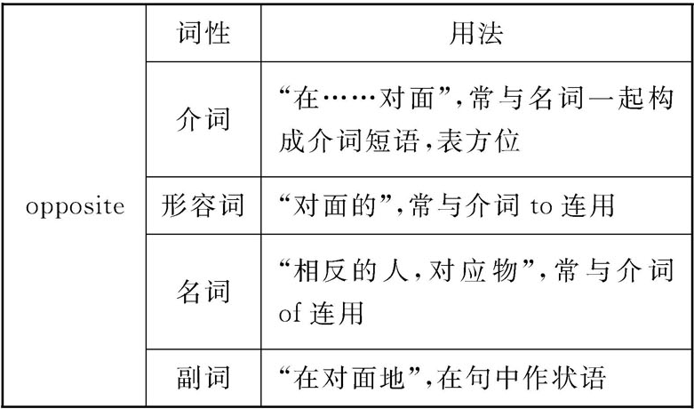
◆We sit opposite each other. 我们相对而坐。
【探究总结】opposite的四种词性
【学以致用】
The cinema is opposite _____ the station.
about B. with C. to D. at

Slide 16
2. across prep. 横过；穿过
◆Go across Dong Chang’an Jie.
穿过东长安街。
◆Please be careful when you cross the street.
过马路时请小心。
◆The sunlight goes through the glass.
阳光透过玻璃。

Slide 17
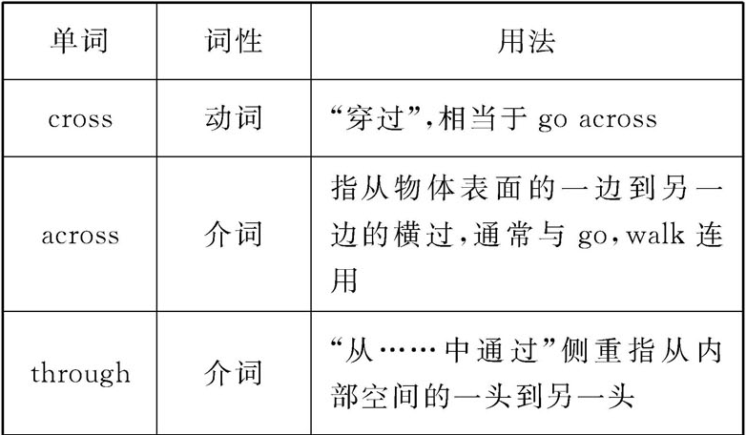
【探究总结】
cross, across, through的用法辨析

Slide 18
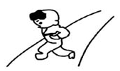
go across/cross the road
go through the tunnel

Slide 19
【学以致用】选词填空
A. across B. cross C. through
①They ____ the road and come into the bookshop.
②The two friends were walking ____ the forest.
③Go ____ the bridge and you’ll see the station.
B
C
A

Slide 20
【探究总结】常见问路、指路的表达方式
(1)问路句型：
Where is. . . ？……在哪里？
Where can I. . . ? 我可以在哪里……呢？
How do/can I get to. . . ? 我怎么(才能)到……呢？
Can you tell/show me the way to. . . ?
你可以告诉/指给我去……的路吗？
Is there a/an. . . (near here)? (附近)有……吗？
Which is the way to. . . ? 去……走哪一条路？

Slide 21
(2)指路句型：
It’s(+表方位的介词短语). . . . 它在……。
Go straight ahead. 径直朝前走。
Go/Walk along/down/across. . . . 沿着……走/越过……。
Walk on and turn left/right. 继续走，再向左/右转。
Turn left/right into. . . , and you can see/find it on
your left/right.
向左/右转进入……，你就会在你的左/右方看到它。

Slide 22
Turn left at the first turning/crossing.
=Take the first turning/crossing on the left.
在第一个拐角处/十字路口向左转。
【温馨提示】在问路之前要说Excuse me, 问路结束时要说Thank you. ，即使对方不知道路径，仍要说Thank you all the same. 。

Slide 23
Pair work
1. Excuse me, is Wangfujing Dajie far
from Tian’anmen Square?
2. There’s a bookshop near here. What’s
the name of the street?
3. Can a tourist ask a policeman the way
to get to places in Beijing?
4. Could you tell me how to get to the
National Stadium?
5. Where’s the underground station?

Slide 24
Read the conversation in Activity 3 again and complete the table
1
Ask
Answer
1. Go across Dong Chang’an Jie, go along the street and turn left at the third street on the left. There you are.
1.Can you tell me the way to Wangfujing Dajie?
2. Is there a bookshop near here?
2.Yes, there is a big bookshop over there?
3.How can I get there?
3.Just along Xi Chang’an Jie, on the right, opposite the bank.
4.Could you tell me how to get to the National Stadium?
4.Sure! Go along the street and you’ll see an underground station. Take the Underground to the Olympic Sports Centre, or you can take a bus or a taxi.

Slide 25
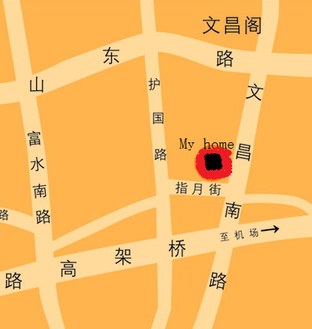
小组活动。画一张你自己家的地图，然后进行问路练习。
- Where’s the market?
- It’s on …
- How do I get there?
- Go along …

Slide 26
Exercise
1. _____ can we go to the Tower of London
A. Where B. Which C. How
2. _____ the bridge, you can see the hospital on your right.
A. Go cross B. Go across C. Across
3. The church is ____ the museum and the palace.
A. in the middle of B. between
C. among
C
B
B

Slide 27
4. Turn left and _____ up the river, you can see the Church.
A. walking B. to walk C. walk
5. Could you tell me how to ________ the National Stadium?
A. go B. get C. be D. get to
6. It’s down the street ________ the left？
A. on B. in C. to D. from
C
D
A

Slide 28
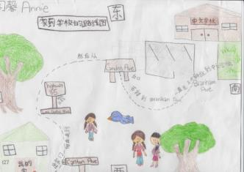
Homework:
编写一个对话，介绍从学校去你的家的路线图。

