Slide 1
Unit 5 Wild animals
第2课时
WWW.PPT818.COM

Slide 2
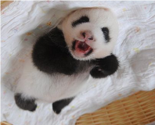
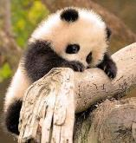
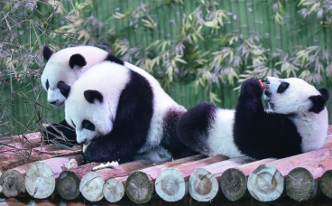
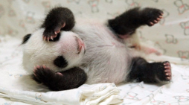
Panda is so cute.

Slide 3
A Giant pandas
The story of Xi Wang
I first saw the baby panda when she was only ten days old. We called her Xi Wang. This means “hope”．
When Xi Wang was born, she weighed just 100 grams and looked like a white mouse. At four months old, she weighed about eight kilograms and started to go outside for the first time. Eight months later, she was not a small baby any more and weighed over 35 kilograms.

Slide 4
In the beginning， Xi Wang drank her mother's milk. When she was six months old, she began to eat bamboo. When she was 20 months old, she learnt to look after herself.
Sadly， giant pandas face serious problems in the wild. For example, it is very difficult for pandas to have babies， and many baby pandas die when they are very young. Also, giant pandas live mainly on a special kind of bamboo. However, the bamboo forests are becoming smaller and smaller. As a result， pandas may not have a place to live or food to eat.

Slide 5
Giant pandas are now in danger. We should take action right away. Here are some ideas.
•help pandas have more babies
•build more panda reserves
•make laws to protect pandas
There are now only about 1, 600 pandas in the wild. If we do nothing, soon there may be none left! However, we do believe that where there is Xi Wang, there is hope.

Slide 6
知识点
mean /miːn/ vt.意思是，意味着
1
过去式/ 过去分词为meant; 名词为meaning
eg: What does the word “physics” mean?
＝What's the meaning of the word “physics”?
“physics”这个单词是什么意思？

Slide 7
考向
meaning的形容词形式为meaningful 意为“有意义的”，其反义词为meaningless 意为“毫无意义的”。
典例
根据括号内的中文提示补全句子
Protecting forests ________( 意思是) giving wild animals lots of living areas.
means
【点拨】“Protecting forests”为主语，mean用其第三人称单数形式means。

Slide 8
知识点
for the first time “第一次”
2
eg: I felt surprised when I saw him for the first time.当我第一次见到他时，我感到很惊讶。
归纳：
与first相关的短语：at first 起初；first of all首先；come first第一；from first to last 自始至终

Slide 9
知识点
not ...any more 不再
3
not ...any more＝ no more 意为“不再”
eg: The baby didn't cry any more.
这个婴儿不再哭了。
拓展
not...any longer
＝ no longer意为“不再”。
【难点】

Slide 10
考向
辨析：not...any more与not...any longer
 | 含义 | 例句
not...any more＝no more | 表示次数上或程度上“不再”增加。 | You can't eat meat any more.＝ You can eat meat no more.你不能再吃肉了。
not...any longer＝no longer | 表示在时间上“不再”延长。 | He isn't young any longer. ＝He is no longer young. 他不再年轻了。

Slide 11
知识点
beginning /bɪ'ɡɪnɪŋ/ n．开始，起初
4
eg: He has made a good beginning.
他已经开了个好头。
考向
in the beginning 一开始
eg: They were cheerful in the beginning.
一开始，他们情绪很高。

Slide 12
拓展
beginning的动词形式为begin，beginner为名词，意为“初学者”。
一语巧记
At the beginning of the term，some beginners began to recite the words.
在学期开始时，一些初学者就开始背单词了。

Slide 13
知识点
learn [lɜːn] v. 学习，了解
5
learn to do sth. 学习做某事
考向
earn about 得知，获悉
learn from… 向……学习
learn… by heart 用心记
拓展

Slide 14
知识点
6
It is ...for ... 对...来说...
这是“It is ＋形容词＋for sb. to do sth.”句式，句型中的形容词是用来说明不定式的性质的。在此句型中，it作形式主语，真正的主语是to do sth.。“It is ＋形容词＋of sb. to do sth.”句型中的形容词用来描述人的特征。
【重点】

Slide 15
eg: It's easy for him to finish the work.
对他来说完成这项工作很容易。
It's very kind of you to help me.
你帮助我，你真是太好了。
It's necessary for us ________ to our parents when we have problems.
A. to talk B. talking C. talk
典例
A

Slide 16
知识点
7
as a result 因此
eg: He made a big mistake. As a result, he lost his job.
他犯了一个大错误，因此丢了工作。

Slide 17
一、根据句意及汉语提示填写单词
1．Take it easy. It's just a cold. There is nothing ________ (严重的)．
2．What does this word ________ (意思是)?
3．He is ________(主要地) interested in butterflies.
4．He always got the same ________ (结果)．
5．We should make ______ (法律) to protect the wild animals.
serious
mean
mainly
result
laws

Slide 18
二、根据句子意思，用方框中所给短语的适当形式填空
6．The baby panda is so young and weak. It _____________ a lovely cat.
7．Usually, a baby panda is weak and small __________. It needs special care.
8．The tiger “ Hero” ___________ last year. It is almost one year old now.
be born, look like, live on, right away, at birth
looks like
at birth
was born

Slide 19
be born, look like, live on, right away, at birth
9．When Hero was young, he almost ____________ his mother's milk.
10．When Hero saw his mother, he ran to his mother ________________．
lived on
right away

Slide 20
本节课主要学习了以下知识点，请同学们及时巩固练习：
mean, more, beginning, learn
for the first time, not ...any, as a result
It is ...for ...

