Slide 1
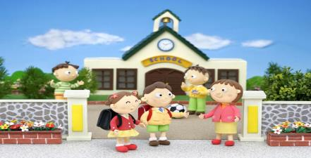
Module 3
Unit 1 Lesson 2
1
How are you?
WWW.PPT818.COM
Notes:
1
1

Slide 2
New words
Morning 早晨、上午
Fine 健康的、身体好
Thank 谢谢
You 你
Thank you 谢谢你
How are you? 你好么？

Slide 3
你是懂礼貌的好孩子吗？
在早上见面与人打招呼时，
在平时的生活中与亲人、朋友、同学、老师见面时可以使用。
？
进行问好

Slide 4
Look and learn
Good morning！
早上好！
How are you?
你好么？
I’m fine, thank you.
我很好，谢谢。

Slide 5
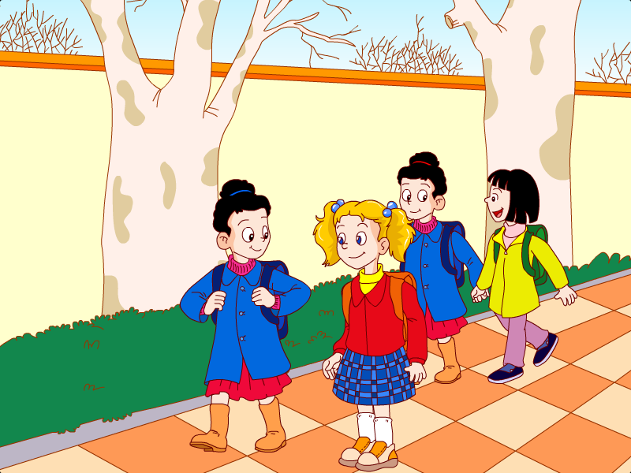
I’m fine, thank you.
How are you, Helen?

Slide 6
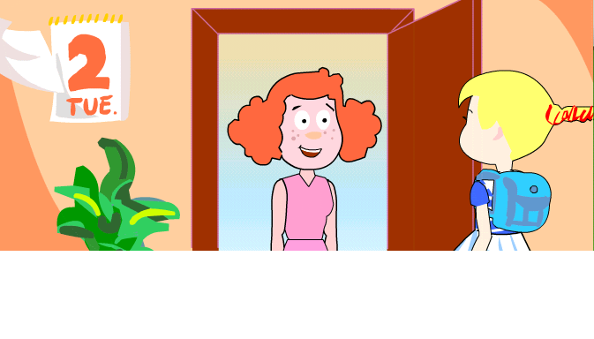
How are you?
I’m fine. Thank you.

Slide 7
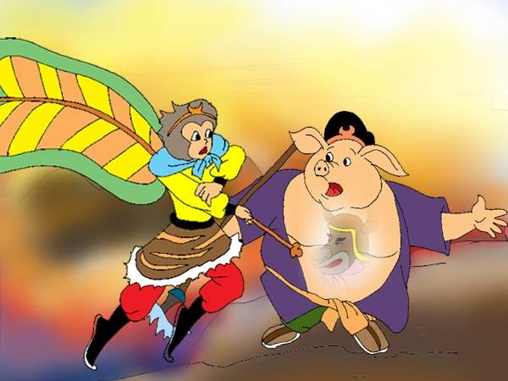
Hello, Mr. Zhu. How are you?
Fine, thank you.

Slide 8
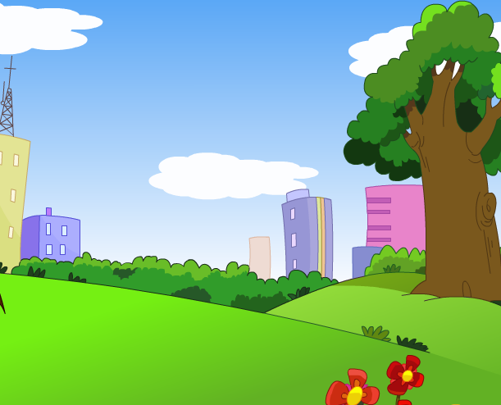
Morning
早晨、上午
Good morning！
早上好！

Slide 9
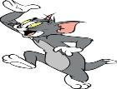
Look and say
Hello, I’m Jerry!
Good morning, Jerry!
Goodbye, Jerry!

Slide 10
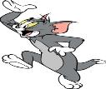
Look and say
Good morning, Tom.
Good morning !
How are you, Jerry?
I’m fine, thank you.

Slide 11
Look and say
Hello, I am Nini.
How are you?
I’m fine, thank you.
I‘m Huanhuan.

Slide 12
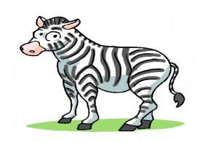
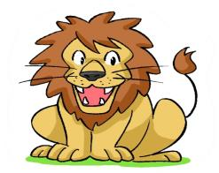
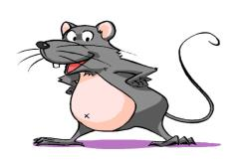
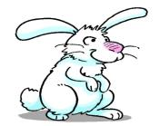
Ask and answer
How are you?
How are you?
How are you?
How are you?
I'm fine. Thank you.

Slide 13
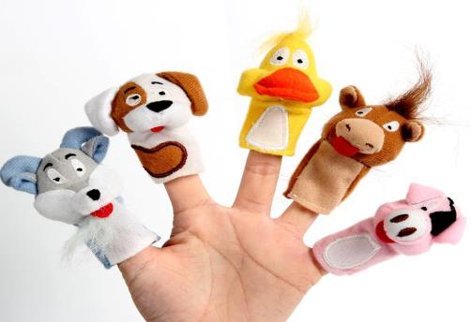
Let's learn
It's time to say goodbye!
See you.
Bye-bye.
So long.
Goodbye.
Farewell.

Slide 14
Good morning. Hello, I’m Sam.
How are you? Bye-bye.
Goodbye. Good morning.
Hi. I’m Amy. I’m fine, think you.
连一连

Slide 15
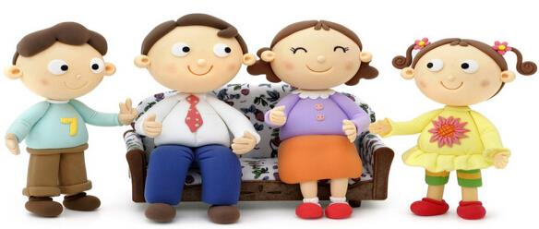
Thank you!

