Slide 1
Unit 2 In Beijing
Lesson 8 Tian’anmen Square
WWW.PPT818.COM

Slide 2
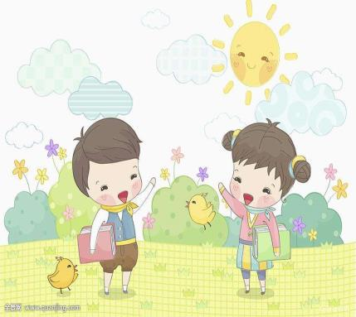
Warming up
Greeting
Do you like playing on the square?
Yes, I do.

Slide 3
Warming up
Talking
1
What do you often do on the square?
2
I fly kites and sometimes I walk around it.
3
Do you like playing with others on the square?
4
No, I don’t.

Slide 4
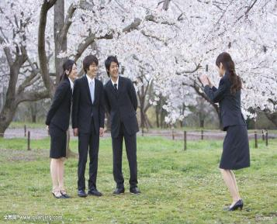
Leading in
Look at the pictures
看图片
说动词
They are taking pictures.
用现在时
进行描述

Slide 5
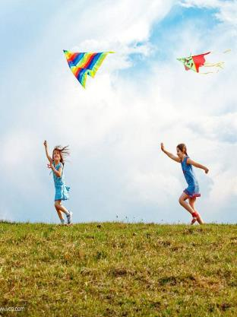
Leading in
Look at the pictures
看图片
说动词
They are playing kites.
用现在时
进行描述

Slide 6
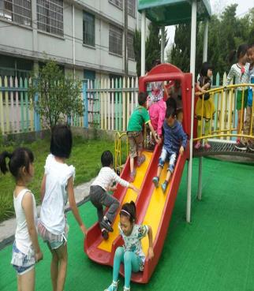
Leading in
Look at the pictures
看图片
说动词
They are playing on the slide.
用现在时
进行描述

Slide 7
Presentation
worry
to be anxious or unhappy about someone or something, so that you think about them a lot
help
to make it possible or easier for someone to do something by doing part of their work or by giving them something they need
sad
not happy, especially because something unpleasant has happened
say
to express an idea, feeling, thought etc using words

Slide 8
Presentation
What is the girl in the picture doing?
She is…
What is Danny in the picture doing?
He is…
Can Danny fly a kite?
No, he can’t.
Can Jenny fly a kite?
Yes, she can.
小组
活动

Slide 9
Consolidation and extension
请同学解说歌舞表演
Guess the action
注意同学正确使用现在进行时哦！

Slide 10
Summing up
重点句型
Some people are taking pictures on the square.
1
2
Some men are flying kites.
3
Don’t worry. I can help you.

Slide 11
Summing up
重点句型
1
情态动词can表示“能够”，后面只能接动词原形。
2
现在进行时：表示主语正在进行的动作，它的形式为be + doing。

Slide 12
Evaluation
同学互评
内容 | 学生A | 学生B | 学生C | 学生D
积极发言
乐于合作
完成情况

Slide 13
Homework
01
用英语讲述今天所见的事情（使用课本句式）
完成Let’s do it!中的练习
02

Slide 14
参考答案：
In picture A, there are two girls. They are talking. There are two women. They are singing. There are two men. They are walking.
In picture B, there are two children. They are playing football. There is one baby. He is crying. There is one woman. She is walking. There is one man. He is singing.

Slide 15
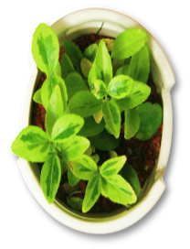
Thank you

