Slide 1
Unit 5 The Value of Money
Section Ⅴ Listening and Talking
WWW.PPT818.COM

Slide 2
1.Translate the following words and phrases.
①hesitate vi. __________________
②eventually adv. ____________
③to one’s surprise _________________
④sequence vt. ____________
n. _______________
犹豫；迟疑；顾虑
最后；终于
令某人惊讶的是
按顺序排列
顺序；一系列

Slide 3
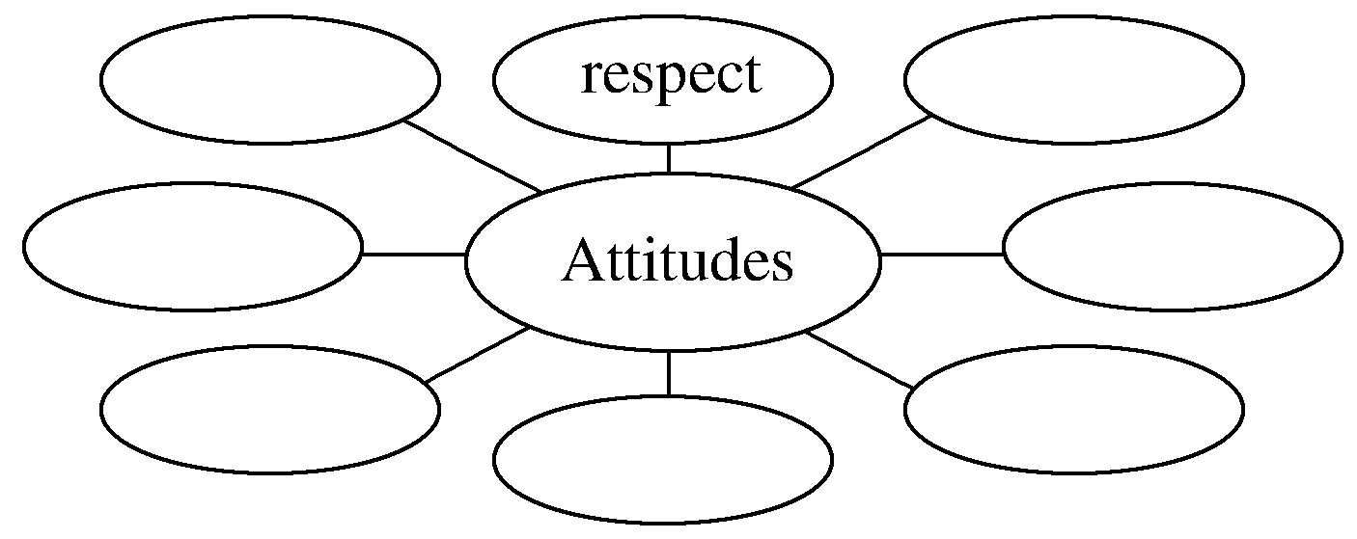
2.Brainstorming：What are people’s attitudes towards Henry?
The answers are open.
______________________________________________________________________

Slide 4
1.Finish Ex.1 on Page 55.
2.Finish Ex.2 on Page 55.
Talking—Finish Ex.4 on Page 55.

Slide 5
语言知识积累
1.叙述故事常用连词
①after doing
②after that
③later (on)
④in the end
⑤eventually
⑥then
⑦after a short while
⑧at the same time/meanwhile
⑨before long

Slide 6
2.表示逻辑关系常用副词
①because
②so
③but
④however
⑤to one’s surprise
⑥as a result/therefore
⑦on the contrary
⑧besides
⑨worse

Slide 7
1.hesitate vi.犹豫；迟疑；顾虑 hesitation n.踌躇；犹豫
[合作探究] 体会hesitate的用法和意义
Don’t hesitate to tell us if you have a problem.
你有问题就直截了当地告诉我们。
Tom hesitated about/at/over the choice between the two courses，while Mary made her choice without hesitation.
汤姆对这两门课程之间的选择犹豫不决，但玛丽毫不犹豫地就做出了选择。
Without hesitation，she leaped into the water and saved the drowning child.
她果敢地跳入水中，救起溺水的孩子。

Slide 8
[自主发现]
①________________________ 对……犹豫不决
②________________________ 对某事迟疑，不情愿做某事
③without hesitation ________________
hesitate at/about/over sth
hesitate to do sth
毫不犹豫地

Slide 9
[巩固内化] 补全句子
①In case you need something，please _________________________.
如果你需要什么东西，请不要客气，尽管对我说。
②They offered her a job，and she accepted __________________.
他们提出给她一份工作，她毫不犹豫地接受了。
③Don’t ____________ your decision once you think it over.
只要你思考清楚了，就不要犹豫你的决定。
don’t hesitate to ask me
without hesitation
hesitate about

Slide 10
2.in case以防；以防万一
[合作探究] 体会in case的用法和意义
If you want to do the job well，you’d better be more careful in case you make mistakes.
如果你想把工作做好，你一定要多加小心以免犯错。
[短语记牢] 记牢下列短语
in any case 在任何情况下；不管怎样
in sb’s case 就某人的情况来说

Slide 11
①In any case，you’ll need to be at the station by nine.
无论如何你都要在九点钟前赶到车站。
②In her case，she failed the exam because she wasn’t well.
就她的情况来看，她是因为生病而没考及格。

Slide 12
[名师提醒] “in＋名词”短语归纳
in addition 另外
in case 以防万一
in fact 事实上
in conclusion 总之
in danger 处于危险中
in detail 详细地
in advance 事先，提前
in particular 尤其，特别
in sight 看得见

Slide 13
[巩固内化] 补全句子
①I’ll be out for some time.________________ anything important happens，call me up immediately.我要出去一段时间。万一有什么重要的事情发生，立即给我打电话。
②Seat belts protect drivers and passengers ________________ accidents.
安全带在发生事故时保护驾驶员和乘客。
③We may miss the next bus，but ________________ we’ll be there before midday.
我们可能赶不上下一趟公共汽车，但无论如何，中午以前我们总可以到那里。
④________________，the first thing to be done is to persuade him that happiness is，in fact，desirable.
就他这种情况，首先要做的一件事就是劝服他：幸福其实是值得追求的。
In case
in case of
in any case
In his case

