Slide 1
Unit 5 The Value of Money
Section Ⅱ Reading and Thinking(1)
WWW.PPT818.COM

Slide 2
1.Discussing—Look at the following pictures and answer the questions.
(1)Would you like to be a millionaire like the following people？Why or why not?
_____________________________________________________________________
The answer is open.

Slide 3
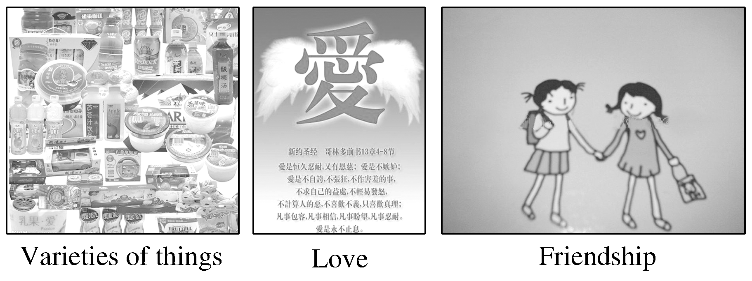
(2)Look at the following pictures and answer the questions：What can money buy? What can’t money buy?
The answer is open.
______________________________________________________________________

Slide 4
2.Predicting—Look at the title on Page 52 and predict what the text is probable about?
The text mainly tells us something about a famous play The Million Pound Bank Note.
________________________________________________________________________

Slide 5
1.First reading—Read the two passages carefully and answer the following questions.
(1)What bet did Roderick and Oliver make?
________________________________________________________________________
________________________________________________________________________
(2)How did Henry come to England?
________________________________________________________________________
They made a bet on whether a man can live in London for a month with a million-pound bank note.
Henry landed in London by accident.

Slide 6
(3)How does Henry want the brothers to help him?
________________________________________________________________________
(4)Why do you think Henry does not want the brothers’ charity?
________________________________________________________________________
(5)Why do you think the brothers choose Henry for their bet?
________________________________________________________________________
Give him a job to earn an honest income.
The answer is open.
The answer is open.

Slide 7
2.Second reading—Fill in the blanks according to the passage.
arguing
bet

Slide 8
American
landed
by
wind
job
income
money
open

Slide 9
3.Third reading
Summarizing：Read the text again and try to summarize the main idea in one sentence.
________________________________________________________________________
________________________________________________________________________
The passage is about a story that after arriving at the UK Henry was given an envelope with money by two wealthy brothers.

Slide 10
1.Group work：If you are a journalist of your school English newspaper，please make an interview with Henry according to the text.You may start like this.
A：Hello，I’m a journalist of our school English newspaper.What do you think of the million pound bank note?
B：...
2.Since everyone has many dreams to realize，what should you do if you are given the million pound bank note?
____________________________________________________________________
The answer is open.

Slide 11
阅读技巧点拨
如何预测课文内容？
1.By looking at the pictures in the passage.
2.By thinking about the content before reading.
3.By relating what you will read to what you have known.

Slide 12
语言现象感知
Ⅰ.单词理解
体会句中加黑单词的词性和含义
1.Is money the basis of a happy life? ____________
2.Chen spent all her savings and took out a large loan. _______________
3.Chen found 10，000 yuan in a small plastic bag in Taiyuan railway station.
____________
4.Wang Zheng apologised to Chen because he couldn’t offer her more money.
____________
5.Should we judge people based on how much money they have? _______________
n.基础
n.贷款；借款
adj.塑料做的
vt.道歉
vt.判断；评判

Slide 13
Ⅱ.词块积累
写出下列词块的含义
1.on the basis of ____________
2.raise funds ____________
3.take out a large loan ________________
4.set up a fundraising website _____________
5.draw a conclusion ____________
6.get something in return __________________
根据某事
筹集资金
取得一大笔贷款
建立筹钱网站
得出结论
得到某物作为回报

Slide 14
Ⅲ.句式欣赏
1.不定式作目的状语
Wang built a website to help raise funds for Liu Xia.
2.because引导原因状语从句
Wang Zheng apologised to Chen because he couldn’t offer her more money.
3.after引导时间状语从句
Wang set up a fundraising website for Chen’s daughter after Chen told him about her situation.

Slide 15
4.第几次做某事
It was the first time Chen Liyan’s story had been recorded.
5.how much引导宾语从句
Should we judge people based on how much money they have?

