Slide 1
Unit 1 Cinderella
五年级
第2课时
WWW.PPT818.COM

Slide 2
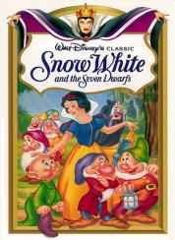
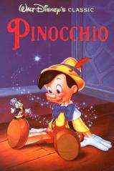
童话故事
I like reading fairy tales.

Slide 3
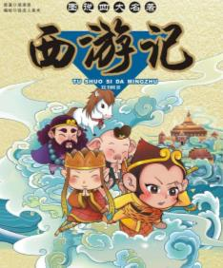
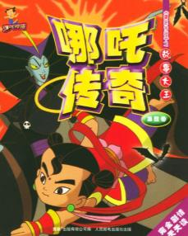
In China, there’re some good stories too.
the story about the Monkey King
the story about Nezha

Slide 4
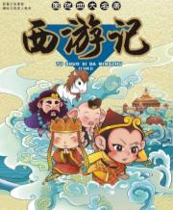
Culture time
I like reading fairy tales.
I like reading stories about the Monkey King and Nezha.

Slide 5
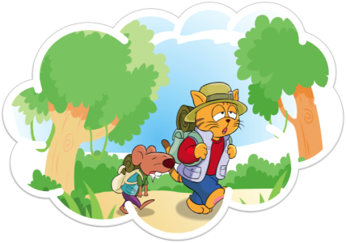
Cartoon time
Do you like reading stories about Sam and Bobby?

Slide 6
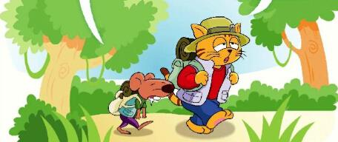
Listen and repeat
1.Bobby and Sam are in the forest.
小吃
No, I don’t.
Do you have any snacks, Sam? I’m very hungry.

Slide 7
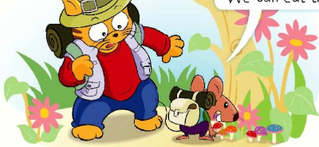
Listen and answer
2.Bobby finds some mushrooms under a tree.
What does Bobby find?
赶紧
蘑菇
Hurry up, Bobby. It’s late.
Look! There are some mushrooms. We can eat them.

Slide 8
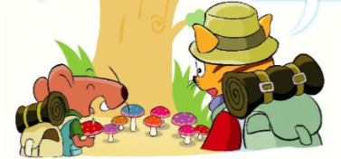
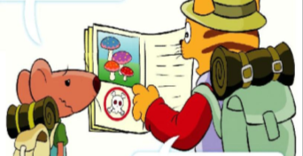
Learn by yourselves
自读图3图4，找到问题的答案并划出来。
Q1：What does Bobby pick?
采、摘
Q2：Can they eat the mushroom? Why?

Slide 9
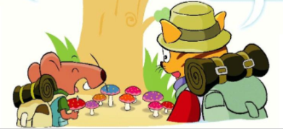
3.Bobby picks a big red mushroom.
No , Bobby! We can’t eat them.
Would you like one?
Bobby does not understand.

Slide 10
be bad for 有害的
Because these mushrooms are bad for us!
Why? They look so nice.
Oh, what a pity!
遗憾、可惜

Slide 11
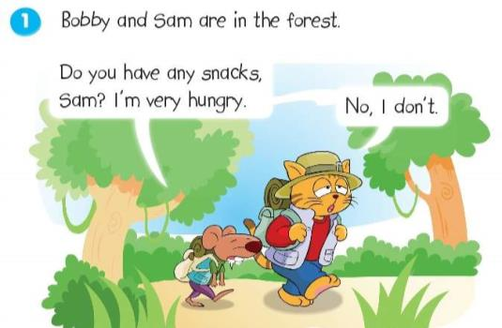
Listen and repeat

Slide 12
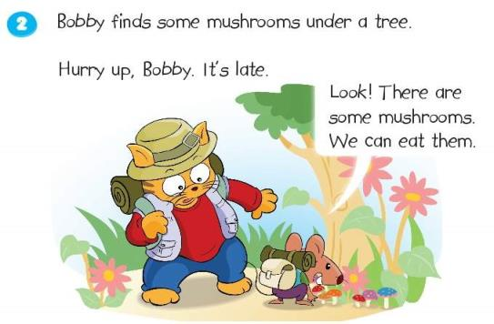
Listen and repeat

Slide 13
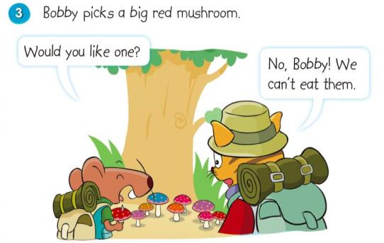
Listen and repeat

Slide 14
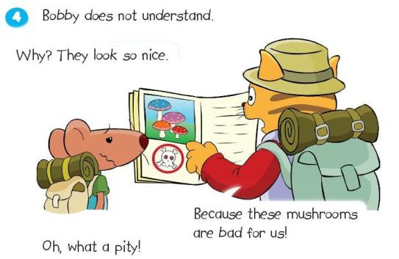
Listen and repeat

Slide 15
Reading is like sunshine,
It can light your heart.
Reading is like water,
It can clean your mind.

Slide 16
Homework
1.Read after the tape three times.
2.Act the story to your parents or your friends.

