Slide 1
Unit 6 Lesson 3
I like green.
WWW.PPT818.COM

Slide 2
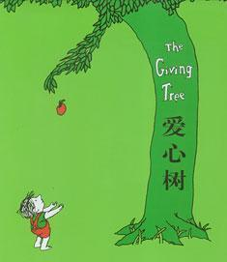
I like green.
Green is the source of life.
绿色是生命之源

Slide 3
blue
I like green and blue.

Slide 4
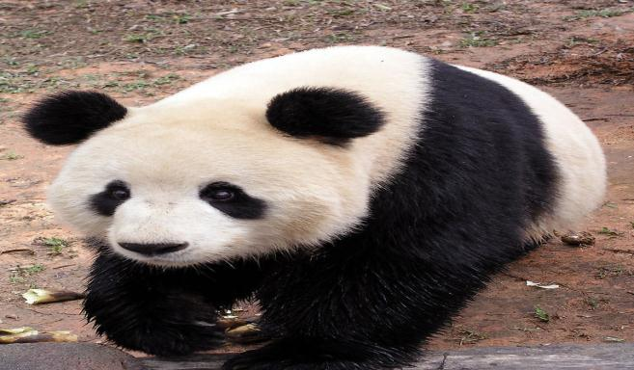
black
white
↑
↘

Slide 5
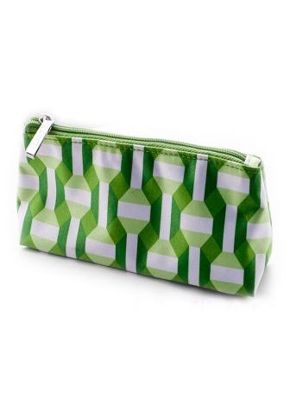
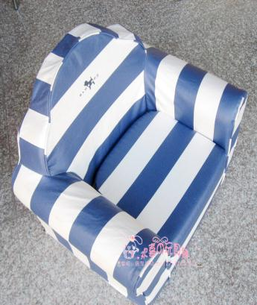
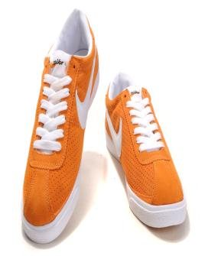

Slide 6
What colour do you like?
I like…

Slide 7
Listen and think （想一想。）
1，Jenny likes_____.
A.green B.blue
2, Guo Yang likes_____.
A.black B.orange

Slide 8
Listen and think （想一想。）
1，Jenny likes_____.
A.green B.blue
2, Guo Yang likes_____.
A.black B.orange

Slide 9
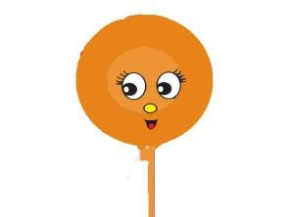
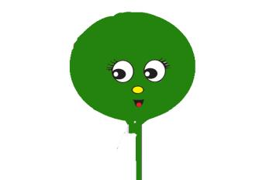
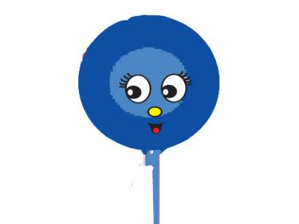
Tt
Rr
Ss

Slide 10
Rr

Slide 11
Tt

Slide 12
Ss

Slide 13
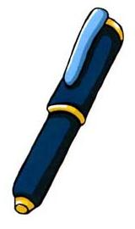
What colour do you like?
I like…

Slide 14
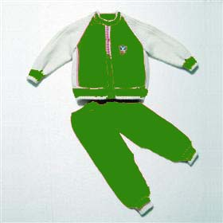
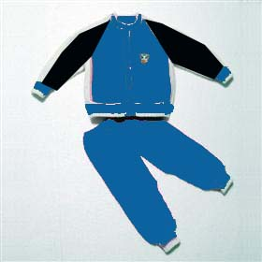
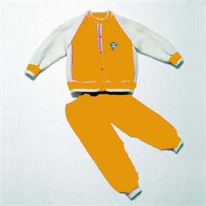
What colour do you like?
I like… and…

Slide 15
make a survey
What colour do you like?
I like…
name | orange | green | black |  | blue

Slide 16
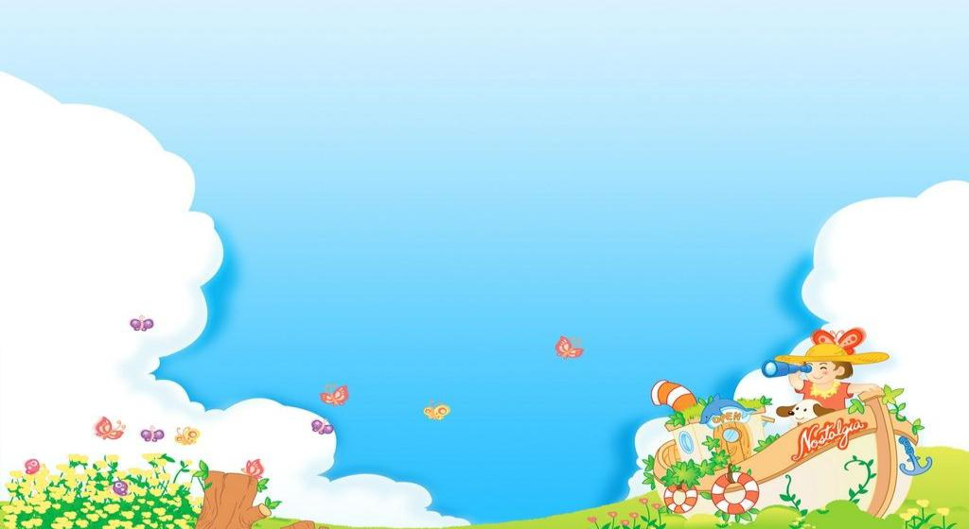
fruit garden
words: green,blue,black,
white,orange
Sentences:
what colour do you like?
I like green.

Slide 17
Thank you!

