Slide 1
Unit 7
Days and Months
Unit Review
WWW.PPT818.COM

Slide 2
Building Your Vocabulary
Unjumble the words and discover the answer to the riddle.
D e c e m b e r
c m e b e r d e __ __ __ __ ___ __ __
p l i r a __ __ __ __
t o b c r e o __ __ __ __ ___ __
y s a d u r t a __ __ __ __ __ ___ __
i f d r y a __ __ __ __ __
o n a d y m __ __ __ __ __
e j n u __ __ __
a m y __ __
r b u f e r y a __ __ __ __ __ ___ __
u l j y __ __ __
Riddle:
On a calendar，Sunday comes before Monday. Where can you find Monday before Sunday？
Answer：
In a_____________.
A p r i l
O c t o b e r
S a t u r d a y
F r i d a y
M o n d a y
J u n e
M a y
dictionary
F e b r u a r y
J u l y

Slide 3
Grammar in Use
Ⅰ
Fill in the blanks with the correct forms of the given words. Then complete the chart.
1.Mr.Liu loves summer.But his________(two)favourite
season is winter.
2.The______(one)month of the year is January.
3.Saturday is the________(seven)day of the week.
4.March the________(eight)is Women's Day.
second
first
seventh
eighth

Slide 4
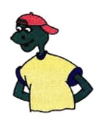
1 | one | first | January
2 |  | second
3 |  |  | March
4 | four |  | April
5 |  | fifth
6 | six |  | June
7 |  | seventh
8 | eight
9 |  |  | September
10
11 |  | eleventh
12 | twelve
two
February
three
third
fourth
five
May
sixth
seven
July
eighth
August
nine
ninth
ten
tenth
October
eleven
November
twelfth
December

Slide 5
Ⅱ
Fill in the blanks.Then circle what “it” means in each dialogue.
1.A：What's this ? B：___is a hotel.
2.A：What's that？ B：____is a calendar.,
3. A：What's the______today？ B：It is January 15.
4. A：Look at my new jacket !
B：_____is very beautiful！
5.A：How's the________today? B：It is nice and cool.,
6．A：Is May your favourite month?
B：Yes，_____is.,
It
It
date
It
weather
it

Slide 6
Listening and Speaking
Ⅰ
Listen and repeat.
/ ʊə / February usually
/ t / hot let skate right
/ d / do day down cold
/ k / like look Christmas calendar
/ ɡ / green grass forget against

Slide 7
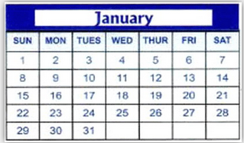
Ⅱ
Look at the calendar and answer the questions.
1.What is the date of the first Wednesday
in the month？
2.What day of the week is January 23？
3.How many Saturdays are in this month？
4.What is the date of the fourth Tuesday？
5.What is the date two days after the
third Monday？
It's January 4.
It's Monday.
Four.
It's January 24.
It's January 19.

Slide 8
Putting It All Together
Work in groups.Interview your classmates and fill in the table.Then use the results to write a report.
Name | Favourite Season | Favourite Month | Favourite Holiday
Zhang Li | summer | June | Children's Day
Linda | winter | December | Christmas
Example：
My classmates like different seasons and holidays. Zhang Li likes summer.He likes to go to the park on Children's Day. Children's Day is on June 1.Linda likes December.She likes to look at the beautiful Christmas lights.

Slide 9
Self­Evaluation
Find more examples from this unit. Then mark your stars.
Talking about Seasons and Weather
______________________________________________
______________________________________________
I can talk about seasons and weather in English.
☆ ☆ ☆ ☆ ☆
Ⅰ
_____________________________________________
How is the weather today?
What season do you like？
I love green grass and rainy days.

Slide 10
Ⅱ
Talking about Days and Months
What day is it?
_______________________________________
What's the date？
______________________________________________________
_______________________________________
When is his birthday？
I can talk about dates in English.,
☆ ☆ ☆ ☆ ☆

Slide 11
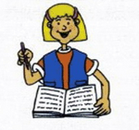
Ⅲ
Numerals
______________________________________
one—first two—second
______________________________________
three—third four—fourth
five—fifth six—sixth
______________________________________
I can use ordinal and cardinal numbers properly.
☆ ☆ ☆ ☆ ☆

Slide 12
Ⅳ
Using “it”
______________________________________
It is warm and rainy.
It's a calendar.
It's on March 11
______________________________________
______________________________________
I can use “it” properly.
☆ ☆ ☆ ☆ ☆

Slide 13
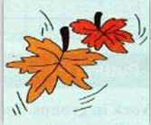
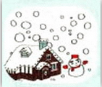
Month by Month
January，January，ice and cold.
Brrrr brrr brrrr! Wear your coat.
February，February，snow，snow，snow.
Let's make a snowman！A man of snow!
March，March，March, the sun is high.
I love March，but I don't know why.
April，April，grass starts to grow
Hurray！Hurray！No more snow!
May，May，May，get your garden in.
June，June，June，let's go for a swim.
July is summer，August is too.
Sit in the shade and stay real cool.

Slide 14
September and October，
The leaves will fall.
It's back to school with our soccer ball.
November and December，
And the weather is clear.
That's 12 whole months，
And it makes one year.

