Slide 1
Unit 11 Can you tell me the way?
WWW.PPT818.COM

Slide 2
Showing the way
Go straight ahead.
Turn right
Turn left
Turn right / left at the second turning.
It is on the right / left.

Slide 3
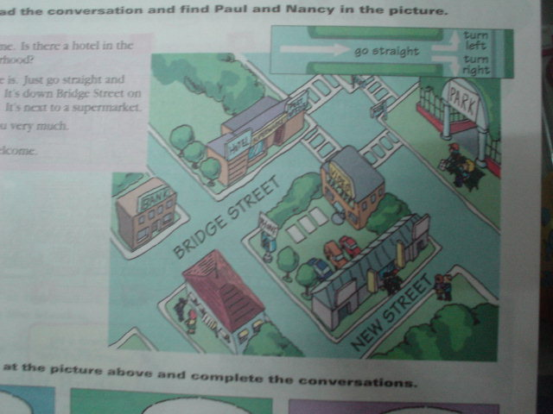

Slide 4
Ask the Way
Could you tell me ___ ____ ____ the park?
Which is ___ ____ ____ the park, please?
Do you know ___ ____ ____ the park?
Do you know ____ ___ ___ __ the park?
______ is the park, please?
____ can I ____ ____ the park?
____ _____ a park near here?
the way to
the way to
the way to
how to get to
Where
How
get to
Is there

Slide 5
Road signs
turn right
turn left
zebra['zebrə]斑马线 crossing
straight on

Slide 6
You must wait.
You can cross the road.
at
traffic lights
crossroads

Slide 7
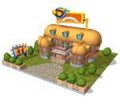
show the way
Go up this road to the end.
Go on until you reach the end.

Slide 8
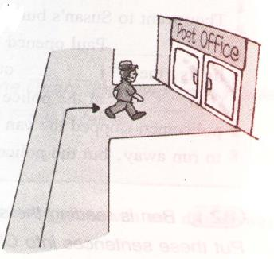
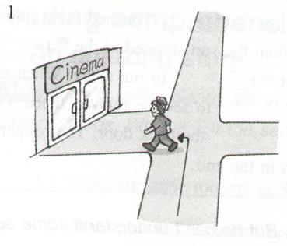
Exercises for road signs(1)
She must _________ if she wants to go to the post office.
She must _________ if she wants to go to the cinema.
turn right
turn left

Slide 9
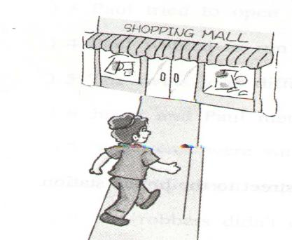
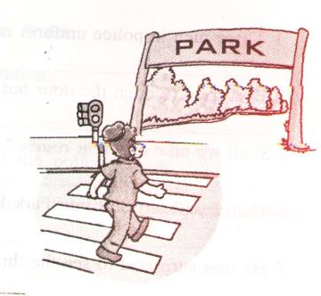
Exercises for road signs(2)
She must go by a _____________ if she wants to go to the park.
She must go _________ if she wants to go to the mall.
zebra crossing
straight

Slide 10
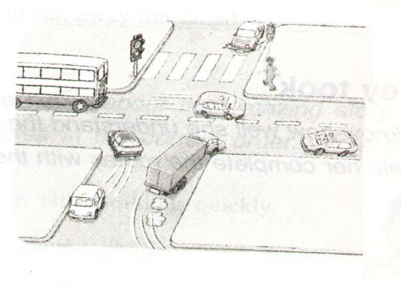
Exercises for road signs(3)
She must look at the ___________. when she is at the __________.
traffic lights
crossroads

Slide 11
Read maps
Turn right when you come to the crossroads.
Walk along this road.
The entrance is on your left.

Slide 12
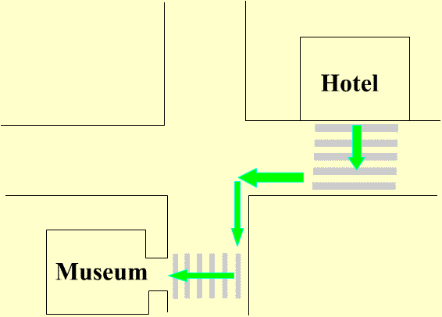
Read maps
Turn left when you come to the corner of the road
Cross the road
Walk along this road.
Cross the road .
The entrance is in front of you.

Slide 13
Translate the following into English(1).
径直走
在十字路口
在交通处
向右转
向左转
斑马线
在你的左边
在你的右边
go straight on
at the crossroads
at the traffic lights
turn right
turn left
zebra crossing
on your left
on your right

Slide 14
Translate the following into English(2).
正确的一个
过马路
当你来到十字 路口时
在街道角落处
在教室的角落处
the correct one
cross the road
go / walk across the road
when you come to the corner
of the road (crossroads)
at the street corner
in the corner of the classroom

Slide 15
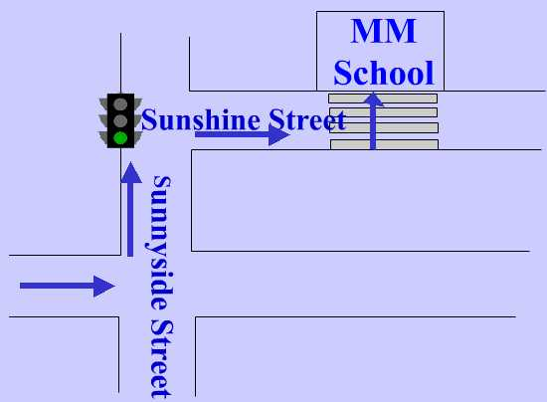
Look at the map below and use “crossroads,straight on , traffic lights ,turn left , turn right , zebra crossing” to fill in the blanks.
________at the_________.walk __________ Sunnyside Street. _________ at the__________. Walk along Sunshine Street You will find the ___________. MM School is just opposite the street .
Turn left
crossroads
straight on
Turn right
traffic lights
zebra crossing

Slide 16
Where can you do these things?
post some letters
post office
borrow some books
library
see a film
cinema
take out some money
bank

Slide 17
Where can you do these things ?
take the guest to a place to stay
hotel
buy a pair of shoes
shoe shop
make a phone call
pay phone
do some shopping
supermarket
Walmart

Slide 18
Video Arcade |  |  | G A R D E N R O A D | Hotel |  |  | Park |  | F I F T H S T R E E T | Zoo
Supermarket
 |  |  |  | Museum |  |  |  |  |  | McDonald’s
KFC
 |  |  |  | Bridge Street
Sports Center |  |  |  | Police office |  |  |  | Shoe shop |  | Post Office
 |  |  |  | Bank |  |  |  | Cinema
 |  |  |  | Hill Road
Library | Book shop |  |  | Clothes shop |  |  | Pet shop |  |  | Hospital
phone
Go along Bridge Street and take the third turning on the right. It’s on the Fifth Street across from the shoe shop. You can’t miss it.

Slide 19
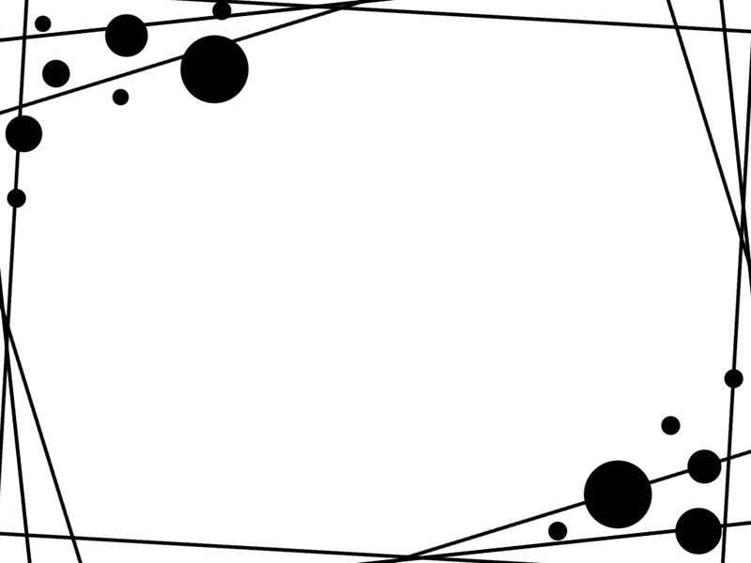
Practice
Please go to
the police office

Slide 20
Practice
Please go to
the McDonald’s

Slide 21
Practice
Please go to
the hospital

