Slide 1
Unit 9
It looks fun
WWW.PPT818.COM

Slide 2
Chant
what are you doing? I am fishing. what are you doing? I am reading. what are you doing? I am singing. what are you doing? I am running.

Slide 3
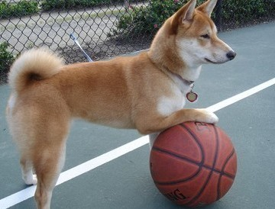
What is the dog doing?
归纳现在分词的构成。
basketball
篮球
The dog is playing basketball.
It looks fun.
有趣的
1/17/2023
Notes:
3

Slide 4
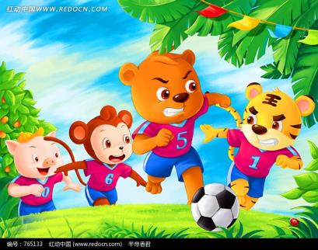
What are they doing?
归纳现在分词的构成。
football
足球
They are playing football.
1/17/2023
Notes:
4

Slide 5
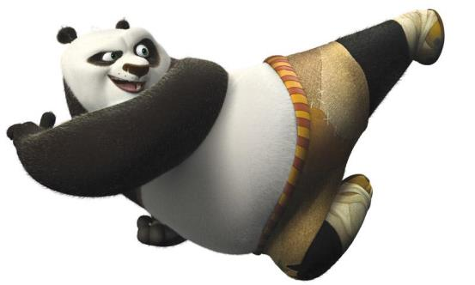
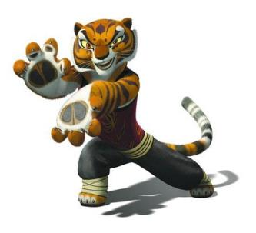
What is the tiger doing?
归纳现在分词的构成。
kung fu
功夫；武术
The tiger is doing kung fu.
1/17/2023
Notes:
5

Slide 6
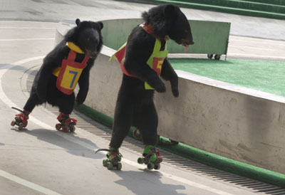
What are the bears doing?
归纳现在分词的构成。
skate
溜冰
They are skating.
1/17/2023
Notes:
6

Slide 7
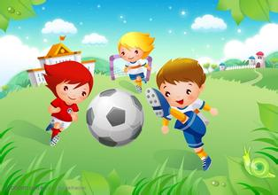
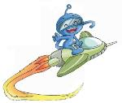
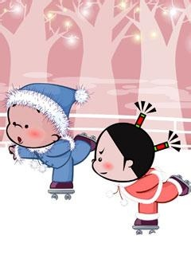
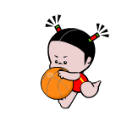
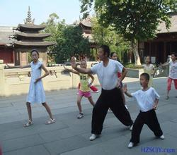
I am playing football.
I am skating.
I am playing basketball
I am doing kung fu
Notes:
7

Slide 8
Let’s try.
Hello. I am
in the zoo
now.
创设情境：Do you know this cute girl? 引出小丸子对自己忙碌、高兴的一天的介绍。
1/17/2023
Notes:
8

Slide 9
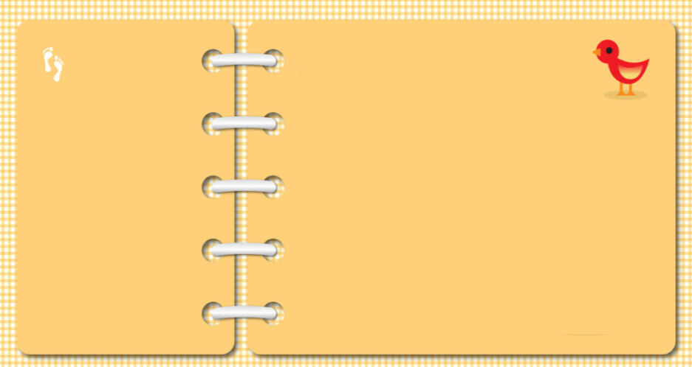
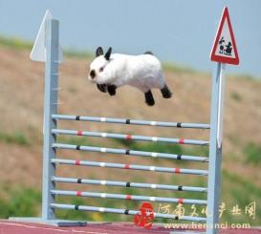
These are my photos in the zoo. Let’s see what are the animals doing?
Look!
In
Picture talking: 引出现在进行时Look! I am …ing.
The
Zoo
Look, the rabbit is
doing the high jump.
跳高
1/17/2023
Notes:
9

Slide 10
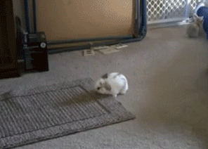
These are my photos in the zoo. Let’s see what are the animals doing?
Look!
In
Picture talking: 引出现在进行时Look! I am …ing.
The
Zoo
Look, the rabbit is
doing the long jump.
跳远
1/17/2023
Notes:
10

Slide 11
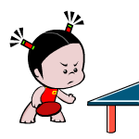
It is 5:00 now.Do you know what am I doing ?
Look!
playing table tennis
I am _____________________.
After
Step 1：Picture talking: 学习… in the … 。
playing table tennis
School
Step 2：学习用What are you doing?进行提问，总体运用词组和句型，并归纳现在进行时的意义和用法。
1/17/2023
Notes:
11

Slide 12
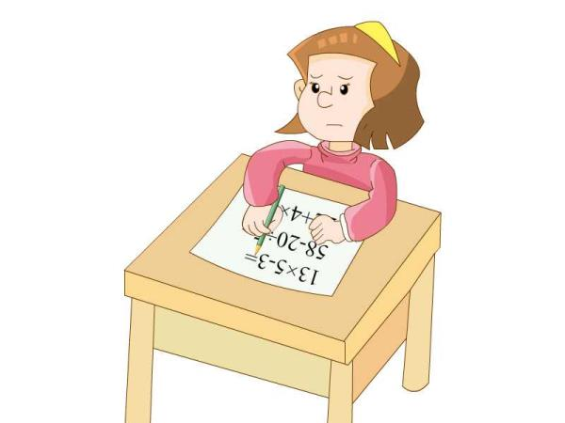
think
想

Slide 13
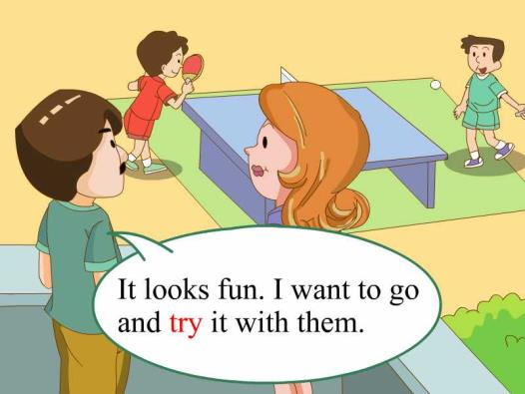
try
尝试

Slide 14
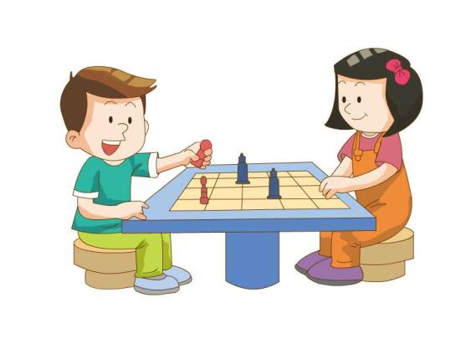
chess
(国际）象棋
I am playing chess.

Slide 15
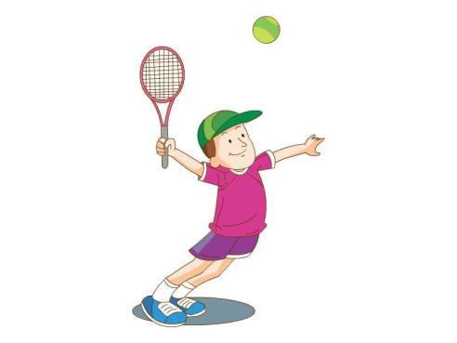
tennis
网球
I am playing tennis.

Slide 16
Homework:
1抄写新单词。
2背新单词。

