Slide 1
Module 6 Hobbies
Unit 2 Hobbies can make you
grow as a person.
WWW.PPT818.COM

Slide 2
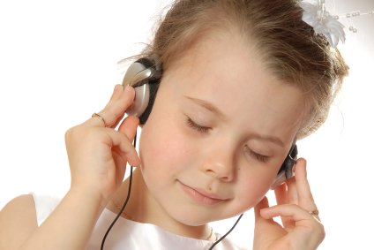
Warming up
Guess
What’s the hobby?

Slide 3
What’s the hobby?

Slide 4
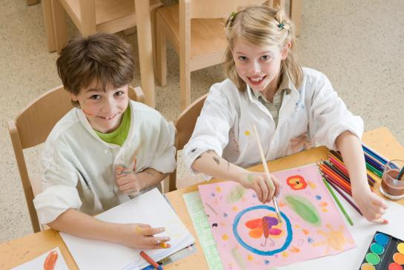
What’s the hobby?

Slide 5
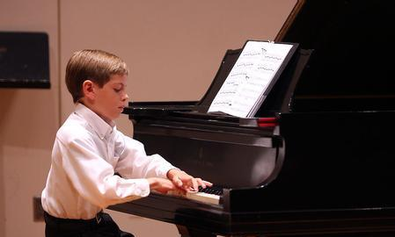
What’s the hobby?

Slide 6
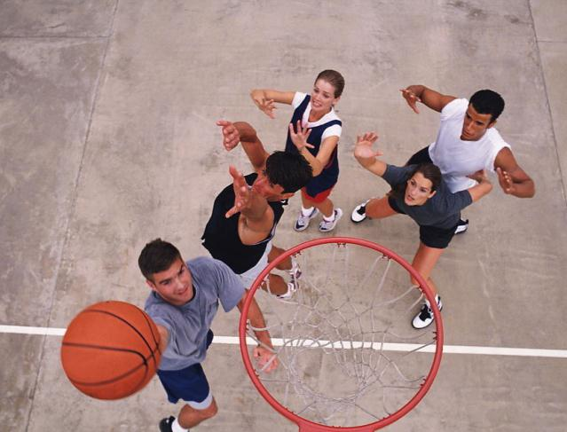
What’s the hobby?

Slide 7
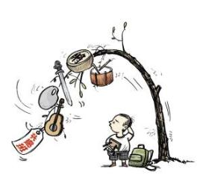
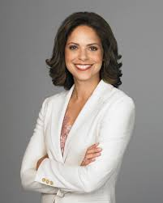
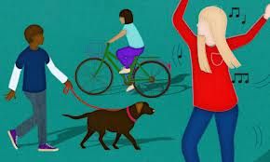
New words
person n.人
interest n. 兴趣，爱好
activity n. 活动
skill n. 技能

Slide 8
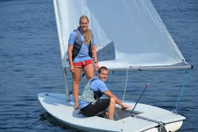
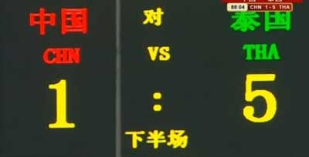
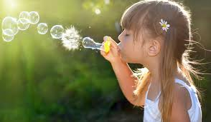
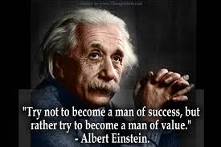
sailing n. 航海；航行
result n. 结果；后果
pleasure n. 愉悦；快乐
success n. 成功；成就

Slide 9
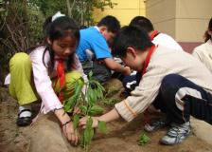
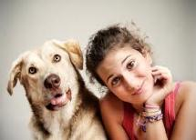
Work in pairs
Activity 1
Talk about your hobbies. Use the words and expressions in the box to help you.
climbing dancing growing vegetables looking after animals painting
playing volleyball singing writing

Slide 10
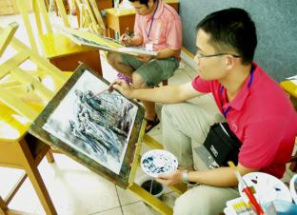
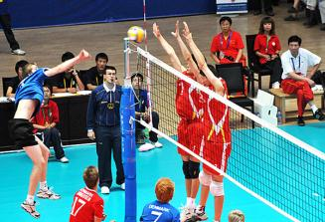
climbing dancing growing vegetables looking after animals painting
playing volleyball singing writing

Slide 11
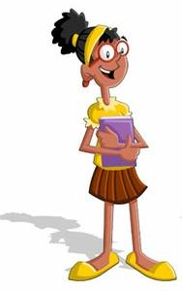
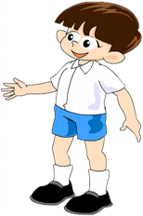
Choose the words from the box to describe your hobbies.
Activity 2
active dangerous healthy interesting relaxing
My hobby is climbing, it is very interesting.
Reading is one of my hobbies. It is relaxing.

Slide 12
Activity 3 1).fast-reading
Read the passage quickly and answer the questions.
1. Is writing one of David’s hobbies?
Yes, it is.
2. Who encouraged David to write about
the experiences at the camp?
David’s teacher.

Slide 13
Activity 3
2).Careful –reading
Read the passage and answer the questions.
What advantages can hobbies bring to
young people?
Hobbies can make you grow as a person,
develop your interests and help you
learn new skills.
2. What hobbies does David have?
David likes writing, playing volleyball
and many other things.

Slide 14
3. When did David become a successful
writer?
After his story about the life of a sixteen-
year-old boy came out as a book in 2012.
4. Will David’s new books be successful?
Maybe. The passage doesn’t say.

Slide 15
Learning to learn
Find a hobby to help you
improve your English. If you like
football, follow an English team. If
your hobby is watching films, try
to watch English films.

Slide 16
Language points
1. Many students have hobbies, such as
reading, painting, growing vegetables
and looking after animals.
such as 表示“例如”，等于for example。
例如：
He learns many subjects, such as English, math and Chinese. 他学习好多科目，比如，英语，数学和语文。

Slide 17
2. Hobbies can make you grow as a person,
develop your interests and help you
learn new skills.
grow as a person，表示“长大成人”。
develop one’s interests，表示“发展某人
的兴趣”。develop 表示“发展，提高”。
e.g. The course can help you develop
your speaking skills.
这门课程可以帮助你提高口语表达
能力。

Slide 18
3. As well as the usual activities, such as
sailing and climbing, there was a
writing class.
as well as 表示“也，还，而且”。
后面加名词或动词ing形式。
例如：
We all want to visit Beijing as well as Shanghai. 我们除了想去北京以外，还想去上海。

Slide 19
4. Back at school, David wrote a story
about the life of a sixteen-year-old boy,
and it came out as a book in 2012.
come out 表示“出版，发行”。还表示“显露”。例如：
The book came out at his early age.
这本书在他年龄还小的时候就出版了。
At last the truth came out.
真相终于大白了。

Slide 20
5…., and as a result, David has become a successful young writer.
as a result表示“结果”。后面用逗号隔开。
so表示“因此”，后面不用逗号隔开。
例如：
The girl kept studying hard, as a result, she
got good marks in the final exam.
The girl kept studying hard, so she got
good marks in the final exam.
这个女孩学习一直很努力，因此，她在期
末考试的时候考了好成绩。

Slide 21
6. I spend some of my free time playing
volleyball for my school team.
spend time (in) doing sth. 表示“花费时间做某事”。介词in可以省略；如果表示“在某物上花费时间”，要用spend time on sth. 例如：
I spend one hour (in) reading every evening.
我每天晚上花一个小时看书。

Slide 22
Activity 4
Complete the sentences with the correct form of the words in the box.
activity pleasure result skill success
What __________ do you enjoy doing?
What new _______ have you learnt through your hobbies?
activities
skills

Slide 23
activity pleasure result skill success
3 Has any of your hobbies brought you _________ and __________?
4 Have you made new friends as a(n)_________ of your hobby?
pleasure success
result

Slide 24
Grammar
简单句的基本句型
4.主语 S+ 谓语（及物动词）V+ 间接宾语In O + 直接宾语DO +（状语P）
主语 | 谓语 | 间接宾语 | 直接宾语 | 状语
His hobby | has brought | him | enjoyment.
My father | bought | me | a very good bike | on my birthday.

Slide 25
5.主语S+谓语（及物动词）V+ 宾语O
+ 宾语补足语OC（+状语P）
主语 | 谓语 | 宾语 | 宾语补足语 | 状语
We | can help | you | develop new skills. | step by step.
I | do not want | you | to work too hard.
The news | made | ever-yone | happy.

Slide 26
6. There +be +主语S（+状语P）
There | be | 主语 | 状语
There | are | many books | in his schoolbag.
There | is | a very nice cup | on the table.

Slide 27
判断下列简单句的句型：
1、He gives me some seeds.
2、We should keep the plants in the shade.
3、There are some apples in the bowl.
4、There is a ruler and five books in the school bag.
5、He asked me to come back soon.
6、John told me his idea.
主S + 谓V + 直宾In O + 间宾DO
主 S + 谓V + 宾 O + 宾补OC
There be+ 主 S ( + 状语P)
There be+ 主 S ( + 状语P)
主 S + 谓V + 宾 O + 宾补OC
主S + 谓V + 直宾In O +间宾DO

Slide 28
Look at the following sentences.
As well as the usual activities …
…such as sailing and climbing …
…as a result, David has become a successful young writer.

Slide 29
Now rewrite the following sentences using as well as, such as or as a result.
1 Some hobbies, for example, reading and painting, are very relaxing.
Some hobbies, such as reading and painting, are very relaxing.

Slide 30
2 David likes writing. He also likes playing volleyball.
David likes writing as well as playing volleyball.
3 Many young people love David’s book, and so his hobby has brought him success.
Many young people love David’s book, and as a result, his hobby has brought him success.

Slide 31
Work in pairs.
Find out about your partner's hobby and make notes.
Write down at least four questions to ask your partner about his/her hobbies. For example:
How did you learn your hobby?
When did you start it?
How often can you do it?
Is it an expensive hobby?

Slide 32
Now write a short passage called My classmate's hobby.
Use as well as, such as or as a result.
Use the following example to help you.
Li Kai is my classmate. His hobby is music. He enjoys playing music as well as listening to it. His favourite music bands are …, such as … As a result, his band is now…

Slide 33
Possible answer
My friend Paul plays chess. His father
taught him to play when he was only five
years old, and as a result, he is good at it
now. He has played in the school team as
well as in many competitions. Paul is not
just a chess player. He also enjoys outdoor
activities such as walking in the
countryside and climbing.

Slide 34
本课小结：
简单句的基本结构。
重点短语
come out as a result
grow as a person as well as
bring sb. pleasure such as

Slide 35
中考链接
— You have joined the Singing Club,
haven’t you? 【2013镇江】
— ____ . I like singing, but I don’t have
any time.
A. Yes. I do B. No. I don’t
C. Yes, I have D. No, I haven’t

Slide 36
2. —What did you do last night?
—I ______ TV and read books.
【2013湖南娄底】
A. watch B. watched
C. have watched

Slide 37
3. —Do you know who took the students to
the old people’s home, Tony?
—Well, Mr. Smith ________.
【2013 湖北宜昌】
A. took B. does
C. did D. do

Slide 38
4. Just a minute! My brother _____ his
car in the garden. 【2013重庆】
A. washes B. is washing
C. washed D. will wash

Slide 39
Homework
根据课文内容，缩写
David’s hobbies。
David Smith is a student,
one of his hobbies
is writing…

