Slide 1

Module 4 Rules and suggestions
Unit 2
We must keep the camp clean.
WWW.PPT818.COM

Slide 2
Revision
Translate the phrases into English.
pay attention
set off
wear proper clothes
the edge of the hill path
hurt oneself
keep together
注意
出发
穿合适的衣服
山路的边缘
伤到自己
在一起; 协同一致

Slide 3
走失；迷路
离开
独立地
一口气；一下子
注意…；留心…
引路； 带路
get lost
go off
on one’s own
in one go
be careful of
lead the way

Slide 4
tent 帐篷
fall 变成，进入
fall asleep入睡，睡着
hang-hung-hung悬挂，吊
sudden 突然的，急剧的
gun 枪
soft 软的
still静止的
wood小树林，林地
blood 血，血液

Slide 5
1 fall/ fell asleep 入睡
2 in the middle of the night半夜
3 put up 搭起，粘贴
4 tidy up 收拾，整理
5 make lots of noise弄出很多的声响
6 keep us safe 确保我们的安全
7 reach out 伸手出去

Slide 6

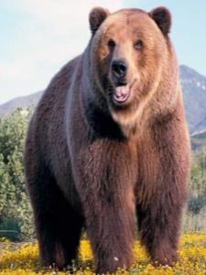
Have you ever seen bears or other
animals when you travel?
Do you like them?
Do you think they are dangerous?
If you really meet a bear outside,
what will you do?

Slide 7
Free talk
How much do you know about bears?

Slide 8
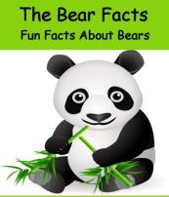
Bears can climb trees. They can smell food from a distance. Bears can run
fast.
There are eight main types of bear:
American black bears, Asian black bears, brown bears, giant pandas, Polar bears, Sloth bears, Spectacled bears and Sun bears. The largest of all bear species is the brown bear, weighing as much as 2200 pounds. Polar bears are the most skilled swimmers of all bear species.

Slide 9
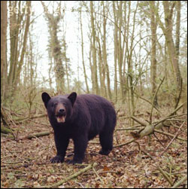
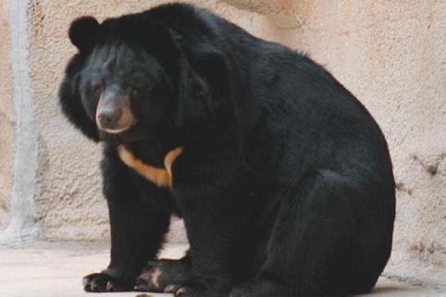
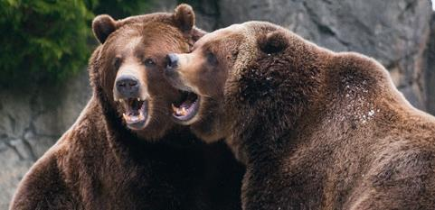
Asian black bear
American black bear
brown bears

Slide 10
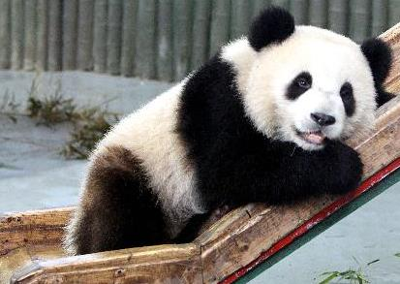
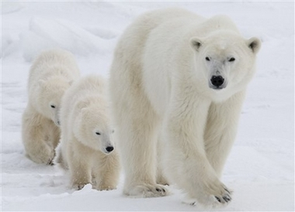
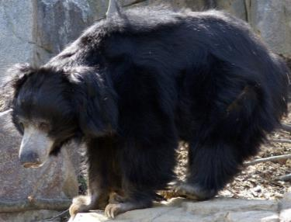
giant panda
Polar bears
Sloth bear
(懒熊; 印度的一种长毛熊)

Slide 11
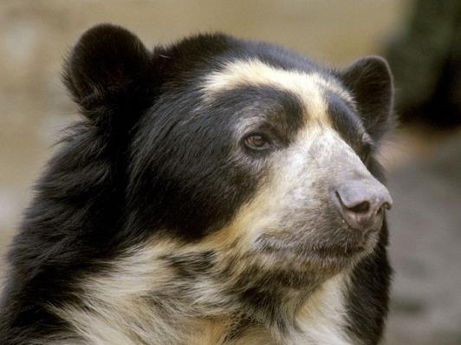
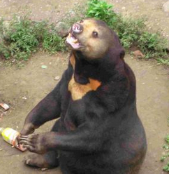
Spectacled bears
(眼镜熊)
Sun bears
(太阳熊)

Slide 12
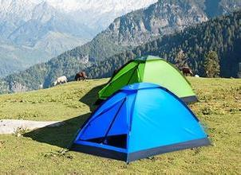
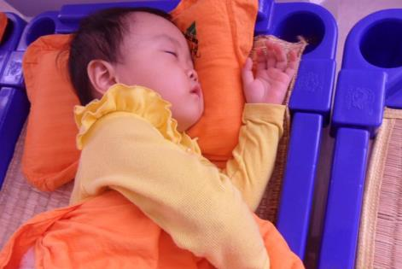
Learn some words.
tent
fall asleep

Slide 13
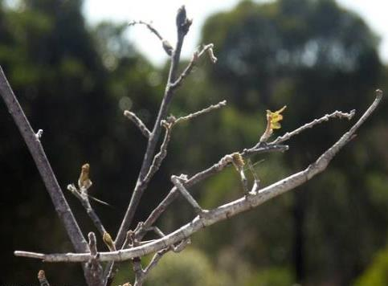
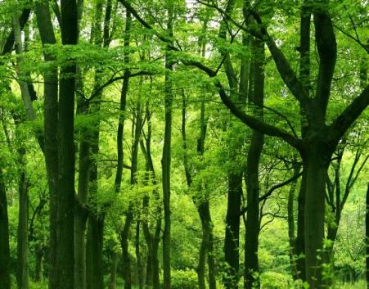
stick
woods

Slide 14
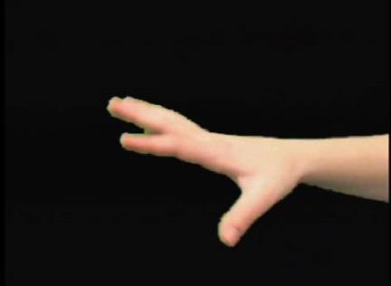
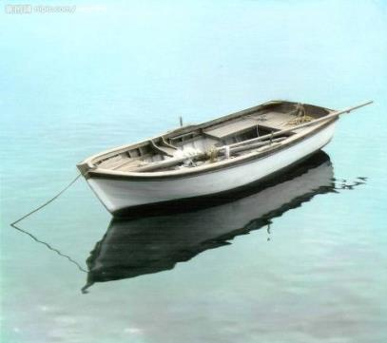
reach out
still

Slide 15
On the first evening, the three of us were tired after walking
for about eight hours . We soon fell asleep.
In the middle of the night, I heard a strange noise outside .But
when I looked out of the tent, there was nothing there.
In the morning , I got up to make breakfast . The bag of food
was open.
“ Bears,” said Joe, “ We should hang the food in a tree tonight.”
Later that day , we stopped in a beautiful field by a stream. We
put up the tent and fell asleep.
During the night , the bears came again. This time they took
the food from the tree .

Slide 16
“ It wasn’t high enough . Bears can climb trees. They can smell
food from a long way away,” said Ben.
“We must keep the camp clean.” I said.” “Bears might think
our rubbish is food .”
“ OK, let’s tidy up and move on. And we should make lots of
noise too. If they know where we are, they may not come any
closer,” said Joe.
“But if you see a bear,” said Ben, “ you mustn’t make any
sudden moves or make a sound. And above all , you mustn’t
run. No one can run faster in the forest than a bear. And
remember, we don’t have a gun to keep us safe!”
That night, we went to sleep… or we tried to .

Slide 17
The next day, we stopped at eleven o’clock for a break.
While the others were resting, I went for a walk in the forest.
Suddenly, I saw a baby bear playing with some sticks and
stones. He looked so soft and friendly, and I remember thinking
“ If I reach out, I can just touch him.”
There was a loud noise behind me.
I stood very still . I didn’t even turn my head . There was
another loud noise. The baby bear looked up, and ran towards
me. I turned pale and he ran past me into the woods.
I was still for a few minutes. Then slowly I turned round, and
I saw the baby bear and his huge mother walking away.
I ran back to my friends. I have never run so fast .
For the next ten days , every time here was a sudden noise,
my blood went cold.

Slide 18
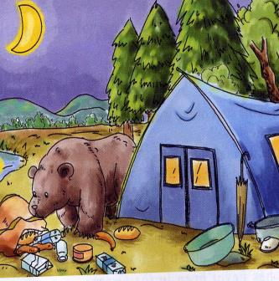
Look at the picture.
Answer the questions.
1. What is the bear doing?
It is around the tent to look for something to eat and finds some food that people put there.

Slide 19
2. What do you think the people in the
tent should do?
They must stay in the tent till the bear goes far and don’t make any noise.

Slide 20

Read the passage and answer the question.
How much do they know about bears?
They know bears can climb trees and they know that bears can smell food from a long way away. They also know that if they see a bear, they mustn’t make sudden moves or make a sound and they mustn’t run.

Slide 21
Read again and answer the questions.
1. Where do you think is the best place to keep food safe from bears?
In a clean place where bears can’t smell the food.

Slide 22
2. What was the noise behind the writer?
I think it may be the baby bear’s noise in which he ran past the writer into the woods to look for his mother and it may be the huge mother bear’s noise.

Slide 23

Do you think their camping trip was interesting? Why?
I don’t think it was interesting. It was very dangerous.

Slide 24
Read again and complete the table.
What happened | What they should or should not do
In the middle of the first night, the writer heard a ________ outside. And the bag of food __________ | They should ___________
During the second night, the bears came again and ______________ from the tree. | They should _______ _________________ and _____________
On the fourth day, the writer saw _________ . Then _________ came. | She should not ____________
noise
hang the food in a tree
was open
hang the
food in a higher tree
took the food
keep the camp clean and make lots of noise
a baby bear
make any sudden moves, make a sound, or run
his mother

Slide 25

What should (must) you do if there are bears nearby?
1) You must hang food in a tree.
2) … must / should pick up the rubbish.
3) … must / should keep the camp clean.
4) … can’t leave anything which bears might think is food.

Slide 26
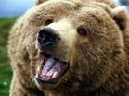
5) … should make a lot of noise.
6) … mustn’t move or make a sound.
7) ... mustn’t run because no one can run faster in the forest than a bear.

Slide 27
Complete the passage with the words in the box.
blood gun sticks sudden
On the third day of our camping trip, Ben told us that if we saw a bear, we should not take any _______ moves. We did not have a _______ to keep ourselves safe. The next day, I saw a baby bear playing with some _______ and stones. His mother arrived soon, and I was so afraid that my _______ went cold. I did not move until the bears walked away. Then I ran back to my friends as fast as I could.
sudden
gun
sticks
blood

Slide 28
Writing
Think of an area of countryside nearby.
Where is it?
Why do people go there?
And there any dangers from animals?
How can we protect ourselves?
What should we do to look after the place?

Slide 29
Say where it is.
Lushan National Park is in Jiangxi Province.
Say why people go there.
People go there to see the mountains,
and streams.

Slide 30
Say if there are any dangers from animals.
The fish and birds there are not dangerous, but there are some snakes.
Say how we can protect ourselves.
We mustn’t walk in the grass.
Say what we should do to look after the park.
We should allow only 1,000 people to visit it each day.

Slide 31
A Sample
Lushan National Park is in Jiangxi Province. Every year, many tourists go to visit it. People visit it to see the mountains, valleys, streams, pools and waterfalls. As we enjoy ourselves in the park, we must be careful of some dangers from animals. The fish and birds which live there are not dangerous but there

Slide 32
Are some snakes. Then how can we protect ourselves? We mustn’t walk in the grass. At the same time, we should do something to look after the park. I think we should allow only 1,000 people to visit it each day.

Slide 33
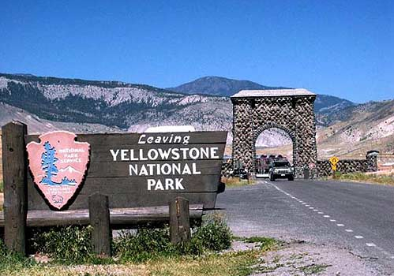
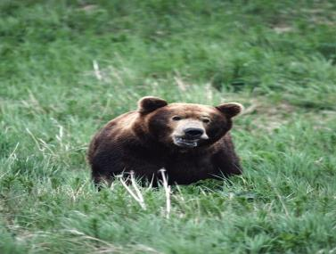
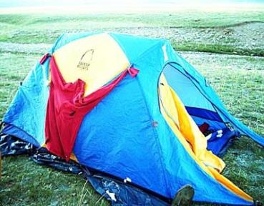
Yellowstone National Park

Slide 34
If you work as a guide for Yellowstone Park, please give some suggestions to the visitors about how to protect yourselves and the park.

Slide 35
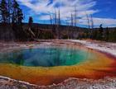
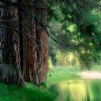
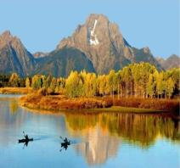
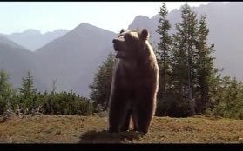
Where it is: in the USA
What to see: mountains / valleys / warm springs / bear / and rare plants.
What dangers there are: bear
How we can protect ourselves:
What we should do to look after the place:

Slide 36

Suggestions
1.When we write in paragraphs, we should choose one topic for each paragraph first.
2.Next, We can write notes under headings.
3.Finally,We should use linking words (and, but, so, because etc.) to join the sentences together.

Slide 37
Yellowstone Park is in the USA. Many people visit it to see the mountains / valleys / warm springs moose / bison and rare plants. It is peaceful but there are some bears. So we mustn’t … And We should … We can … We can’t … We should allow only 1,000 people to visit it each week.

Slide 38
Changbai Mountain Eco-tourism
Where: Northeast China
What to see: forest waterfall / mountains
Danger: tigers / black bears
Suggestions:
Group work
Huanghe delta nature reserve Zone (黄河三角洲自然保护区)
Where: the northeast of Dongying, Shandong
What to see: wetland / swan / the sunset
Danger: deep water
Suggestions:
Lushan National Geological Park
Where: Jiangxi
What to see: mountains stream / pool
Danger: wild animals
Suggestions:

Slide 39
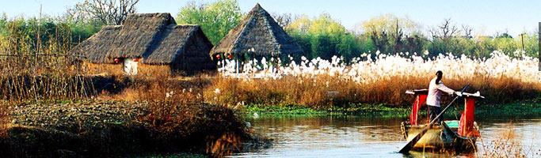
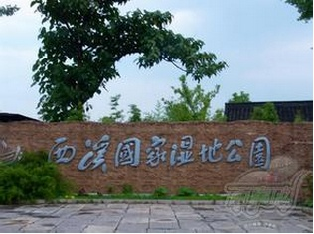
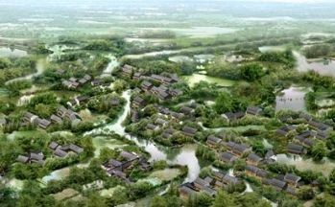
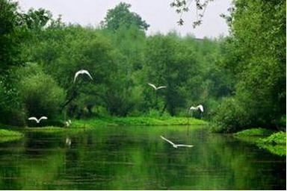
Xixi National Wetland Park
The first and so far only National Wetland Park in China is located in beautiful paradise city of Hang Zhou.

Slide 40
Language points
1. … the three of us were tired after walking for about eight hours.
the 用在数词前, 表示特指。
the three of us 指的是“我们三个人” (总数就三个人); three of us指的是“ 我们中的三个人” (总数不一定为三个人) 。

Slide 41
There are eight people in the team. The eight of them will have dinner together tonight.
队里有八个人，他们八个今晚一起吃饭。
There are 10 people in the office and eight of them are women.
办公室有十个人，有八个是女的。

Slide 42
2. We soon fell asleep.
fall asleep 入睡，睡着
Don't cry. The sick have fallen asleep.
别叫喊，病人们已经入睡了。
Warm milk helps you fall asleep.
喝热牛奶有助你入睡。
He fell asleep when there was a loud knock at the door.
他刚睡着，这时有人大声敲门。

Slide 43
(2014年湖北荆州中考) 完成句子
Because it was too noisy outside last night, we all found it difficult ______________. (fall)
由于昨晚外面太吵，我们发现很难入睡。
The math teacher got angry with me when I did not ______ him in class yesterday.
A. look for B. take care
C. pay attention to D. fall asleep
  to fall asleep
  C

Slide 44
知识链接
fall asleep表动作，意为“刚刚入睡”，指“刚睡着”这动作；be asleep表状态，意为“睡着的”；go to bed表动作，指“去睡觉”；go to sleep和fall asleep意思接近，指“入睡，睡着”。
The baby has been asleep for an hour.
He found it difficult to go to sleep.

Slide 45
3. We should hang the food in a tree tonight.
hang v. 悬挂；吊
其过去式、过去分词均为hung。
A full moon hung in the sky.
圆圆的月亮挂在天上。
I'll hang the pictures as high as I can.
我将尽可能把这些画挂得高。
He hung his coat on the hook.
他把衣服挂在钩子上。
The decision is still hanging.
尚未决定。

Slide 46
知识链接
hang about / around / round 闲逛; 闲呆着；围着, 缠住
hang behind 落在后面；挂在…后面
hang down 挂下来
hang from 悬挂
hang in 不泄气, 坚持下去
hang on 紧紧抓住；坚持下去；把…挂在…上

Slide 47
知识链接
hang v. 绞死, 上吊
其过去式、过去分词均为hanged。
He was hanged for his crimes.
他因犯罪而被处绞刑。
Mussolini was hanged by the Italian people.
墨索里尼被意大利人民给吊死了。

Slide 48
hang - hung- hung 悬挂
hang - hanged- hanged 绞死, 上吊
可以这样记忆：上吊需要一把椅子，hanged后面的ed就像一把椅子一样，这样记住，就不会混淆。

Slide 49
  B
The picture _________ on the wall is painted by my nephew.
A. having hung B. hanging
C. hangs D. being hung
— Is this raincoat yours?
— No, mine ______ there behind the door.
A. is hanging B. has hung
C. hangs D. hung
Wet clothes are often _____ up near a fire
in rainy weather.
A. hang B. hanged
C. hanging D. hung
  A
  D

Slide 50
4. We put up the tent and fell asleep.
put up 挂起；张贴; 举起
Let’s put up the Christmas decorations in the living room.
我们在起居室里张贴一些圣诞装饰物吧。
He put up his hand to ask a question.
他将手举起来问问题。

Slide 51
学过的含有up的短语还有: get up“起来”, grow up“长大, 成长”, give up“放弃”等。
The dog will grow up quickly.
小狗会很快长大的。
When do you get up this morning?
你今天早上几点钟起床的？
She doesn't give up easily.
她做任何事都不轻易放弃。
Cheer up! I'm sure you'll feel better tomorrow.
振作起来！我肯定你明天会好些的。

Slide 52

【2013山东菏泽】10. —Why do you collect so many old bikes?
—I'll have them ______ and give away to the children who don't have bikes.
A. used up B. given up
C. fixed up D. set up

Slide 53
【解析】考查动词短语辨析。句意：---你为什么收集了这么多旧自行车。---我将找人把他们修理一下，然后捐给那些没有自行车的孩子。fix up “修理”，use up“用尽”， give up “放弃”，set up“建立”。注意本句使用了句式have sth. done， 表示“让别人做某事”。

Slide 54
【2013湖南益阳】31. When he saw a wallet on the ground, he ______at once.
A. picked it up B. gave it up C. picked up it
【解析】考查动词词组辨析。句意:当他看到地上有一个钱包，他立刻捡了起来。pick up 捡起，拾起来；give up 放弃。在动副词短语中，若代词作宾语，要放在动词和副词之间。根据句意选A。

Slide 55
【2013湖北宜昌】33. —It’s everyone’s duty to join the Clean Your Plate Campaign.
—Sure. We should try to _______ all the food that we’ve ordered.
A. give up B. eat up
C. turn up D. show up

Slide 56
【解析】考查动词短语的辨析。give up“放弃”，eat up“吃光”，turn up “调大”，show up“出现”。根据句意“---我们每个人都有责任加入‘光盘行动’。---是的，我们应当把我们点的饭菜都吃光。”可以判断用eat up。所以选择答案B。

Slide 57
【2013江苏盐城】10.David Burt’s dream in China is to go into the west and ______ an early childhood school there.
A. clean up B. look up
C. give up D. set up
【解析】动词词组辨析。根据句意：应是创建一所幼儿学校。clean up“清理”； look up “向上看”；give up“放弃”。

Slide 58
【2013山东济南】43. —Alice, could you help me _________ the meat? I want to make some dumplings for dinner.
—OK. I’ll do it right away.
A. put up B. give up
C. use up D. cut up
【解析】考查短语辨析。根据问句句意：爱丽丝，你能帮我切这些肉吗？晚饭我想包水饺。put up张贴；举起；give up放弃；use up用尽；cut up切碎。所以答案选D。

Slide 59
5. Let’s tidy up and move on.
tidy up 整理； 收拾
The room is in a mess. Let's tidy it up.
屋里很乱，让我们收拾一下。
Tidy up the room before the guests arrive.
客人来之前把这间屋子整理整理。

Slide 60
(2012年天津市中考)
根据所给中文意思完成句子，每空限填一词。
我经常帮助妈妈收拾房间。
I often help my mum to _____________ _____________ the room.
(2013山东聊城) If you want to buy this dress, you’d better ______ first to make sure it fits you.
A. pay for it B. take it off
C. tidy it up D. try it on
  tidy
  up
  D

Slide 61
move on 继续前进
Accept your failures and move on.
接受失败然后继续前行。
Don't stop here; move on, move on!
不要停留在这里, 往前走, 往前走!
You've got to let it go and move on.
你得忘记一切继续生活。

Slide 62
6. … if I reach out, I can just touch him.
reach out 伸出(手或臂)
The monkey reached out a hand for the banana.
猴子伸出手去够香蕉。
He reached out for the tool.
他伸手去拿工具。
reach for 伸手去拿……

Slide 63
7. I was still for a few minutes.
still adj. 静止的；不动的
Keep still while I fasten your shoe.
站着别动, 我给你系鞋带。
How still everything is!
一切都是多么的寂静!

Slide 64
知识链接
still, calm, quiet这几个形容词的共同意思是“安静、平静、寂静”，其区别在于:
1.在修饰环境时各词所指的状态为: calm指风平浪静; quiet指没有吵闹干扰; still指完全没有声音。
2.在修饰人时: calm指人心平气和,毫不激动; quiet指性情温和、安静等,有时也指人的闲散或不活动; still指“一动不动” 。

Slide 65
选词填空: calm, quiet, still
1) Could you keep the kids ________ while
I’m on the phone?
2) He was still ______when he was in danger
3) Keep ______ while I take photos of you.
4) Anna is ______ enough to drive a car.
The clock struck 11 at night and the
whole house was ______.
quiet
calm
still
calm
quiet

Slide 66
知识链接
still作副词使用时，含有“仍旧、还”之意，表示某事仍在继续。例句：
Although she felt ill, she still went to work.
她虽然觉得身体不舒服，但仍然去上班了。 Her arm still hurts.
她的胳膊还在痛。
I'm still not sure what you mean.
我还不明白你到底是什么意思。

Slide 67
Practice
1 每当他一入睡，就弄出很多噪音。
______________ he falls asleep, he __________
________________.
Every time
makes
a lot of noise
2 第二天我们仨去山坡采花去了。
______________, _______________went to the hillside to pick up flowers.
The next day
the three of us

Slide 68
3. 当我转过身时，那个孩子经过我身边跑到人群中去了。
When I ______________, the child _________
________the crowd.
turned round
ran past
me into
4. 我朝门外看去，有一只可爱的小狗，当我伸手去摸它的时候，它却很快跑开了。
looked out of
I ______________the door, a lovely dog was there. I ___________ for it, but it __________ quickly.
reached out
ran away

