Slide 1
Unit 1 Topic 3
What class are you in?
Section D
WWW.PPT818.COM

Slide 2
Talk with each other
What’s this / that?
It’s a /an …
Is this /that a /an …?
Yes , it is. / No, it isn’t. It’s a/an …

Slide 3
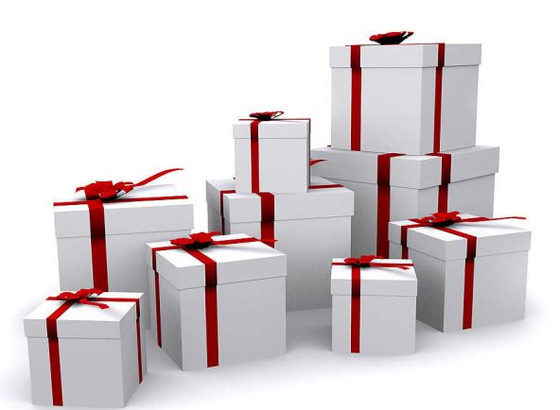
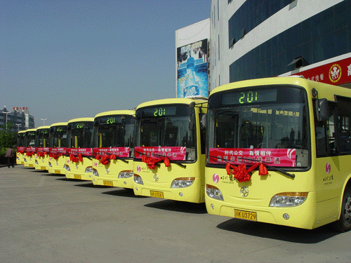
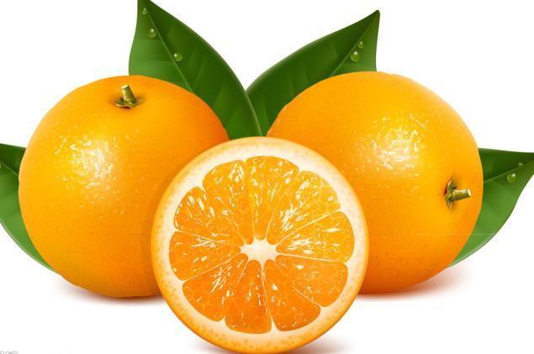
What are these/those?
They are …
Are these/those …?
Yes, they are. /No, they aren’t.
rulers
oranges
buses
boxes

Slide 4
下列每组单词中都有一个相同的音素，
读一读，你能找到吗？
hi bike nine bright
nose home OK old
duty use excuse student
big him is his
dog job box not
us bus but mum

Slide 5
1 Read ,Listen and follow

Slide 6
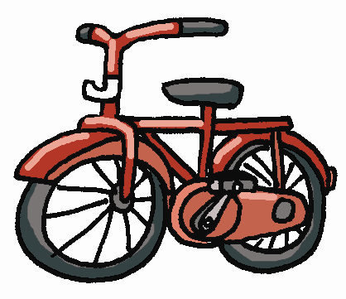
1 Listen and follow
6
9
/ ai /
/ I /
bike
knife
nine
six
kid
pig
/ /
D
go
nose
phone
box
dog
shop
/ju:/
/ʌ/
Cuba
student
computer
bus
number
up

Slide 7
你发现了吗, 红色字母都发什么音呢？
fine nine hi kind ——
/ ai /
in this Miss him ——
/ I /
hello post those know ——
/əu/
clock sock on not ——
/ D /
music computer use Cuba ——
/ ju:/
cup much sun number ——
/ ʌ /

Slide 8
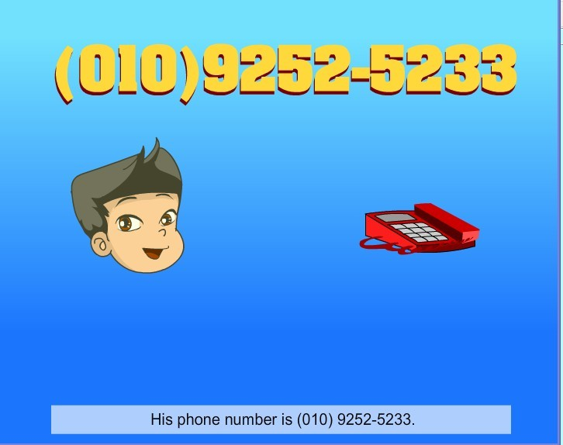
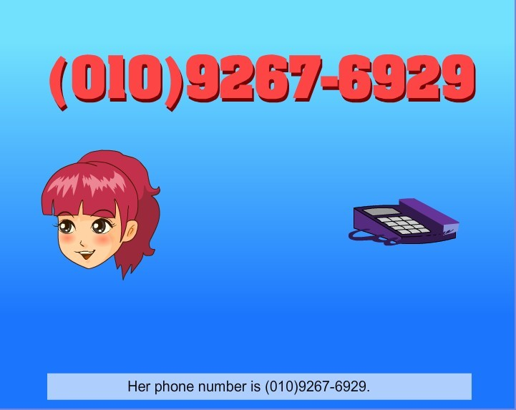
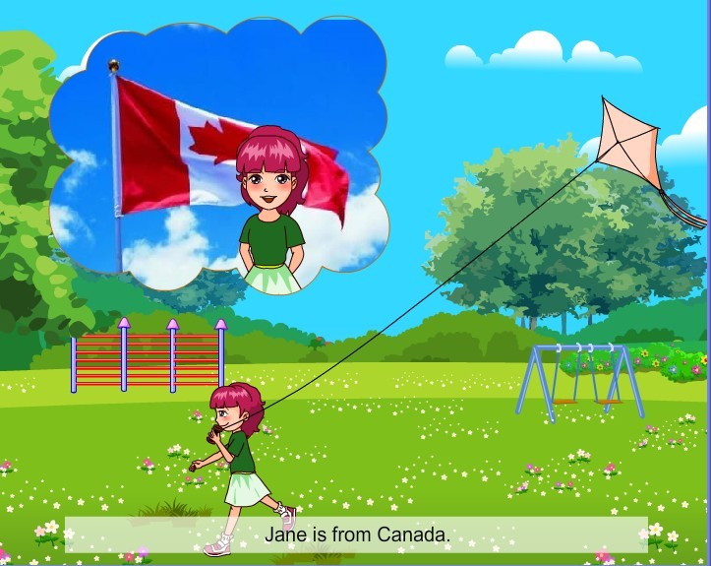
2 Read and understand

Slide 9
Name:
Age:
From:
Class:
Grade:
Phone number:
Jane
twelve
Canada
Four
Seven
(010)9267-6929

Slide 10
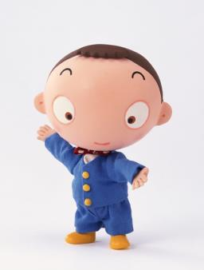
Huang Hua
Name:
Age:
From:
Class:
Grade:
Phone number:
twelve
China
Three
Seven
(010)9252-5233

Slide 11
Written work
3 Complete the passage with the information
on the name card. Pay attention to the capital letters.
Name: Bai Lili English name : Lily
Age: 13 From: Beijing
Class: Four Grade: Seven
Phone number: (010)6298-6575
ID number: 230123199812062261
School: Yuying Junior High School

Slide 12
Bai Lili is ______ Beijing. Her _______ name is Lily. She is________. Now she is in Yuying Junior High School. She is in _____ _____, ______ ______.Her _______ _______ is (010) 6298-6575. Her ID number is __________________.
from
English
thirteen
Class Four
Grade Seven
phone number
230123199812062261

Slide 13
4a
Grammar focus
Demonstrative Pronouns: this/that/these/those
Yes, it is. / No, it isn’t.
Yes, they are. / No, they aren’t.
It’s an eraser/a map.
They are books/apples.
Is this/that a/an ...?
Are these/those oranges?
What’s this/that in English?
What are these/those?
it’s = it is that’s = that is
name’s = name is you’re = you are

Slide 14
4b
Useful expressions
How old are you?
What class are you in?
What grade are you in?
How do you spell it?
Can you spell it, please?
Thank you. / Thanks.
I’m twelve, too.
I’m in Class Four, Grade Seven.
I’m in Grade Seven.
E-R-A-S-E-R, eraser.
Yes. M-A-P, map.
That’s OK. / You’re welcome.

Slide 15
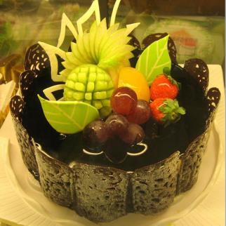
Fill in the blanks according to the pictures.
A： Excuse me. What’s this in English?
B: It’s a _____.
A： How do you spell it?
B: _________, ______.
A： Thank you.
B: _____ ________.
.
cake
C-A-K-E
cake
You’re
welcome

Slide 16
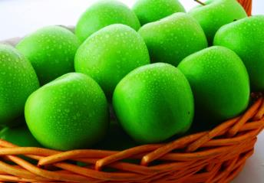
A：Are these apples?
B: ____ , ____ _____.
A：Thank you.
B: ______ __________.
A：Are those cars?
B: ____, ______ _______.
A：What are those in English?
B: _____ _____ ______.
Yes
they
are
You’re
welcome
No
they
aren’t
They
are
buses

Slide 17
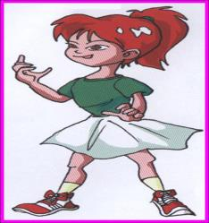
A：Look! Who’s that?
B: That’s _____ .
A：How old is she?
B: She is _____.
A：What class is she in?
B: She’s in ______ _______.
A：Thank you!
B: ______ ______ .
Jane
13
Class 1,
Grade 7
Name: Jane
Age: 13
Class: 1
Grade: 7
That’s
OK

Slide 18
Summary
在这个单元里，我们学到了什么？大家一起来总结一下。
音标：
2.词汇：
3.语法：
4.重点句子：

Slide 19
Homework
Read and write a passage.
Name: Li Ping
English name :David
Age: 12 Sex:man(男)
From: Shanghai
Class: 9 Grade: 7
School: Zhanjiang NO. 1 High School
Phone number: 0759-2322252

