Slide 1
Unit 8 Topic 2
The summer holidays are coming.
Section D
WWW.PPT818.COM

Slide 2
Grammar
want/plan/wish/hope/would like to
I want to go to Canada.
I plan to go to Australia.
I wish to travel around the country and take some pictures.
I hope to get together with them.
I'd like to visit some places of interest in China.

Slide 3
Make sentences
60
59
58
57
56
55
54
53
52
51
50
49
48
47
46
45
44
43
42
41
40
39
38
37
36
35
34
33
32
31
30
1
0
60
59
58
57
56
55
54
53
52
51
50
49
48
47
46
45
44
43
42
41
40
39
38
37
36
35
34
33
32
31
30
1
30
0
29
28
27
26
25
24
23
22
21
20
19
18
17
16
15
14
13
12
11
10
9
8
7
6
5
4
3
2
30
29
28
27
26
25
24
23
22
21
20
19
18
17
16
15
14
13
12
11
10
9
8
7
6
5
4
3
2
Make sentences with want/plan/wish/hope/would like to.
Start

Slide 4
Functions
What places should I visit in Yunnan?
You should visit Dali and Lijiang.
What should I take with me?
You should only drink safe water.
Don't go to dangerous places.
You shouldn't stay in the sun too long.
You'd better take a camera,a pair of sunglasses,a map and so on.
You shouldn't swim alone.

Slide 5
Make sentences
60
59
58
57
56
55
54
53
52
51
50
49
48
47
46
45
44
43
42
41
40
39
38
37
36
35
34
33
32
31
30
1
0
60
59
58
57
56
55
54
53
52
51
50
49
48
47
46
45
44
43
42
41
40
39
38
37
36
35
34
33
32
31
30
1
30
0
29
28
27
26
25
24
23
22
21
20
19
18
17
16
15
14
13
12
11
10
9
8
7
6
5
4
3
2
30
29
28
27
26
25
24
23
22
21
20
19
18
17
16
15
14
13
12
11
10
9
8
7
6
5
4
3
2
Make sentences with should/shouldn't/don't.
Start

Slide 6
Match the questions with the correct answers.
( )1.How is the weather in Wuhan in July?
( )2.What is the best time to go to Yunnan?
( )3.How was your trip to Lijiang?
( )4.Where did you go on holiday?
( )5.How did you travel to England?
C
A
E
B
D
A.Anything is OK.
B.Australia.
C.It's very hot.
D.By plane.
E.It was wonderful.

Slide 7
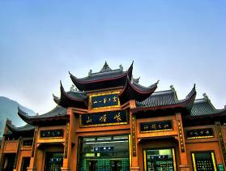
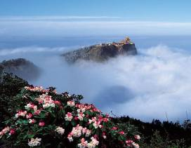
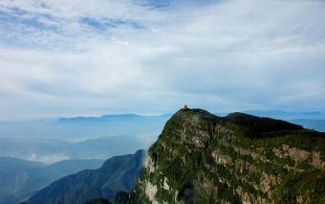
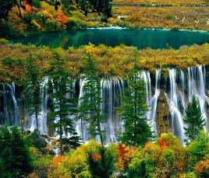
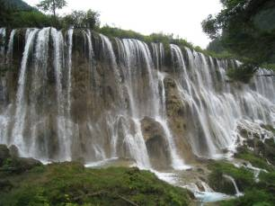
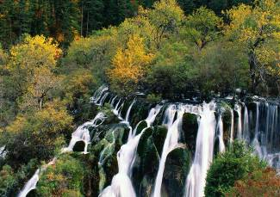
Do you know something about Sichuan?
Mount Emei
Jiuzhaigou
I went to Sichuan last year. And I arrived there by plane.

Slide 8
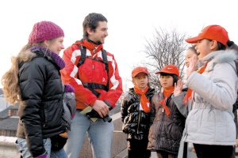
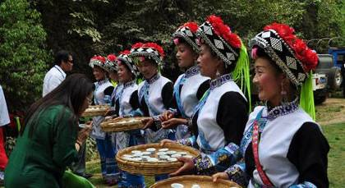
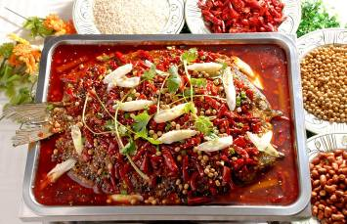
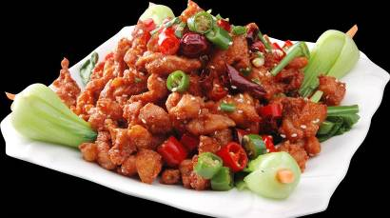
The people there were very friendly.
The food there was very hot and nice.

Slide 9
Read and complete the table.
Dear Cao Yan,
How are you doing? I had a wonderful trip in Sichuan. I arrived there by plane with my family on May 3rd. The weather was sunny and warm that day. I stayed there for only three days, but I had a good time. I visited some places of interest, such as Mount Emei and Jiuzhaigo. We also took some photos and enjoyed the delicious food. It was very hot and nice, and very different from our food. People there were very friendly and helped us find our way. We thanked them so much. We bougtht many gifts in the shops there. Guess what I bought for you!
Please give my love to your parents.
Yours,
Jack

Slide 10
Jack's Trip in Sichuan
Time
Weather
Places to visit
Food
People
from May 3rd to May 5th
sunny, warm
Mount Emei, Jiuzhaigou
hot and nice, delicious
friendly

Slide 11
Sharing Your Holiday Trip.
Suppose you are on holiday and making a trip to an interesting place. Write a postcard to a friend to tell him/her:
--where you are;
--who you went with;
--what the weather is like there;
--what you did there;
--how you went there;
--how you like your trip.

Slide 12
Summary
1.Useful expressions：
How are you doing?/How are you?
arrive in/at=get to 到达
be friendly to=be kind to 对某人友好
give one's love to sb.向某人问好
2.Review the expressions of talking about future plans and intentions.
I want to/plan to/wish to/ hope to/would like to...
3. Review the expressions of making suggestions.
You should.../You shouldn't...
You'd better.../Don't.../Remember to...

Slide 13
Homework
1. Review the key points of this topic.
2. Write a passage: My Holidays.
3. Finish Section D in your workbook.
4. Preview Section A of Topic 3 in Unit 8.

