Slide 1
七年级下册
Unit 4 After-school Activities
How was Your Weekend?
WWW.PPT818.COM

Slide 2
Aims
1.掌握一些与周末活动介绍有关的词汇：everybody,away， help ， sing .
2.运用所学知识介绍自己周末活动的情况。
3.让学生了解电子邮件的正确写法。
4.进一步掌握be going to 的用法。

Slide 3
Lead in
I had a great weekend. How about you?
Now let’s learn Lesson 24!
How was Danny’s weekend?
What did he do on the weekend?
What is he going to do next weekend?

Slide 4
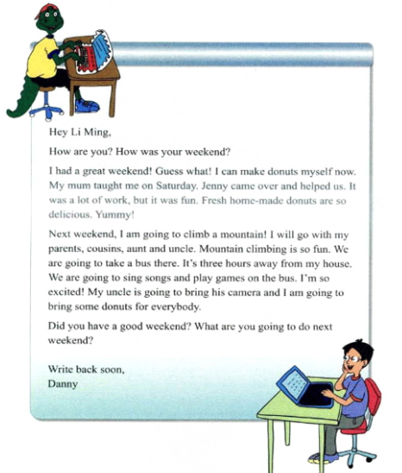
Presentation

Slide 5
Language points
1.We are going to take a bus there.
take a bus 意为“乘公共汽车”，表示使用某种交通工具有以下几种表达方式:
by +交通工具 by bike
by boat

Slide 6
Language points
take +冠词+交通工具
take a bus take the subway
in(on) +冠词/物主代词+交通工具
in a car on one’s bike /on a bike

Slide 7
Language points
2.My uncle is going to bring his camera….
bring为动词，意为“带来，拿来”，反义词为take也可表示“拿；取”，但用法有所不同，bring,take与fetch 所表示的物体离说话人的方向有所不同。

Slide 8
Language points
Eg：Bring me the book.
Bring the book to me.

Slide 9
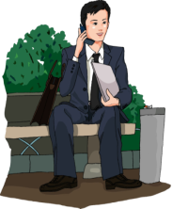
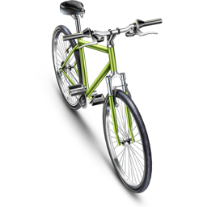
Language points
Who has taken my bike?

Slide 10
Language points
Please fetch me some paper.

Slide 11
Language points
be going to/will 的用法区别
be going to与will两者都可表示将要发生的事、将要去做某事,但它们有如下几点区别：
1.be going to 表示近期、眼下就要发生的事情,will 表示的将来时间则较远一些,如：He is going to write a letter tonight.
He will write a book one day.

Slide 12
Language points
2.be going to 表示根据主观判断将来肯定发生的事情,will表示客观上将来势必发生的事情.
He is seriously ill.
He is going to die.

Slide 13
Language points
3.be going to 含有“计划,准备”的意思,而 will 则没有这个意思,如：
She is going to lend us her book.

Slide 14
Language points
4.在有条件状语从句的主句中,一般不用 be going to,而多用will,如：
If you have any trouble,I'll stay with you and help you.

Slide 15
用所给词适当形式填空
Exercises
myself
1.I can make donuts (me)now.
go
2.Tom will (go)swimming sometime next week.
games
3.The children are playing (game) on the grass.

Slide 16
根据汉语完成句子
Exercises
1.从我家到公园有一个小时。
The park is one hour my house.
away from
2.我们度过了一个快乐的周末。
We had .
a great weekend
Mountain climbing
3.爬山是有趣的。 ________ is so fun.
4.他每天坐公交车上班。
He to work every day.
takes a bus
5.下周末你打算干什么？
What____ do next weekend?
are you going to

Slide 17
Homework
1.What are you going to do after school this week? Make up a dialogue.
2.Preview Unit 5 Lesson 25

