Slide 1
Module 3 Heroes
Unit 1 She trained hard, so she became a great player later.
WWW.PPT818.COM

Slide 2
新课导入
Words and expressions
思 考
prep. 包含；包括
n. 奖牌；奖章
v. 上(学)；出席；
参加(事件或活动)
adv. 在国外；到国外
再一次
n. 博士
n. 课程；学位
including
medal
attend
abroad
once again
doctor
degree

Slide 3
新课导入
Words and expressions
思 考
conj. 无论什么；不管什么
放弃（努力）
adj. 惊人的；极好的
n. 意志；决心
n. 成功；胜利
adv. 实在；的确
whatever
give up
amazing
will
victory
simply

Slide 4
新课导入
Who is your hero?
思 考
How do you define hero?
Or anybody else?

Slide 5
新课导入
a person who is admired for doing something extremely brave
思 考
英雄；勇士
hero
偶像
someone you admire very much for their intelligence, skill, etc

Slide 6
新课导入
What qualities do heroes have?
strong
generous
hard-working
Qualities
of heroes
brave
honest
warm-hearted
helpful
confident
kind
independent

Slide 7
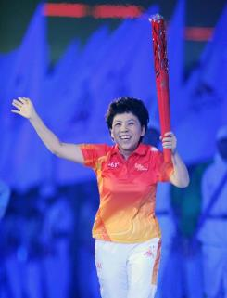
新课讲解
1
Work in pairs. Look at the picture and say who the person is and why she is famous.
1.Deng Yaping
2.February 5, 1973
3.Zhengzhou, Henan
4.a table tennis player
5.She won six world championships(冠军) and four Olympic championships between 1989 and 1997

Slide 8
新课讲解
2
Listen and choose the correct answer.
1 Who are the speakers?
a) A student and a teacher.
b) A person on the radio and a guest.
c) Two students.
2 Where are the speakers?
a) At a radio station. b) At home. c) In a classroom.
3 What are they talking about?
a) A famous person. b) A friend. c) A teacher.
b)
a)
a)

Slide 9
新课讲解
Tapescript:
Presenter: Hello, you’re listening to Our Heroes. Today, I have Zhao Ming with me, and we’re talking about Deng Yaping. Welcome, Zhao Ming. Why did you choose to talk about Deng Yaping?
Zhao Ming: Well, I love table tennis and Deng Yaping is my favourite table tennis player in China, so I chose her.
Presenter: What can you tell us about her life?
Zhao Ming: Well, she was born in 1973, and she was only 13 when she won her first national competition. She’s not tall, but her success made everyone in China very proud!

Slide 10
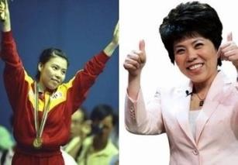
新课讲解
Who is the hero that is mentioned in the listening passage?
She is Deng Yaping.
She is one of the greatest table tennis players in the world. She is also a successful woman in other areas.

Slide 11
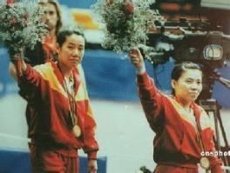
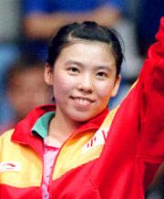
新课讲解
She won her first world championship title with Qiao Hong in 1989.
She won a gold medal in both the singles and doubles competitions at the 1992 Olympics in Barcelona, Spain.

Slide 12
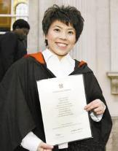
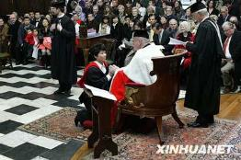
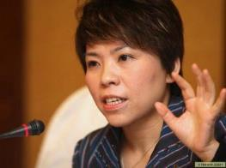
新课讲解
She received a doctor’s degree from Cambridge University in 2008.
She was making a speech for the bid for the 2008 Olympic Games.

Slide 13
新课讲解
Let’s talk
1.Describe your hero and let your partner guess who he/she is.
2.Two persons are talking about hero. Listen and read. Finish the following exercises.

Slide 14
新课讲解
3
Listen and read.

Slide 15
新课讲解
Task 1
Read and answer the questions.
1. Who is Daming’s hero?
2. Why does Daming choose her to be his hero?
3. What competitions has she won?
Deng Yaping
Because Deng Yaping is one of the best table tennis players in the world, and Daming loves playing table tennis.
She’s won many world competitions, including four gold medals in the Olympics.

Slide 16
新课讲解
Task 2
Now complete the table.
Facts about Deng Yaping
When she was five, | she__________________________.
When she was twenty-four, | she_________________________.
After she stopped playing, | she began to ______________________ in Beijing.
After seven years’ study abroad, | she__________________________________________________________________.
started playing table tennis
stopped playing
study at Tsinghua University
completed her doctor’s degree at Cambridge University

Slide 17
新课讲解
Task 3
4
Complete the sentences so that they are true for Deng Yaping.
1 She says she is not _______________________.
2 She has a very __________________________.
3 She helped _____________________________
________________________.
4 Whatever she does, she ___________________.
cleverer than anyone else
strong will
make the Beijing Olympics a
victory for world sport
never gives up!

Slide 18
新课讲解
Task 4
5
Complete the passage with the correct form of the words in the box.
abroad attend clever victory will
Deng Yaping is Daming's hero. At first, she was a table tennis player. Later, she (1)__________ Tsinghua University and then went to study (2)________. She says she is not (3)________ than anyone else, but she has a very strong (4)________. She also helped make the Beijing Olympics a(n) (5)________ for world sport. She is a true hero.
attended
abroad
cleverer
will
victory

Slide 19
新课讲解
Language point
1. She’s won many world competitions, including four gold medals in the Olympics.她在很多世界级比赛中获胜，包括获得四块奥运会金牌。
including 作介词，和后面的名词/代词构成介宾短语，意思是“包括……在内”。

Slide 20
新课讲解
Language point
→知识归纳：including作介词，后接宾语。included作后置定语，需在其前面加中心词。
例如：
（用including或者included填空）
① We all went to the zoo, __________ Tom.
我们都去了动物园，包括汤姆。
② We all went to the zoo, Tom __________.
我们都去了动物园，包括汤姆。
including
included

Slide 21
新课讲解
Language point
2. Whatever she does, she never gives up! 无论她做什么，她永不放弃。
(1) whatever作连词，意为“无论什么；不管什么；无论如何”，相当于no matter what, 引导让步状语从句。
_________difficulty she may meet, she will overcome it.无论遇到什么困难，她都会克服。
=________ _______ ______ difficult she may meet, she will overcome it.
Whatever
No matter what

Slide 22
新课讲解
Language point
【拓展】类似的合成词还有：
wherever=no matter where无论哪里
however=no matter how不管怎样
whenever=no matter when 无论何时
whoever=no matter who 无论谁
e.g.I’ll never forget you ________ you go .
= I’ll never forget you ____ ______ ______ you go. 无论你去哪里，我都不会忘记你。
wherever
no matter where

Slide 23
新课讲解
Listen and mark the pauses.
6
∕
1. She’s my hero because she’s one of the best table tennis players in the world.
2. She started playing table tennis when she was five.
3. Whatever she does, she never gives up!
4. Deng says that she isn’t cleverer than anyone else, but she has a very strong will.
∕
∕
∕
Now listen again and repeat.

Slide 24
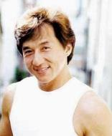
新课讲解
Work in pairs. Talk about your heroes.
7
Work in pairs. Talk about your heroes.
A：Who's your hero?
B：It's Jackie Chan!
A：Why?
B：Because he's a great film star. I think his films are
fantastic!
Now talk about each other's heroes with the whole class.
My friend Jim likes Jackie Chan best. Jackie Chan is his hero because he's a great film star and his films are fantastic.

Slide 25
当堂小练
一、根据句意及首字母提示补全单词
1. He mistook the time and did not a the meeting.
2. W we do，we must be careful.
3. (嘉兴改编）Today some students choose to study
a for further education.
4. He tried hard to finish his doctor's d in Peking
University.
5. Work hard，and the v will be ours.
ttend
hatever
broad
egree
ictory

Slide 26
当堂小练
二、单项选择
6. happens，the first important thing is to keep
calm.
A. Who B. Whenever C. Whatever D. Whichever
7. (海南）No matter how hard it is， don't .
Things will be better in the future.
A. give out B. give up C. give away
C
B

Slide 27
当堂小练
8.（中考·宁波）Jenny，you should practice as often as you can the piano competition.
A. fail B. to fail C.win D. to win
Sally chose badminton with me because we
have the same skill in it.
A. play B. playing C. to play D. played
10.（中考·佛山）I am writing to you I'm afraid to talk about it face to face.
A. because B. though C. until
D
C
A

Slide 28
当堂小练
三、根据汉语完成句子
11. 他种花和蔬菜。
He grows flowers ________ _______ ________ vegetables.
12.你如果想学好英语，不要放弃。
If you want to learn English well，don't ________
________ .
13.这首歌很好听，你能再唱一遍吗？
The song sounds beautiful. Could you sing it
________ ________.
as well as
give
up
once again

