Slide 1
Unit 1 Countries
I’m from Britain.
WWW.PPT818.COM

Slide 2
Welcome back to school! （欢迎返校！）

Slide 3
Let’s ask him some questions!
（我们来通过提问了解他吧！）
What’s your name?
How old are you?
What’s your hobby?
What’s your favourite food?
What season do you like?
…

Slide 4
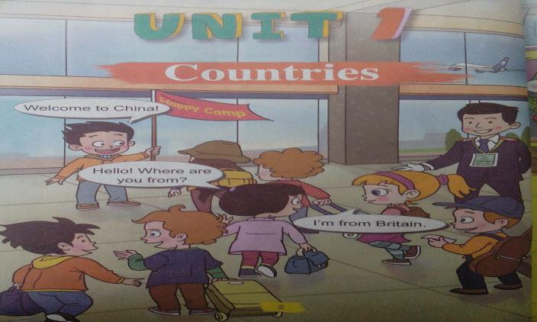
Li Ming has some new friends, too.

Slide 5
Who are they? Watch and match.
Mary
Jim
Mike

Slide 6
Who are they? Let’s match.
Mary
Jim
Mike

Slide 7
Watch and choose.
: Where are you from?
: I’m from _______.
A. the U.S.
B. Canada

Slide 8
Let’s choose.
: Where are you from?
B
: I’m from _______.
A. the U.S.
B. Canada
（加拿大）

Slide 9
Let’s sing.
Hello! Hello!
Where are you from?
Where are you from?
Where are you from?
Hello! Hello!
Where are you from?
I’m from Britain.
the U.S.
Canada
China

Slide 10
Listen and repeat.
Pay attention to your pronunciation and intonation.
（听录音、跟读，注意语音语调。）

Slide 11
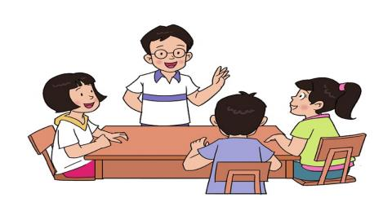
Group work: Role play.
（小组内分角色朗读并试着表演。
小组长要尽快用英语分配角色呦！）

Slide 12
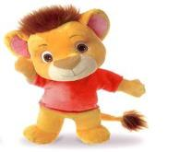
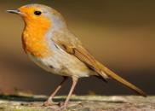
Let’s meet more friends.

Slide 13
——Where are you from?
——I’m from the U.S. I love my country.

Slide 14
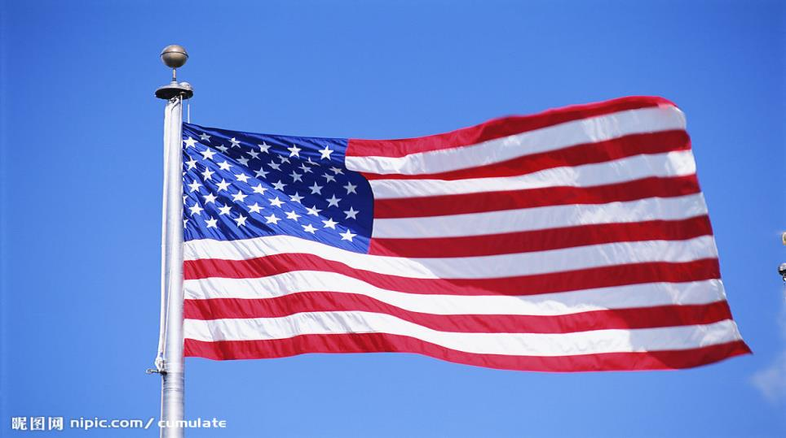
the U.S.

Slide 15
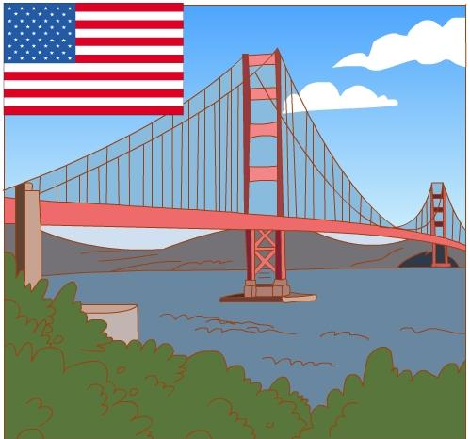
the U.S.
金门大桥

Slide 16
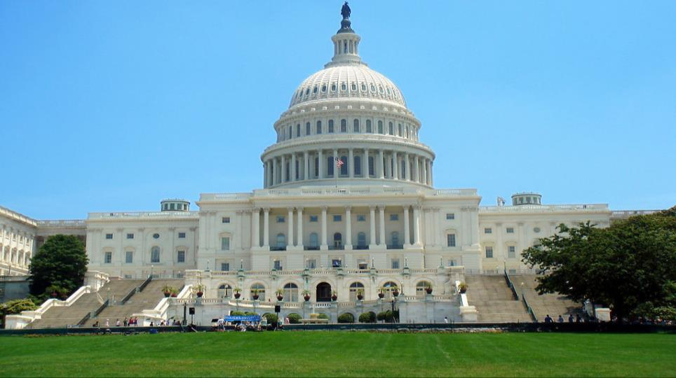
the U.S.
白
宫

Slide 17
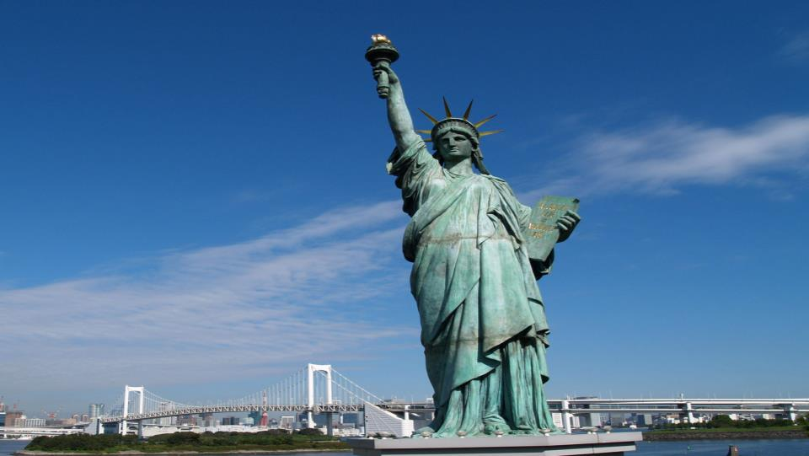
the U.S.
自由女神像

Slide 18
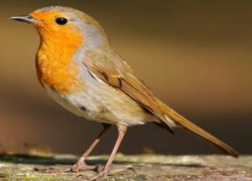
——Where are you from?
——I’m from Britain. I love my country.

Slide 19
Britain

Slide 20
Britain
伦敦桥

Slide 21
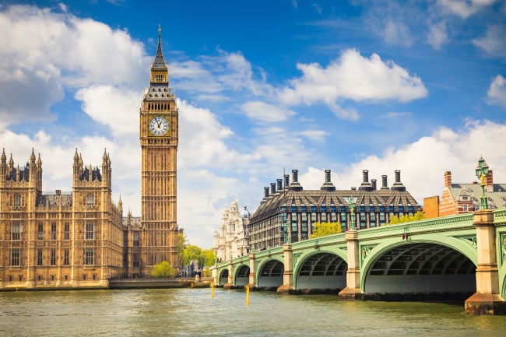
Britain
大本钟

Slide 22
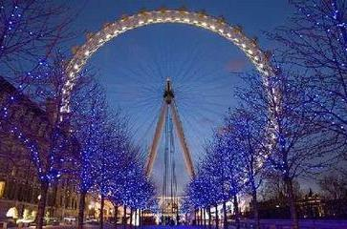
Britain
伦敦眼

Slide 23
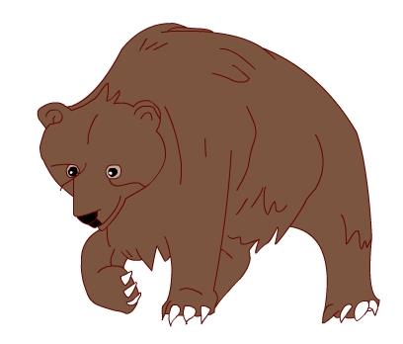
——Where are you from?
——I’m from Canada. I love my country.

Slide 24
Canada

Slide 25
Canada
枫林大道

Slide 26
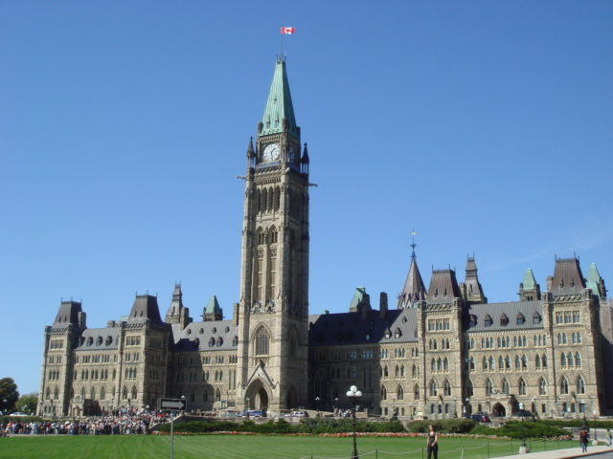
Canada
国会大厦

Slide 27
Canada
国家电视塔（CN塔）

Slide 28
——Where are you from?
——I’m from China. I love my country.

Slide 29
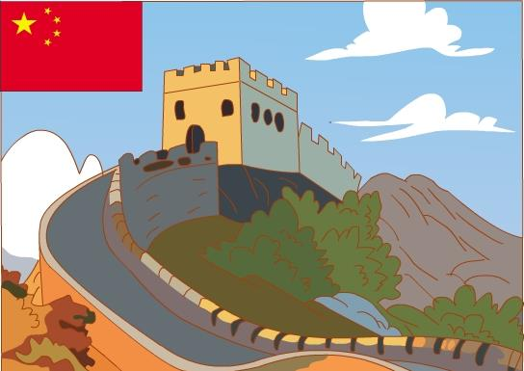
China

Slide 30
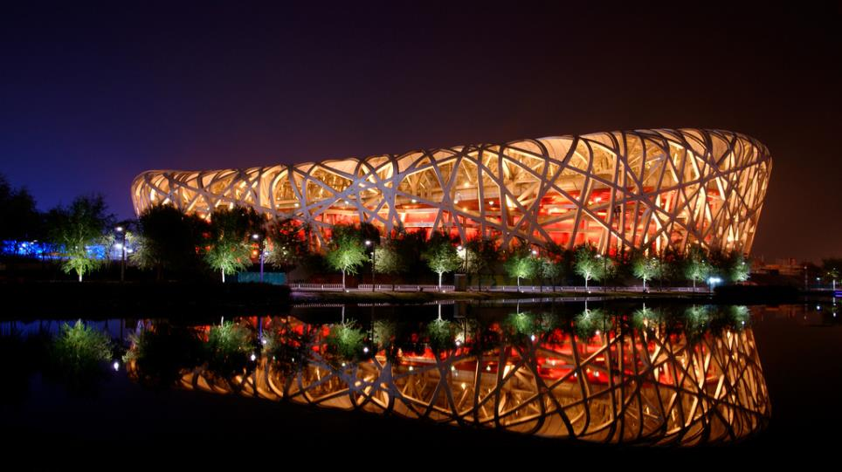
China
鸟巢

Slide 31
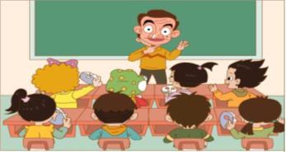
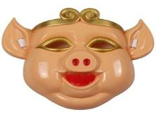
Group work: Act, ask and answer.
（用你准备的面具或手偶等在小组内做角色扮演，问答国籍）
---Hello!
---Hello! What’s your name?
---I’m...
---Where are you from?
---I’m from ...

Slide 32
Homework
Listen and repeat for 3 times.
（听课文录音，模仿跟读3遍）
2. Draw the national flags we learned today and write their names.
（画一画今天学过的国家的国旗，并写上国家名称）

