Slide 1
Unit 1 Winter Holidays
I didn’t ski
WWW.PPT818.COM

Slide 2
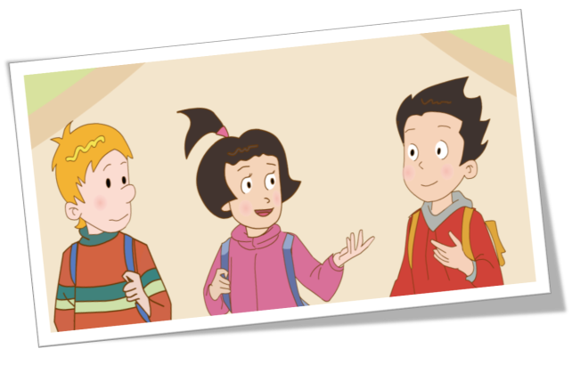

Slide 3
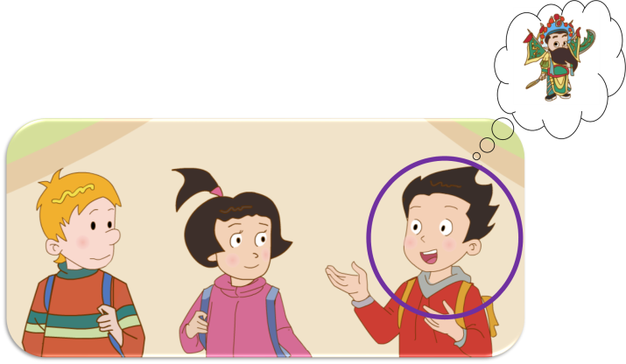
I learned Beijing Opera.
It’s a little difficult.

Slide 4
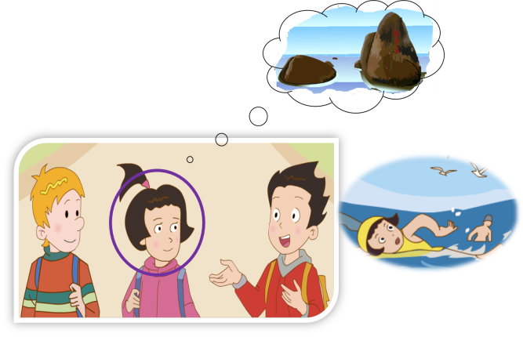
I went to Hainan.
I had a good time.

Slide 5
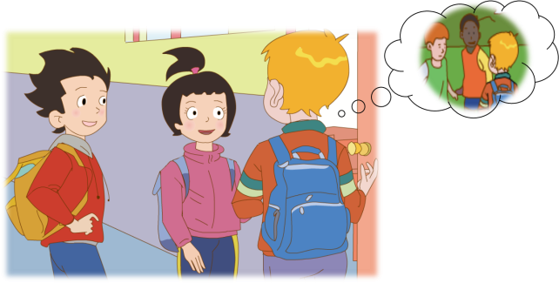
I went back to Canada.
I visited my friends and took many pictures.

Slide 6
Where did Peter take the pictures ?

Slide 7
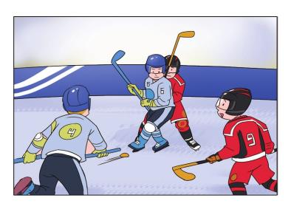
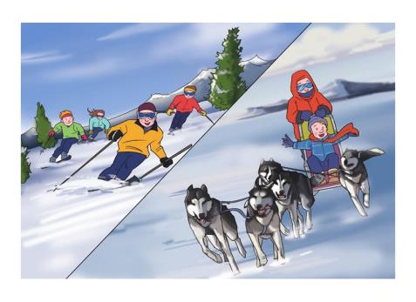
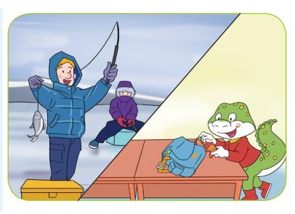
Ottawa

Slide 8
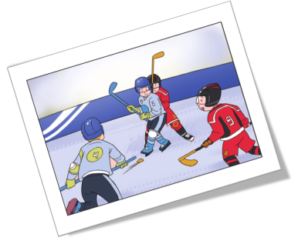
What sport is this ?
ice hockey
It’s ___________.
Where is Peter?
behind
I’m here, _______ the tall boy.
Ice hockey is my favourite
sport. I played it with my friends.

Slide 9
ski
I didn’t ski.
I took pictures for them.

Slide 10
dog sledding
I went dog sledding with my dad.

Slide 11
ice fishing
I also went ice fishing on the lake.
And I got a big fish.

Slide 12
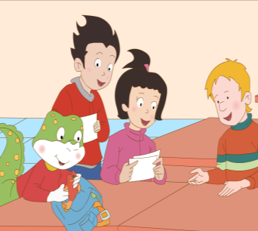
I didn’t go ice fishing, but I got a fish, too.

Slide 13
Thank You

