Slide 1
Unit 1
Goldilocks and the three bears
第一课时
WWW.PPT818.COM

Slide 2
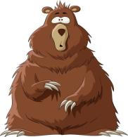
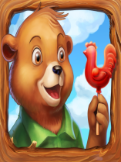
Introduce
There is a house in the forest.
There is some soup on the table.
There are three beds in the room.
This soup/bed is too hot/cold/hard/soft.
There is···in the forest.
There is···on the table.
There are···in the room.
This···is too···

Slide 3
Words
Afraid /əˈfreɪd/
形容词，表示“害怕的；恐怕；担心的”
常用短语：I ‘m afraid 我害怕；恐怕
afraid of 害怕
eg：I'm afraid this task is beyond me.
A
小练习：( ) I was ____ that nobody would believe me.
A. afraid B. afraid of C. afraids

Slide 4
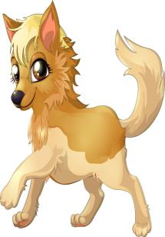
Expressions
There‘s a man at the door. 门口有个人 。
There be 是英语中常用句型， 表示“有”。
PPT模板：www.1ppt.com/moban/ PPT素材：www.1ppt.com/sucai/
PPT背景：www.1ppt.com/beijing/ PPT图表：www.1ppt.com/tubiao/
PPT下载：www.1ppt.com/xiazai/ PPT教程： www.1ppt.com/powerpoint/
资料下载：www.1ppt.com/ziliao/ 范文下载：www.1ppt.com/fanwen/
试卷下载：www.1ppt.com/shiti/ 教案下载：www.1ppt.com/jiaoan/
PPT论坛：www.1ppt.cn PPT课件：www.1ppt.com/kejian/
语文课件：www.1ppt.com/kejian/yuwen/ 数学课件：www.1ppt.com/kejian/shuxue/
英语课件：www.1ppt.com/kejian/yingyu/ 美术课件：www.1ppt.com/kejian/meishu/
科学课件：www.1ppt.com/kejian/kexue/ 物理课件：www.1ppt.com/kejian/wuli/
化学课件：www.1ppt.com/kejian/huaxue/ 生物课件：www.1ppt.com/kejian/shengwu/
地理课件：www.1ppt.com/kejian/dili/ 历史课件：www.1ppt.com/kejian/lishi/
（1）当名词是单数可数名词或不可数名词时， 用is.
当名词是复数的可数名词时，用are.
eg: There is some apple juice in the bottle.
There are some strangers in the street.

Slide 5
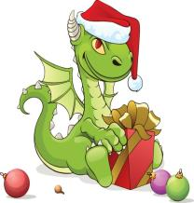
Expressions
(2)如果There be 后面是几个并列名词做主语时，动词be的形式和最靠近它的那个名词保持数的一致。[就近原则]
eg: There is an ashtray and two bottles on the shelf.
There are two bottles and an ashtray on the shelf.
(3)如果主语是复数名词，却表示一笔金额或一个总数或表达一个单个概念时，则仍用单数形式。
eg: There is five hundred dollars to pay.
There is duck and green vegetables for supper.

Slide 6
Expressions
(4) There is(was)+no +动词 ing = It is(was) impossible to +动词原型。
eg: There is no going home. = It is impossible to go home.
(5) There be 后面的名词是句子的主语，属倒装结构。因此要表达
“某个地方或某个时间存在什么事物或人”的时候常用“There be + 名词+ 地点（时间）”这一句型。
eg:There are lots of people there who can actually help you.

Slide 7
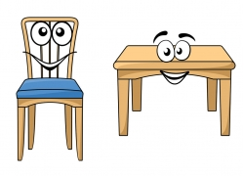
Dialogue
Talk about your classroom using“There is/are…”.

Slide 8
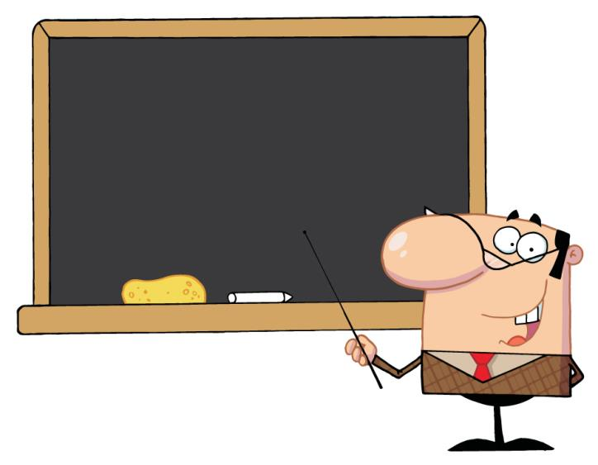
Summary
afraid
There is/are···

Slide 9
Expand
Little Red Riding Hood
Little Red Riding Hood is a lovely girl. She likes red hats. So her mother calls her little Red Riding Hood.
Her grandma loves her very much. But now she is ill. Her mother is busy. So she asks little Riding Hood to see her grandma.
In the forest, a wolf sees little Red Riding Hood, “Look, and little Riding Hood. I have children for lunch; the path goes to her grandma’s house.”
The wolf comes to grandma’s house and eats grandma. Then he wears grandma’s glasses and clothes, and in her bed.

Slide 10
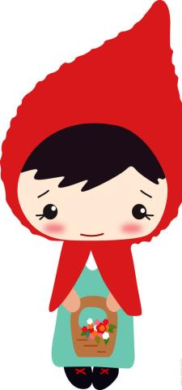
Expand
小红帽
小红帽是一个可爱的女孩。她喜欢红帽子，于是她妈妈就叫她小红帽。
她的祖母很爱小红帽，但现在她生病了。小红帽的妈妈非常忙，所以她让小红帽去看望祖母。在森林里，一只狼看见了小红帽。“瞧啊！小红帽。午餐有小孩子可以吃啦！这是一条去她祖母家的路。” 狼来到了祖母家并吃掉了祖母。然后他戴上祖母的眼镜，并穿上祖母的衣服并睡在祖母的床上。

Slide 11
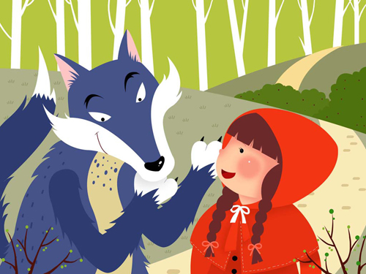
Expand
After a while, little Red Riding Hood comes to grandma’s bed. To her surprise, grandma’s mouth is very big. So she asks: “Grandma, why is your mouth so big?”
“I eat little girls with this mouth.” And he rushed at little Red Riding Hood.
“Help! Help!” The wolf runs after little Red Riding Hood. At this time, a hunter passes through the house. He shoots the wolf and saves little Red Riding Hood. Then he cuts the wolf and grandma comes out.

Slide 12
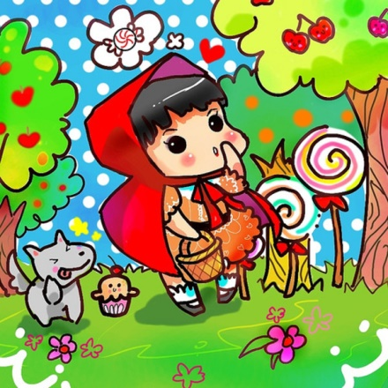
Expand
过了一段时间，小红帽来到了祖母的床前，使她吃惊的是祖母的嘴巴非常大。于是她问：“祖母，为什么你的嘴巴这么大？”“用它来吃小女孩。”狼说这就扑向小红帽。
“救命，救命！狼追着小红帽。正在此时，一个猎人路过这儿，他用枪打死了狼并救出小红帽；然后他剥开狼的肚子，救出祖母。”

Slide 13
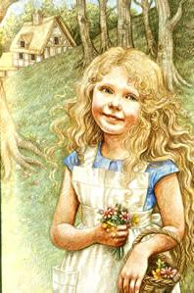
Exercise
（）1、There____ a boy in the room.
A. is B. are C. am
（）2、There____ two bears in the forest.
A. is B. are C. am
（）3、There____ some soup on the table.
A. is B. are C. am
A
B
A

Slide 14
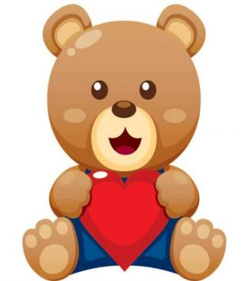
Exercise
1、This soup is too cold.
___________________________
2、What a beautiful girl!
___________________________
3、There are four apple trees in front of the house.
___________________________
这汤太凉了。
真是一个漂亮的女孩！
在房子前面有四棵苹果树。

Slide 15
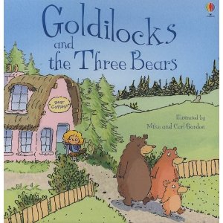
Exercise
4、This bed is too soft.
___________________________
5、I’m hungry and thirsty.
___________________________
这床太软了。
我又饿又渴。

Slide 16
Exercise
（ ）This soup is too hot.
（ ）What a beautiful house.
（ ）This bed is just right.
（ ）There are three bears in front of her!
（ ）This soup is just right.
（ ）Help! Help!
2
1
4
5
3
6

Slide 17
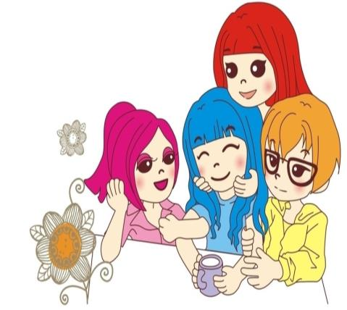
Homework
A group of four students adapts a story.

