Slide 1
Unit 7
Films
Reading 2
WWW.PPT818.COM

Slide 2

Objectives
To get some idea about the life of Audrey Hepburn
To learn to describe your favorite person
To master the words and phrases in this text

Slide 3
Words review
all-time
actress
dancer
lead
role
mark
lifetime
adj. 一向的，空前的
n. 女演员
n. 舞蹈者
n. 主角，扮演主角的演员
n. 角色
vt. 表明，标志
n. 终身，一生

Slide 4
Words review
final
peacefully
catch one’s attention
play a role of
pass away
adj. 最终的，最后的
adv. 宁静地，和平地
吸引某人的注意
扮演……的角色
（委婉语）去世

Slide 5

Think about it!
1. Can you tell me something
about your favourite film stars?
2. How much do you know about
Audrey Hepburn?

Slide 6

A topic 电影 films
要点：
1.奥黛丽·赫本（Audrey Hepburn) 不仅仅在美国，
而且在世界上的其他地方都很著名；
2.赫本生于1929年；1953年被选在电影《罗马假日》
中担任女主角，扮演年轻的公主；影片大获成功，赫本
因在该片中的这个角色而赢得了奥斯卡最佳女主角奖；
3.她把许多时间贡献给了慈善事业；赫本于1993年逝世。
Audrey Hepburn is famous not only in the USA ,but also in other parts of the world. Hepburn was born in 1929.In 1953, she was chosen to play the lead role of a young princess in the film Roman Holiday .The film was a big success .Hepburn won an Oscar for Best Actress for her role in the film . She devoted much of her time to charity.
Hepburn died in 1993.

Slide 7
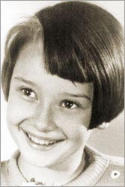
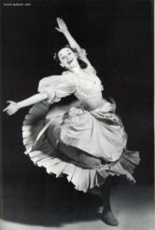
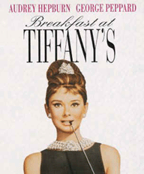

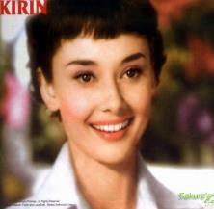
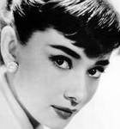
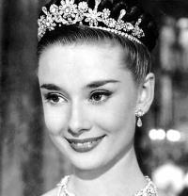
A great beauty

Slide 8
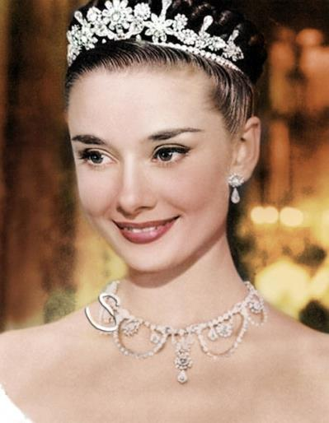
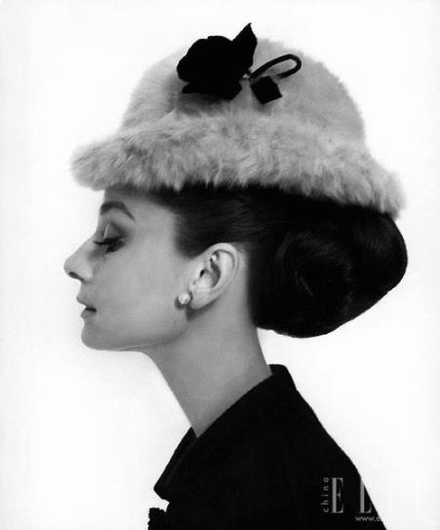

Slide 9
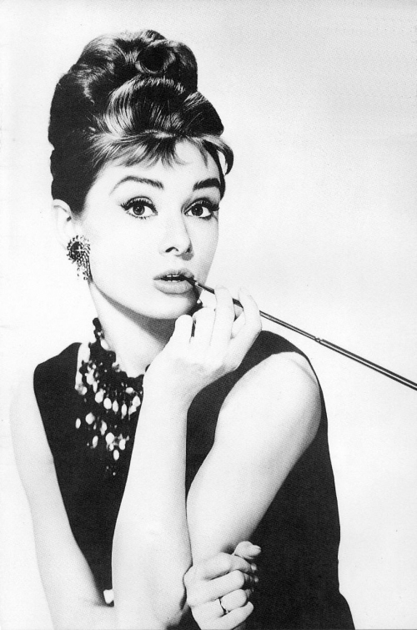
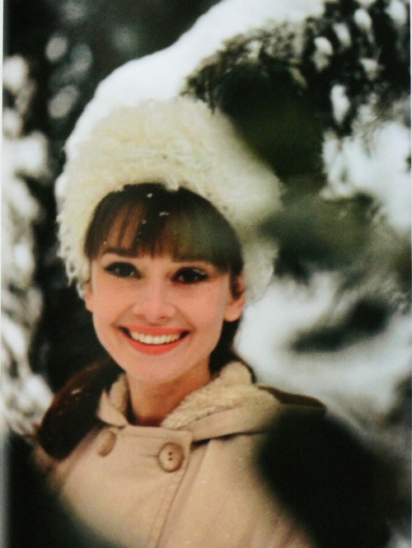

Slide 10
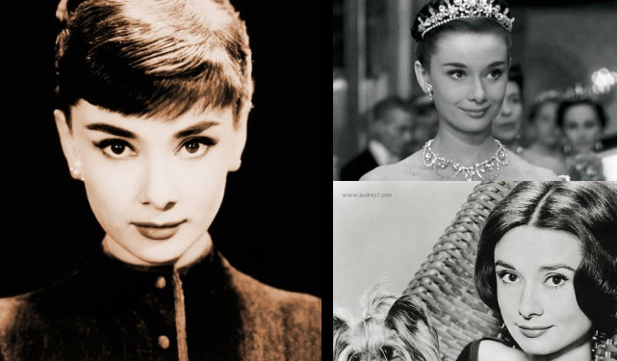

Slide 11
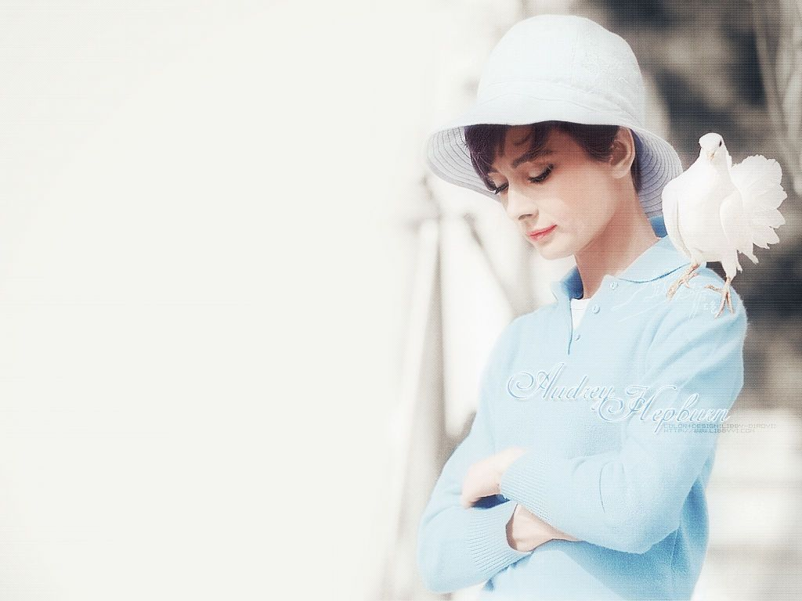

Slide 12
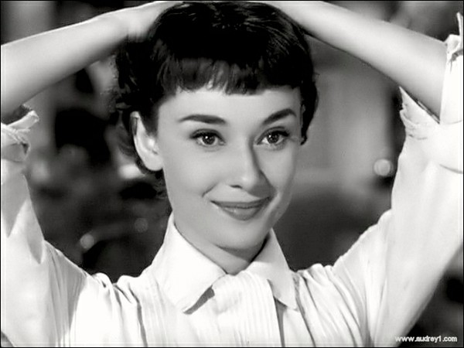

Slide 13
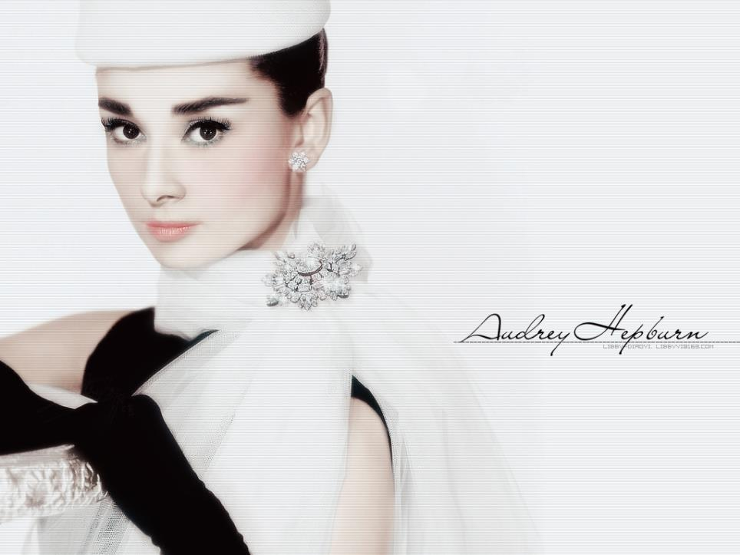
Audrey Hepburn
奥黛丽·赫本

Slide 14
A Kitty's favourite film star
Kitty's favourite film star is Audrey Hepburn. She has found an article about this international superstar in a magazine. Here is the article.

Slide 15
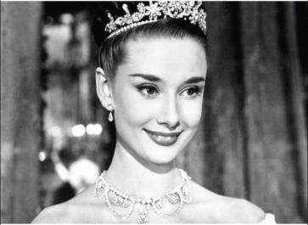
Hollywood’s all-time best —
Audrey Hepburn
Audrey Hepburn is one of Hollywood’s all-time greatest actresses. When she died in 1993,
the world felt very sad about the loss of a great beauty, a great actress and a great humanitarian.

Slide 16
Hepburn was born in Belgium on 4 May 1929. As a child, she loved dancing and dreamt of becoming a successful ballet dancer. After World War II, she moved to London with her mother. She worked as a model before becoming an actress.
In 1951, while acting in France, Hepburn met the French writer Colette.

Slide 17
Hepburn’s beauty and charm caught the writer’s attention. Colette insisted that Hepburn was the perfect girl for the lead role in Gigi, a play based upon her novel, although Hepburn had never played any major roles before. That event marked the beginning of her successful career.
Two years later, Hepburn was chosen to play the lead role of a young

Slide 18
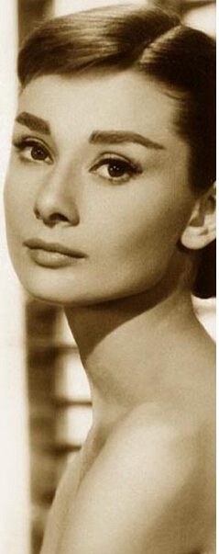
princess in the Hollywood film Roman Holiday. It was a big success and Hepburn soon became world-famous. She won the Oscar for Best Actress for her role in this film that year.
During her lifetime, Hepburn had four more Oscar nominations. In 1989, Hepburn made her final

Slide 19
appearance in the film Always and played the role of an angel.
Hepburn’s achievements went beyond the film industry. She began to work for UNICEF in the 1950s. Hepburn spent her last few years working closely with UNICEF so that she could help poor children in

Slide 20
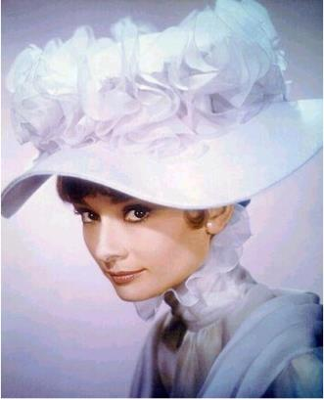
different parts of the world. She won many awards because of her efforts in this area.
In 1991, Hepburn discovered that she had cancer. On 20 January 1993, she passed away peacefully in her sleep.

Slide 21
Read and answer.
1. When and where was Audrey Hepburn born?
She was born in Belgium on 4 May 1929.
2. What did Hepburn dream of when she was a child?
She dreamt of becoming a successful ballet dancer.
3. What event marked the beginning of Hepburn’s successful career?
Playing the lead role in Gigi.

Slide 22
4. What film won her the Oscar for
Best Actress?
Roman Holiday.
5. What charity did Hepburn work
closely with in the last few years of
her life?
UNICEF.
6. When did Audrey Hepburn pass
away?
On 20 January 1993.

Slide 23
Structure of the text
Part 1: (Paragraphs 1-2)
Before Hepburn entered the film industry
Part 2: (Paragraphs 3-5)
Hepburn’s acting career
Part 3: (Paragraphs 6-7)
Hepburn’s achievements beyond the film industry and her death

Slide 24

According to the pictures and the expressions given below, retell the life of Audrey Hepburn.

Slide 25
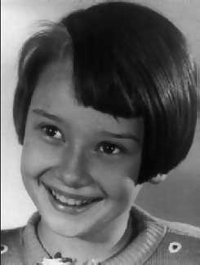
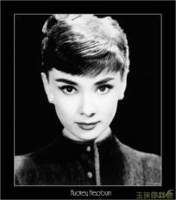
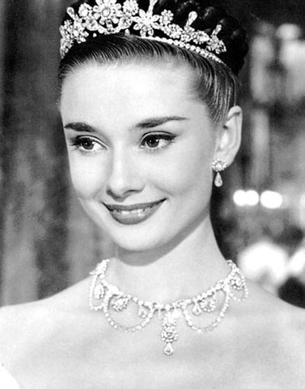
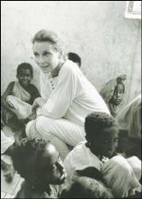
Hepburn’s whole life
(Her early life)
Hepburn was born in Belgium
on 4 May 1929.
(Her acting life)
(Her later life)

Slide 26
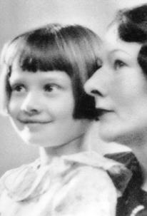
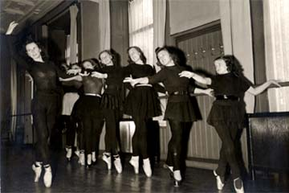
Her early life
She loved dancing and her dream was to …

Slide 27
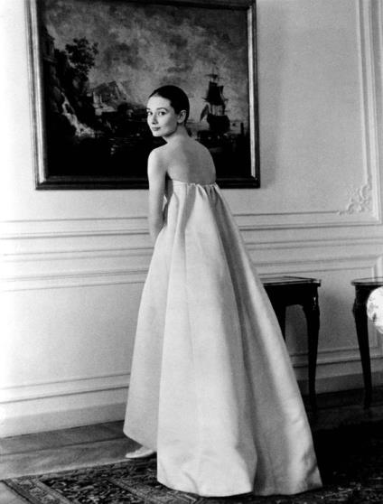
She worked as a model before becoming an actress

Slide 28
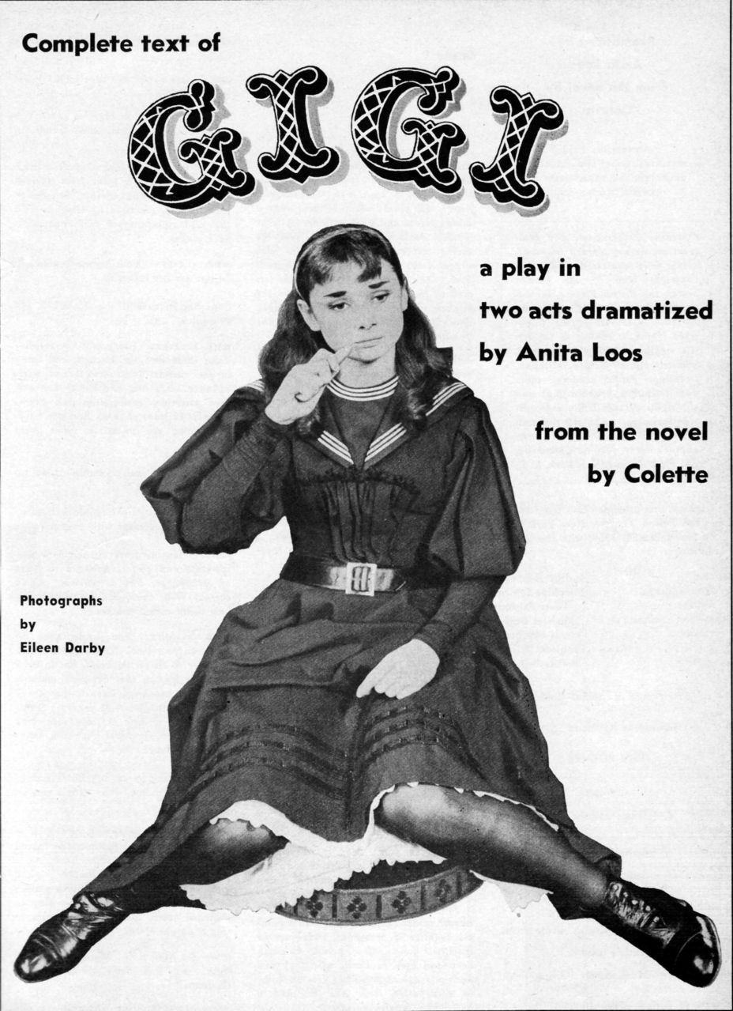
Her acting life
In 1951, while acting …, Hepburn met …
Hepburn’s beauty and charm …
Colette insisted that …
That event marked the beginning of Hepburn’s successful career.

Slide 29
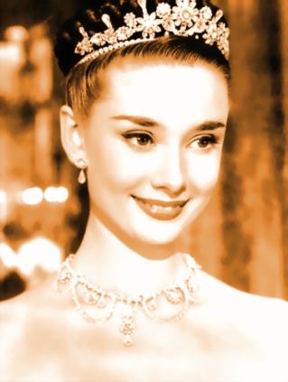

Two years after, Hepburn was chosen to play the lead role of a young princess in the Hollywood film
Roman Holiday.
Roman Holiday
罗马假日

Slide 30
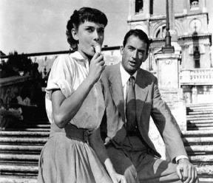
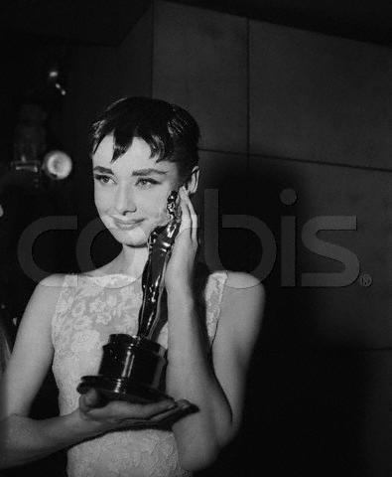
It was … and Hepburn soon became world-famous.
She won …for
Best Actress for her role in this film that year.

Slide 31
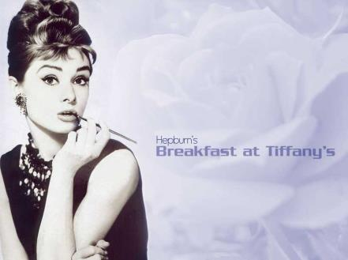
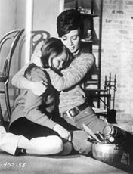
During her lifetime, Hepburn had four more Oscar nominations.
Breakfast at Tiffany’s蒂凡尼的早餐
Wait Until Dark
盲女惊魂记

Slide 32
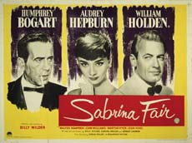
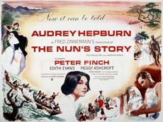
Four Oscar Nominations
Sabrina
龙凤配
The Nun's Story
修女传

Slide 33

In 1989, Hepburn made her final appearance in the film Always and played the role of an angel.

Slide 34
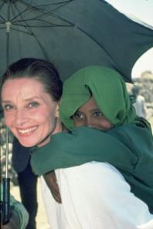
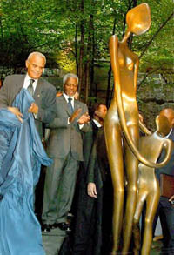
Her later life
Hepburn’s achievements went beyond
the film industry.
Hepburn spent her last few years … She won many awards because of….

Slide 35
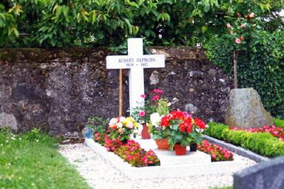
In 1991, Hepburn discovered that she had cancer.
On 20 January 1993, she passed away peacefully in her sleep.

Slide 36
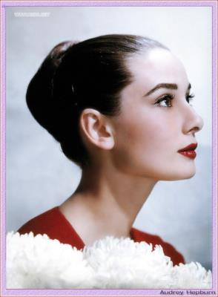
When Hepburn died, the world felt very sad about the loss of a great beauty, a great actress and a great humanitarian.

Slide 37
Remember, if you ever need a helping hand, you’ll find one at the end of your arm.
如果你在任何时候需要一只帮助之手, 你可以在你自己的手臂下面找到它。
As you grow older you will discover that you have two hands; one for helping yourself, the other for helping others.
随着年龄的增长, 你会发现你有两只手： 一只用来帮助自己, 另一只用来帮助别人。
感悟!

Slide 38
‘The beauty of a woman is not in a facial mode, but the true beauty in a woman is reflected in her soul. It is the caring that she lovingly gives, the passion that she shows.’
女人的美丽不是体现在脸上，真正的美丽体现在她的灵魂。真正的美是她的亲切关怀与满腔热情。
It was written by the late educator-humorist Sam Levinson for his grandchild and read by Audrey Hepburn on Christmas Eve, 1992. It was also used by Ms. Hepburn on occasion when she was asked for beauty tips.

Slide 39
Language points

Slide 40
1. Hepburn’s beauty and charm caught the writer’s attention. =
The writer was attracted by Hepburn’s beauty and charm.
sth. catch sb’s attention.
吸引或引起某人的注意
Her sweet voice caught others’ attention.
她甜美的声音引起了人们的注意。

Slide 41
2. Colette insisted that Hepburn was the perfect girl for the lead role in Gigi.
insist that 表示“坚持认为，坚持宣称”时，从句 时态与主句相同。若表示“坚决要求”时，从句用(should)+do sth.
那个男子坚持说他不在那里。
The man insisted that he was not there.
他坚持要求我们必须5点前完成工作。
He insisted that we should finish the work before 5 o’clock.

Slide 42
insist on sth./doing sth.
他坚持要把他的照片给我看。
He insisted on showing me his pictures.

Slide 43
3. Hepburn’s achievements went beyond the film industry.
go beyond 超过，胜过
这件工作非我力所能及。
This job goes/is beyond my ability.
这篇文章超出了我的理解力。
The article goes/is beyond my understanding.
go beyond the limit 超过限度
go beyond one's duty in doing sth.
超越职权范围做某事
go beyond everything 超越一切

Slide 44
4. UNICEF 联合国儿童基金会
United Nations International Children’s Emergency Fund
5. pass away 委婉语，表示“去世”
昨天，那位著名的数学家去世了。
That famous mathematician passed away yesterday.

Slide 45

Let the word fly
What’s the meaning of ‘act’ in each
sentence? Guess!
The time for thinking is over, now we
have to act.
Don’t act like a child! You are an adult
(成年人).
It takes a couple of minutes for the drug
to act.
Andy Lau acts very good in the movie
Shaolin Temple.
vi. 采取行动
vi. 举动，表现
v. 起作用
v. 演出，表演

Slide 46
What’s your first act when going home?
Hamlet eventually kills the king in Act 5.
They used to do a comedy act together.
n. 行动，行为，举动
n. （舞台剧，歌剧等的）一幕
n. （戏剧，马戏等的）一段表演
Flying ‘act’
action n. 行动，活动，行为，运转
acting n. 表演，演技
actor n. 男演员 actress n. 女演员

Slide 47
用 act 的不同形式填空。
Gong Li is a very famous _______. Just
as Jackie Chen is a world-famous _____.
2. She is not a new face for TV screen. She
has done a lot of _______ while she was
in college.
3. The girl’s life was saved because the
doctors ______ so quickly.
4. A man of ______ is not content just to
talk. (讲求行动的人不以空谈为满足。)
actress
actor
acting
acted
action

Slide 48
B About Audrey Hepburn
B1
Kitty does not know the meanings of some words in the article. Help her work out their meanings. Circle the correct letters.
1. If someone is a humanitarian, he or
she _____.
    a. loves animals
    b. protects the environment
    c. cares a lot about people
c

Slide 49
2. Someone of great charm _____.
    a. has lots of money
    b. has an attractive quality
    c. wears beautiful clothes
3. If someone insists on something, he or
she_____.
  a speaks loudly
  b cannot make a decision
  c is sure to say that something is true
b
c

Slide 50
4. If someone plays the lead rule in a film
or a play, he or she is ____.
    a. the director
    b. the main character
    c. the leader of a group
5. If someone gets an Oscar nomination,
he or she_____.
will have the chance to win an Oscar
will travel around the world
should be a singer
b
a

Slide 51
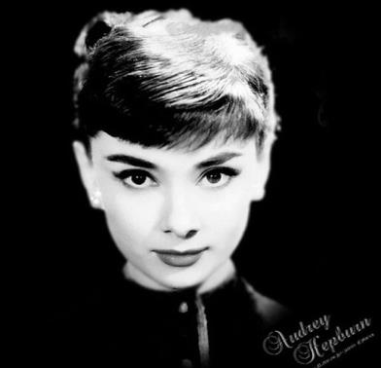
6. If someone passed away,
he or she ___.
  a. went away
  b. died
  c. went past
b

Slide 52
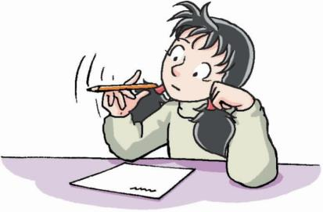
B2
Kitty wants to make sure that she knows about Audrey Hepburn. Look at the magazine headlines. Help Kitty put them in the correct order. Write the numbers 1-6 in the boxes.

Slide 53
1
Hepburn met Colette in France
Hepburn had four more Oscar nominations
c. Roman Holiday was a big success
d. Hepburn won the Oscar for Best Actress
e. Always—Audrey Hepburn’s last appearance in a film
f. Hepburn played the lead role in the play Gigi
5
3
4
6
2

Slide 54
B3
Kitty is reading an article about Audrey Hepburn's career. She carelessly dropped some ink onto the paper. Help her fill in the missing words.
actress angel attention career
lifetime Oscar insisted role
Audrey Hepburn was one of Hollywood's greatest actresses. She worked as a model before she became an (1)_______. Her
actress

Slide 55
successful (2)_______. lasted for about 40 years. In 1951, while acting in France, she met Colette, a famous French writer. Hepburn‘s beauty and charm caught the writer’s (3)_________. She (4) _______ that Hepburn was the right person for the lead (5) _____ in the play Gigi. Two years later. Hepburn was chosen to play
career
attention
insisted
role

Slide 56
the lead role in Roman Holiday, and won the (6)______ for Best Actress that year. During her (7)________ Hepburn had four more Oscar nominations. She made her final appearance in the film Always in 1989 and played the role of an (8)______.
Oscar
lifetime
angel

Slide 57
B4
Sandy wants to know something about Audrey Hepburn. She is asking Kitty some questions. Help Kitty answer Sandy's questions.
1. Sandy: Why is Audrey Hepburn one of
Hollywood’s all-time best?
Kitty: ___________________________
___________________________
_______________________
Because she is not only a great
beauty and a great actress, but
also a great humanitarian.

Slide 58
2. Sandy: What was Hepburn's dream
when she was a child?
Kitty: ___________________________
___________________________
________________
3. Sandy: How did Hepburn become
world-famous?
Kitty: ___________________________
___________________________
___________________________
_______________
Her dream was to become a successful ballet dancer when she was a child.
She became world-famous by playing the lead role of a young princess in the Hollywood film Roman Holiday.

Slide 59
4. Sandy: What did Hepburn do beyond
the film industry?
Kitty: ___________________________
___________________________
_______________________
She worked with UNICEF to help poor children in different parts of the world.

Slide 60
Exercises

Slide 61
I. 词组翻译。
好莱坞空前最伟
大的女演员
2. 一位成功的芭蕾
舞蹈者
3. 为失去一位伟大
的人道主义者哀悼
4. 进入电影工业
5. 在她一生中
Hollywood’s all-time
greatest actress
a successful ballet dancer
sad about the loss of
a great humanitarian
enter the film industry
during her lifetime

Slide 62
6. 赢得奥斯卡最
佳女演员
7. 扮演主角
8. 超越
9. 吸引某人的注
意
10. 逝去
win the Oscar for Best Actress
play the lead role
go beyond
catch one’s attention
pass away

Slide 63
II. 根据所给句子填空。
1. 他是历来最杰出的选手之一。
He is one of the _______ great players.
2. 她上学时曾梦想成为一名女演员。
As a schoolgirl, she had dreamed of becoming an ______.
  3. 她想当芭蕾舞演员。
She wants to be a ballet ______.
all-time
actress
dancer

Slide 64
  4. 他的新角色会确保他跻身我们的一流演员之列。
  His new ____ could confirm him as one of our leading actors.
  5. 他的日记在他生前未曾发表过。
  His diary was not published during his _______.
  6. 我们彻底仔细地检查了措词后才最终定稿。
  We examine the wording in detail before deciding on the _____ text.
role
lifetime
final

Slide 65
  7. 你认为他会死 吗 ?
Do you think he'll __________?
  8. 不管你在说什么，如果孩子们听不懂，就会很快走神。
  Whatever you're talking about, children rapidly tune out if you __________ them.
pass away
go beyond

Slide 66
Homework
Read the text again and again &try to recite it.
Finish the exercises in the
workbook.

