Slide 1
Unit 2 Let’s colour it.
WWW.PPT818.COM

Slide 2
A: What colour is it ?
B: It is …
颜色
colour
red
white
yellow
blue
green

Slide 3
A: What colour is it ?
B: It is …
purple
black
brown
orange

Slide 4
Do you like …?
Yes,I do.
No,I don’t.

Slide 5
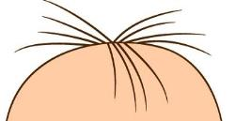
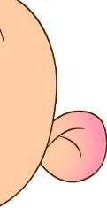
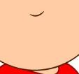
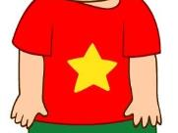
baby
hair
nose
eye
ear
ear
face
mouth
hand
foot
feet

Slide 6
a funny face

Slide 7
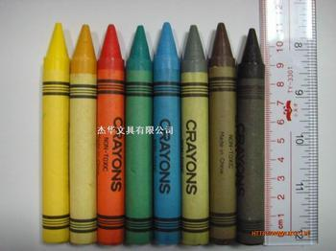
I have .
crayons

Slide 8
Let’s colour the mouth….
a brown mouth

Slide 9
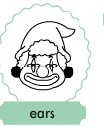
Let’s colour the ears….
two black ears

Slide 10
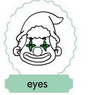
Let’s colour the eyes….
two green eyes

Slide 11
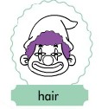
Let’s colour the hair….
purple hair

Slide 12
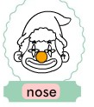
Let’s colour the nose….
an orange nose

Slide 13
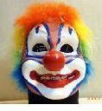
a funny face

Slide 14
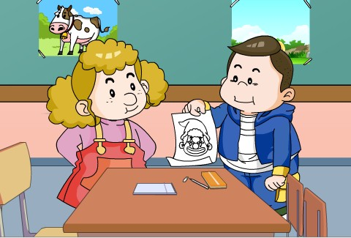

Slide 16
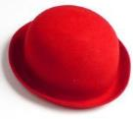
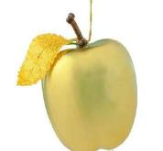
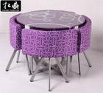
Let’s colour the hat red.
Let’s colour the cat black.
Let’s colour the apple yellow,
Let’s colour the table purple.

