Slide 1
陕旅版四年级上册 Unit3 What’s for breakfast? 第3课时
WWW.PPT818.COM

Slide 2
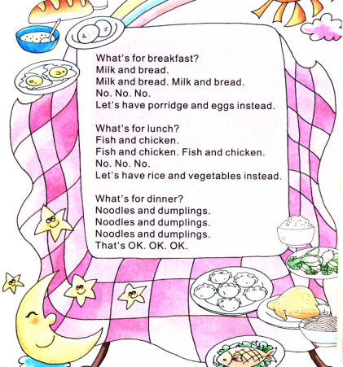
Let’s chant---What’s for breakfast?

Slide 3
教学目标：
1.听懂会说句型Dinner/ Lunch…is ready! What’s for dinner?
Do you have…(食物)及其否定回答No, we don’t./ Very little.
2.能在实际生活中灵活自如地运用所学的有关一日三餐表达的词汇和句型，并能进行相应的替换练习。

Slide 4
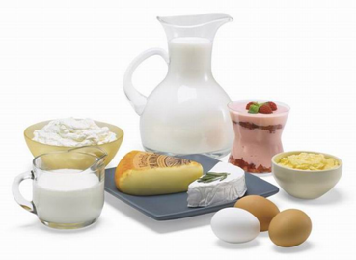
Good morning, boys and girls!
What’s for breakfast?
What do you have for breakfast?
Do you like bread for breakfast?
What do you like for breakfast?

Slide 5
Brainstorm
全班学生分为两大组，说出学过的所有有关食物的单词，说对一个加一分，分出胜负。
限时三分钟！

Slide 6
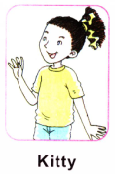
Look, she has two big blue eyes, do you have blue eyes?
What color is her hair?
Do you have yellow hair?
OK. We guess that Kitty is from America.
Welcome her to China.
Welcome to our school.

Slide 7
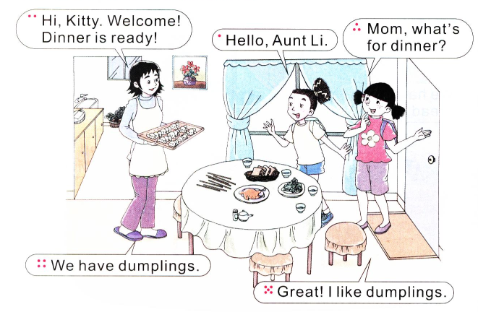
Let’s learn more
I can see…from the picture.

Slide 8
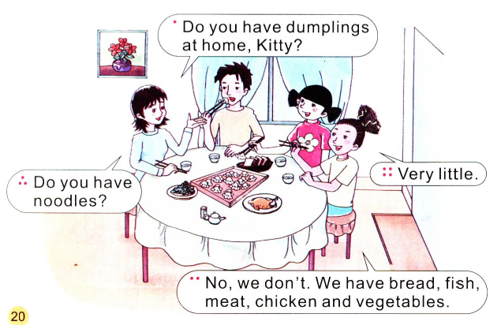
听录音，回答问题：
Does Kitty have dumplings at home?
Do they have rice?

Slide 9
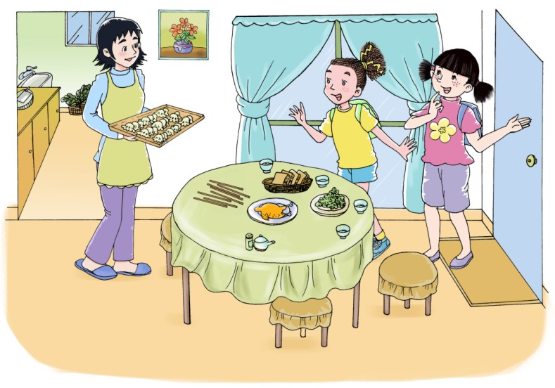
Hi, Kitty. Welcome! Dinner is ready!
Mom, what’s for dinner?
Hello, Aunt Li.
We have dumplings.
Great! I like dumplings.

Slide 10
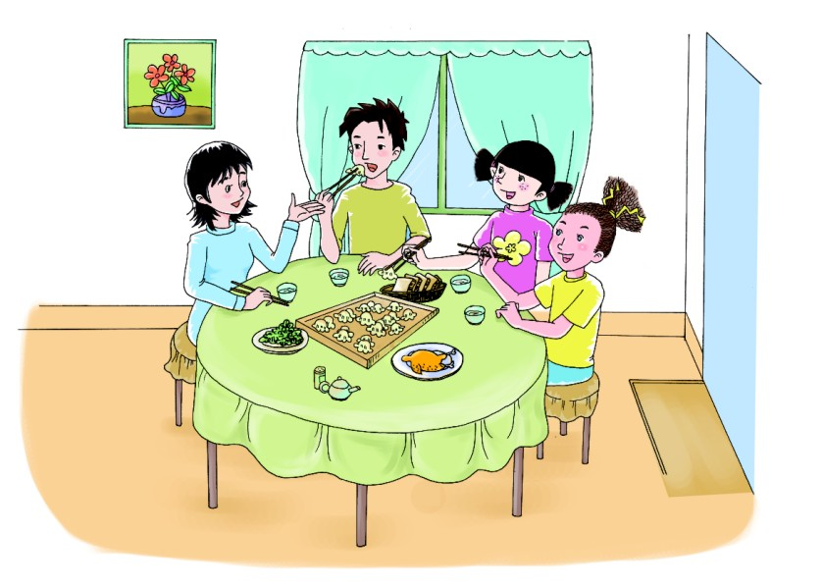
Do you have dumplings at home, Kitty?
Very little.
Do you have noodles?
No, we don’t. We have bread, fish, meat, chicken and vegetables.

Slide 11
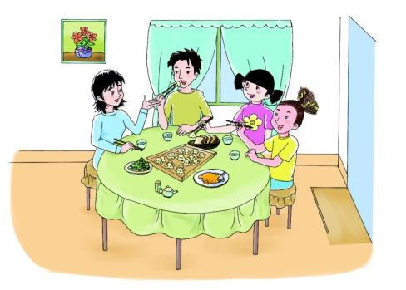
Role play

Slide 12
Summary
一日三餐用语:
—Dinner is ready.
—What’s for dinner?
—We have…
—Do you have…?
—No, we don’t / Very little.

Slide 13
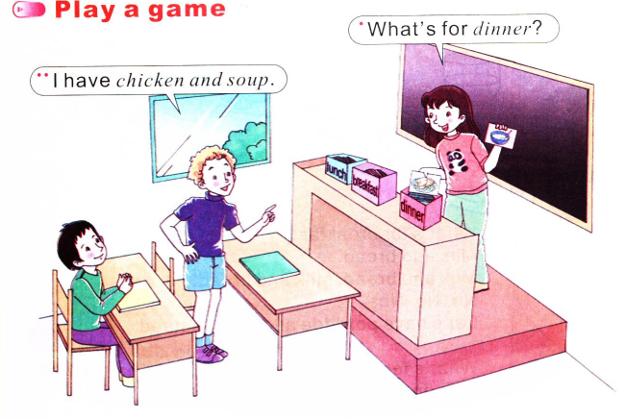
Play a game

Slide 14
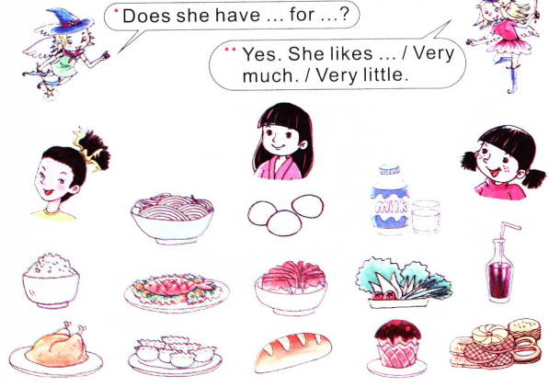
Think, match and talk

