Slide 1
Module 5 Lao She Teahouse
Unit 2 It describes the changes in Chinese society
WWW.PPT818.COM

Slide 2
Words review
actress
teahouse
offer
end
in the end
no idea
n. 女演员
n. （尤指亚洲的）茶馆
v. 提议；提出
n. （时间的）最后一段，
末尾
v. 结束
最后；终于
不知道

Slide 3
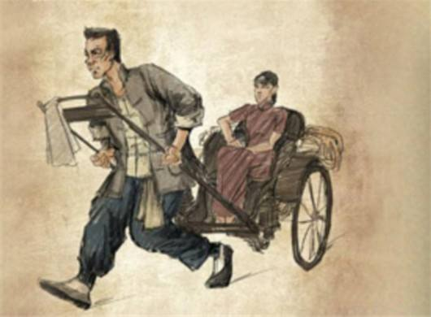
骆驼祥子
Camel Xiangzi

Slide 4
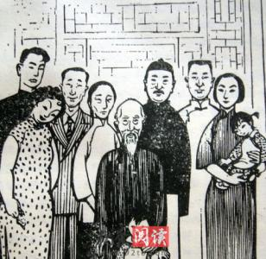
四世同堂
The Yellow Storm

Slide 5
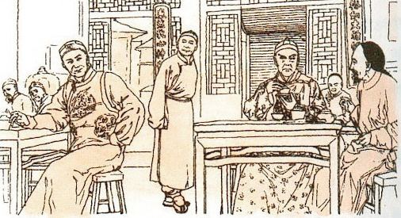
茶馆
Teahouse

Slide 6
Watch the video.

Slide 7
The story
of
Teahouse
Lao She
Teahouse
Lao She

Slide 8
How many acts does the play have?
The story of
Teahouse
What story does it tell us?
What does the play describe?

Slide 9
Lao She
left home
and
went to England
was sent to
a teacher’s
school
1957
1918
1899
wrote
Teahouse
1924
was
born in
Beijing
1913
finished
school

Slide 10
Lao She
was named “__________________”.
the People’s Artist

Slide 11
What can you enjoy in
Lao She’s Teahouse?
You can enjoy the tea, delicious Beijing food, Beijing Opera, traditional music or magic shows.
Lao She
Teahouse
welcomes
Lao She Teahouse ____________ people from all over the world________.
warmly

Slide 12
Complete the passage
Lao She’s play, Teahouse, has three acts. It describes the life of Wang Lifa and the changes to the lives of (1) ___________ in Chinese (2) ______ in the first half of the (3) _______ century.
Lao She went to a teacher’s school in Beijing, taught in _______and later returned to China. He is one of China’s greatest (4)_______.
Come to Lao She Teahouse in Beijing if you like (5)_____________, traditional music or (6)_____ shows.
common people
society
twentieth
London
writers
the Beijing Opera
magic

Slide 13
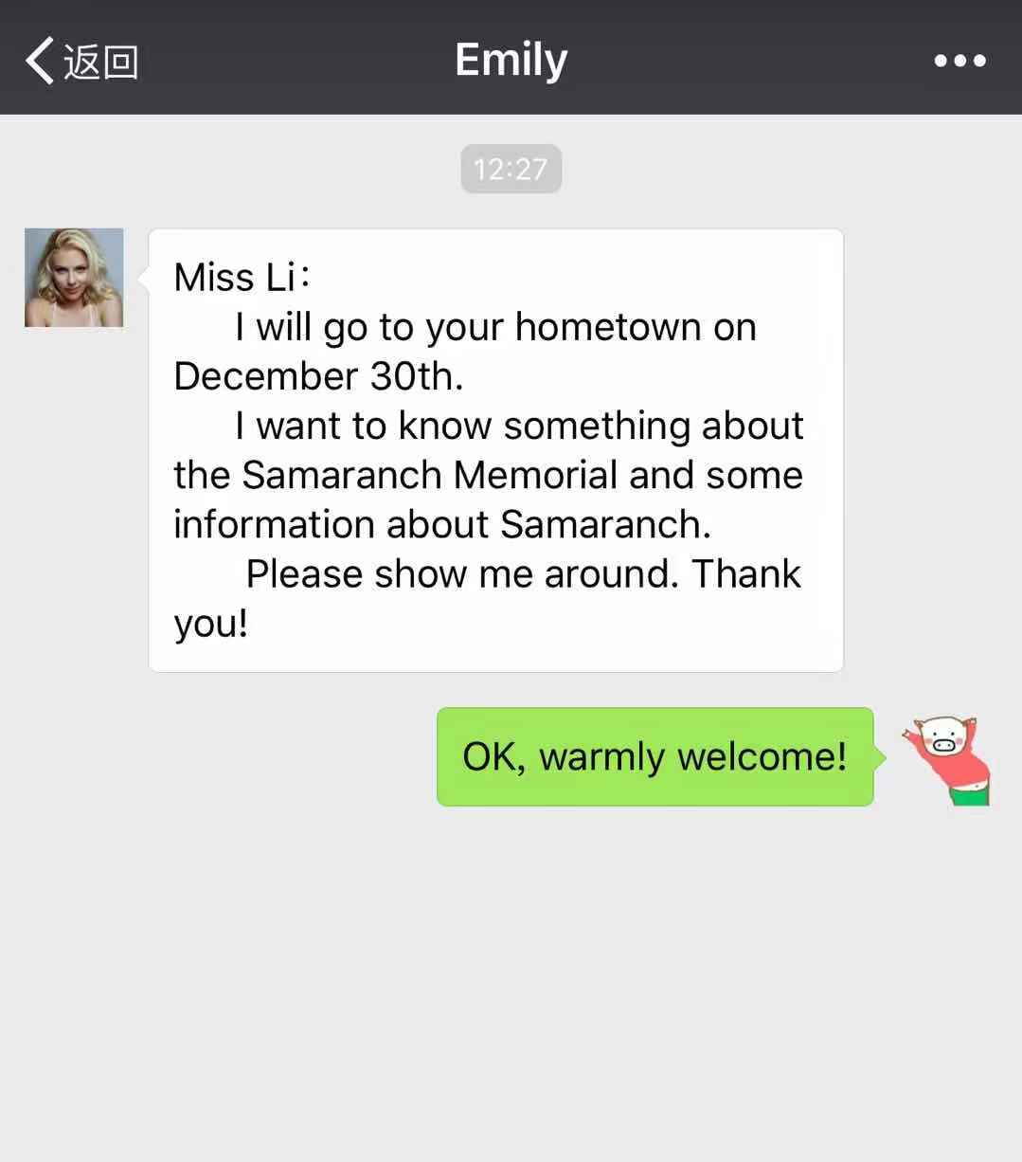

Slide 14
Homework
1. Write a letter to Emily and tell
her more about Samaranch.
2. If you can , try to search more
information about Olympics.

Slide 15
Thank you for listening!

