Slide 1
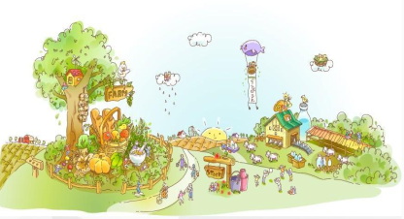
Unit4 He Lives in a Village
陕旅版
五年级下册
第二课时
WWW.PPT818.COM

Slide 2
>>Warm-up
Sing a song

Slide 3
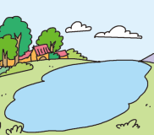
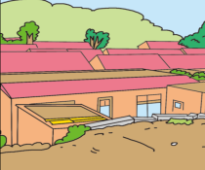
>>Review
Quick response

Slide 4
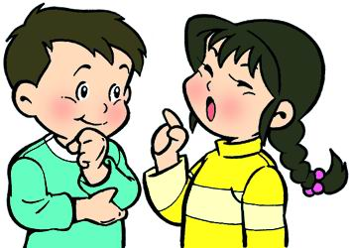
>>Lead-in
Free talk
Where do you live?
Is your village(home) big or small?
Can you tell me how to get to your home?

Slide 5
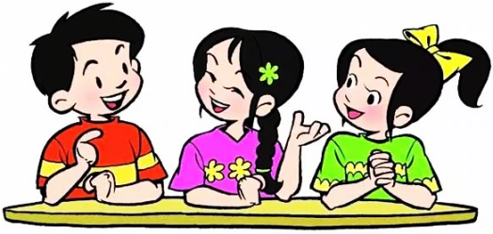
>>Presentation
Make a survey
1
Do(Does) … live(lives) in the city(village)?
Is your village(city) big(small)?
2

Slide 6
>>Presentation
Let’s learn
Do/Does… live/lives in …?
Yes, /No, …
1
询问他人的居住环境？
-Do you live in the city, too?
-No. I live in a village far from the city.
e.g.
2
Is … village big?
Yes, /No, … but …
如何询问并描述自己/他人的居住环境？
-Is your village big?
-No. It is small, but very beautiful.
e.g.

Slide 7
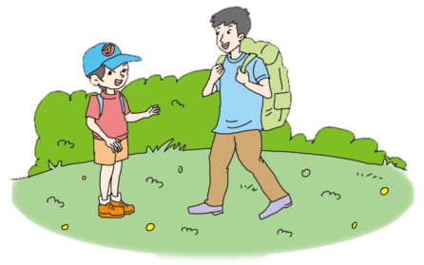
>>Presentation
Listen, then ask and answer
Where does Liu Zhaoyang live?
He lives in Xi’an.
Does the tourist live in the city?
No, he lives in a village far from the city.

Slide 8
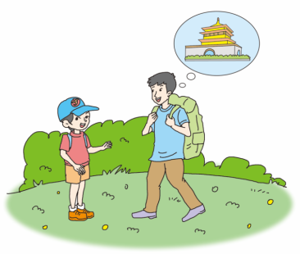
>>Presentation
Let’s talk
Read and imitate
打扰了
Tourist: Excuse me, how can I get to
the Bell Tower?
Liu: You can go with me.
Tourist: Thank you. Xi'an is really a
beautiful city.
Liu: Yes. Do you live in the city, too?
Tourist: No. I live in a village far from the city.
住在……
当它位于疑问句句末时，表示渴望得到肯定的回答。

Slide 9
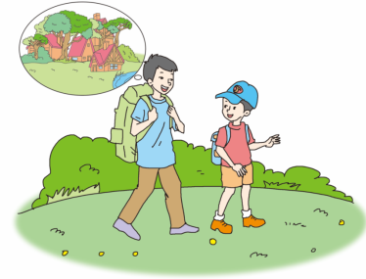
>>Presentation
Let’s talk
Liu: Is your village big?
Tourist: No. It is small, but very
beautiful. In April and May,
there are many kinds of
flowers around. In September
and October, we have many fruits.
Liu: It sounds very nice.
许多种
adv.在周围，在附近

Slide 10
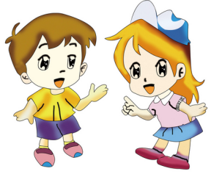
>>Practice
根据自己的情况，选择来做吧！
Role play
Level1:分角色朗读对话，注意模仿语音语调。
Level2: 2人一组，试着表演出来吧。

Slide 11
>>Presentation
Listen again and answer
Where does the tourist live?
He lives in a village far from the city.
Is the village big?
No. It is small, but very beautiful.
What does the tourist have in September
and October?
The tourist has many fruits.

Slide 12
>>Practice
Listen and number
5
( ) It sounds very nice.
2
( ) The tourist lives in a village far from the city.
4
( ) In September and October, we have many fruits.
1
( ) Xi’an is really a beautiful city.
3
( ) The village is small, but very beautiful.

Slide 13
>>Practice
Write and say
how
A: Excuse me, ______ can I get to the library?
B: You can go with me.
A: Thank you.
B: ____________ in this city?
A: No. I ______ in a village _________ the city.
B: Is your village big?
A: No. It is ______. But very beautiful. In autumn
we have many fruits.
B: It ________ very nice.
Do you live
live
far from
small
sounds

Slide 14
>>Practice
一、英汉互译。
1. 许多种 ___________ 2. a beautiful city __________
3. 远离…… ________ 4. live in ________
many kinds of
一座美丽的城市
far from
居住
二、单项选择题。
5. ( )-Where is your home?
- ________.
A. In a big village. B. At 8 o’clock C. In the afternoon
6. ( )-Do you live in the city?
- ________.
A. No, I do. B. Yes, I don’t. C. Yes, I do.
A
C

Slide 15
>>Practice
6. ( )-______, how can I get to the school?
- This way, please.
A. Sorry. B. Excuse me. C. I’m sorry.
B
7. ( )-Is your village big?
- ______.
A. Yes, it isn’t. B. No, it is. C. Yes, it is.
C
8. ( )In autumn, we have _____ fruits and we can
eat them.
A. much B. many C. them
B

Slide 16
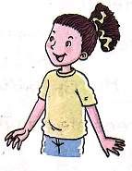
>>Practice
Ask and answer. Then report
Where do you live?
I live in …
Questions:
Where do you live?
Is it big/small/beautiful?
Is there a river/lake?
What’s in the city/village?
Do you love it?
How can I get there?
Kitty lives in …

Slide 17
>>Summary
如何询问去某地：
-How can + I / we + get to + 地点？
-You can …
e.g.
-How can I get to the cinema?
-You can go straight, then left.

Slide 18
>>Summary
如何询问他人的居住环境：
-Do you live in …？
-I live …
e.g.
-Do you live in a city?
-No. I live in a village far from the city.

Slide 19
>>Homework
1.听课文录音并跟读，按照正确的语音、语调朗读并表演课文对话。 2.Pair work: 2人一组，表演课文对话,并在此基础上创编新对话（创编对话可在下节课展示）。
3.预习 Unit4 B Let’s learn more。
close

