Slide 1
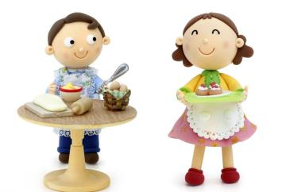
Unit 7 Topic 2
I’m not sure whether
I can cook it well.
Section C
WWW.PPT818.COM

Slide 2
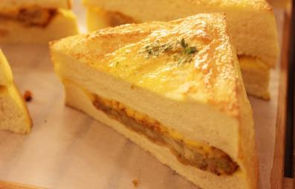
Do you remember how to make a sandwich?
First, take two pieces of bread and spread butter on them.
Next, cut a pear into small pieces carefully.
Then, put them on the bread lightly.
After that, put some honey over the pear slowly.
Finally, put the pieces of bread together.

Slide 3
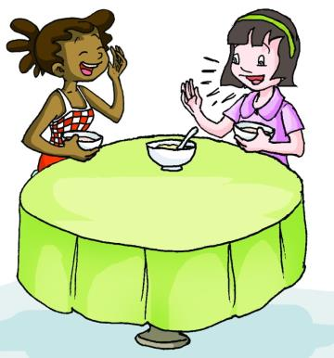
Do you know if it is polite to eat soup noisily in Japan?

Slide 4
Suppose you would go to a formal western
dinner party for the first time, but you don’t know
their table manners. Do you want to get some
advice?
adj.正式的
n.方式；举止；态度

Slide 5
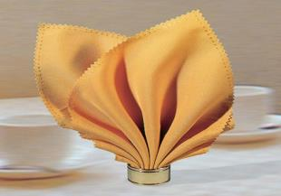
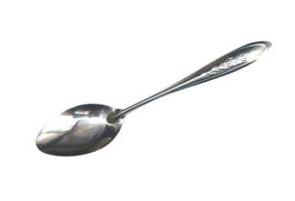
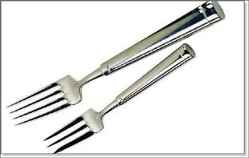
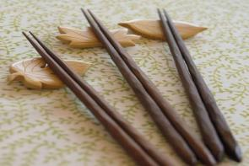
napkin
n.餐巾
spoon
n.匙，调羹
fork
n.叉，餐叉
chopstick n.筷子

Slide 6
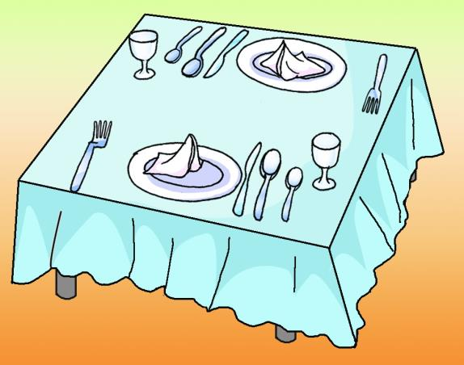
Look at the picture and write the words on the lines.
C spoon
plate
D _______
fork
B _______
glass
E _______
knife
F _______
napkin
A _______

Slide 7
1b
Read 1a and mark T (True) or F(False).
1.When you start dining, you should take your napkin first and put it on your lap.
2.At the table, people always keep the fork in their left hands.
3.It’s impolite to eat up the food on your plate.
4.It’s polite to speak loudly and smile a lot.
5.When you drink to someone, you should raise your glass and take only a little.
( )
T
F
( )
( )
F
( )
F
( )
T

Slide 8
Key points of 1a
1.If you go to a formal western dinner party for the first time,you'd better know about western table manners.
(1) for the first time 第一次
E.g:2012年，我第一次到北京去度假。
I went to Beijing for my holiday in 2012 for the first time.
(2) table manners 餐桌礼仪
2.It's polite to eat up the food on your plate,...
eat up sth./eat sth. up 吃完，吃光
3.When you drink to someone,...
drink to sb./sth.为......干杯（祝酒）
4.Remember not to drink too much.
(1) remember to do sth.记得要做某事（事情还没有做）
否定形式为：remember not to do sth.
(2) too much 在句中作状语，修饰动词drink。

Slide 9
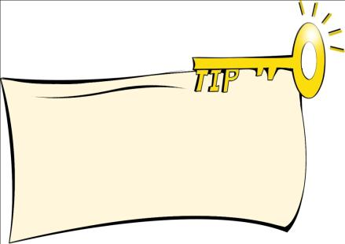
1c
Read again and underline the key points about western table manners. Then work in groups and compare them with Chinese table manners.
Knowing about the differences in table manners in different cultures is very helpful for you to succeed in cross-cultural communication.

Slide 10
First,talk with your partner about western table manners.
When you sit down at the table, ...
The dinner always starts with …
You should keep the fork ...
If you use your knife, ...
Don’t take …
Don’t speak …
When you drink to someone, you 'd better...

Slide 11
Second,collect some information about table manners in China. Then talk about them.
You may use these sentences:
I think (that) it is polite to … in China.
I think (that) it is impolite to … in China.

Slide 12
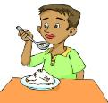
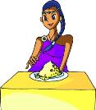
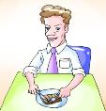
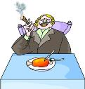
2
Match the pictures with the conversations.Then practice in pairs.
Can you tell me if it's polite to eat with your arms or elbows on the table in America?
Yes, I can. It's impolite.
A
C
n.肘，肘部
B
Do you know whether or not it's impolite to smoke during a meal in France?
Yes, I do. It's impolite.
D
C
We know people use a spoon and a fork to eat in Thailand.Do you know whether they use knives?
Yes, I do. They don't use them.
A
D
I know Indians eat with their right hands. I don't know if there's no need for knives,forks or chopsticks.
No, there's no need.
B

Slide 13
宾语从句
宾语从句用陈述句语序
Do you know if / whether he likes Times English Post?
I want to know what they are talking about.
Maybe you don’t know whether it’s polite or not to
speak loudly at the table.

Slide 14
3
Discuss eating customs in different countries, using object clauses.
Example:
Is it polite to point at people with chopsticks in China?
A:I want to know whether/if it is polite to point at people with
chopsticks in China.
B:I don't think that it is polite to point at people with chopsticks in China.
point at sb.指向某人
quiet+ly——quietly adv. 安静地，寂静地
1.Is it polite to eat soup very quietly in most African countries?
2.Can people smoke during a meal in France?
3.Will people leave as soon as they finish eating in western countries?
4.Do Americans eat food like chicken legs with their fingers?
5.Does a formal western dinner always start with a small dish?
finish doing sth. 完成某事
n.手指

Slide 15
Project
Write a short passage about table manners in China, using object clauses and the information you have collected in 1c.

Slide 16
Exercises in class
把下列句子合并成一个含有宾语从句的复合句。
1. I don’t know. Is she a teacher?
2. Do you know? Is it good to watch TV
too much?
3. I don’t know. Is it polite to eat up the
food on your plate?
4. I’m not sure. Is he at home?
5. I want to know. Will it rain tomorrow?

Slide 17
Summary
We learn:
1. Some new words:
formal, manner, napkin, lap, fork, dish, quietly,
dine, elbow, spoon, chopstick, finger
2.Some phrases:
for the first time, eat up sth., table manners, drink to sb.
remember to do sth. , point at, finish doing sth.
3.Object clauses with if/whether:
Can you tell me if it's polite to eat with your arms or elbows on the table in America?
Do you know whether it's impolite to smoke during a meal in France?
We can:
◆Talk about table manners for a formal western dinner party
First, when you sit down at the table, take your napkin and put it on your lap.
You should keep the fork in your right hand.
It’s polite to eat up the food on your plate.
Don’t take more food than you need.
You should speak quietly and smile a lot.
When you drink to someone, you’d better raise your glass and take only a little.
Remember not to drink too much.

Slide 18
Homework
1. Read 1a and retell it .
2. Collect more information about table manners
in different countries.
3.Finish Section C in your workbook.
4.Preview Section D.

Slide 19
Thank you !

