Slide 1
Unit 4 Christmas
Lesson 20 Christmas Tree
WWW.PPT818.COM

Slide 2
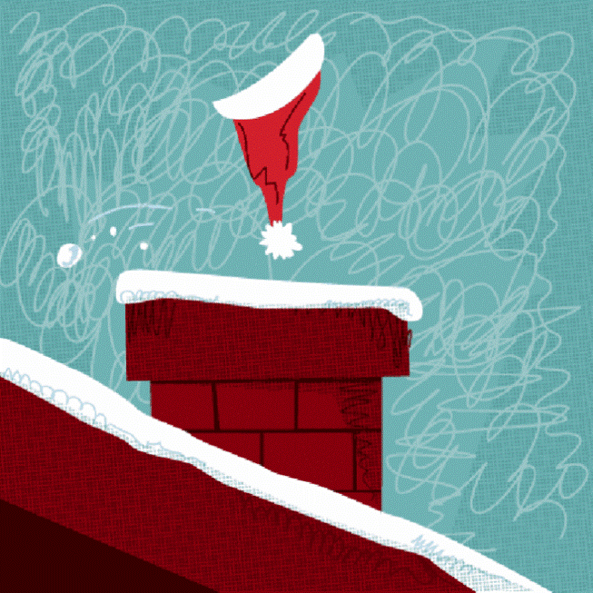
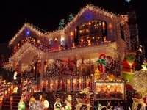
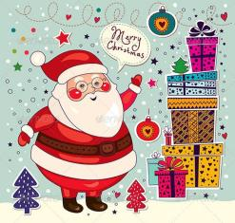
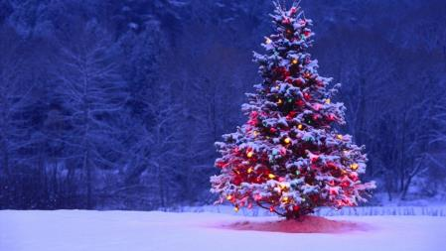
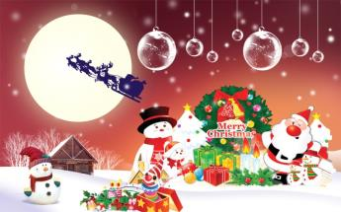
Warming up
What do you usually do at Christmas?
I usually…
It’s fun to do…

Slide 3
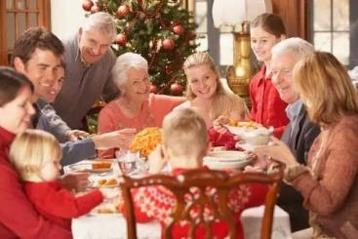
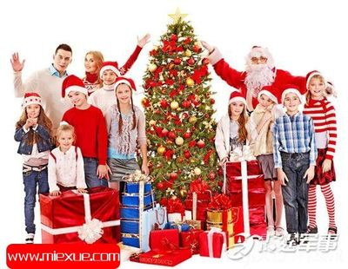
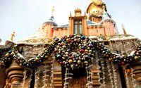
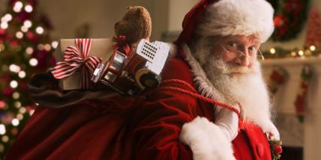
Presentation
1.A Western holiday

Slide 4
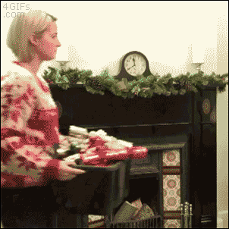
Presentation
The origin of Christmas

Slide 5
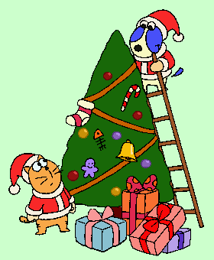
Presentation
First , I’m going to put the lights on the tree.
Then I’m going to put Christmas things on the tree.
The star always goes on top.
We put our gifts under the tree.

Slide 6
The Origin of Christmas
Christmas Day December 25-which celebrates the birth of Jesus Christ, the founder of the Christian religion, is the biggest and best-loved holiday in the United States.
According to the Bible, holy book of Christians, God decided to allow his only son, Jesus Christ, to be born to a human mother and live on earth so that people could understand God better and learn to love God and each other more.“Christmas” meaning “celebration of Christ ” honors the time when Jesus was born to a young Jewish woman Mary.
Mary was engaged to be married to Joseph, a carpenter, but before they came together, she was found to be with child. Because Joseph, her husband, was a righteous man and did not want to expose her to public disgrace, he had in mind to divorce her quietly. But after he had considered this, an angel of the Lord appeared to him in a dream and said, “Do not be afraid to take Mary home as your wife, because what is conceived in her is from the Holy Spirit. She will give birth to a son, and you are to give him the name Jesus，because he will save his people from their sins."
Although the exact date of the birth of Jesus nearly 2000 years ago is not known，the calendar on the supposed date divides all time into B.C.(Before Christ)and A.D.( a Latin phrase, Anno Domini,“in the year of our Lord.”)For the first 300 years, Jesus‘ birthday was celebrated on different dates. Finally, in the year 354, church leaders chose December 25 as his birthday.

Slide 7
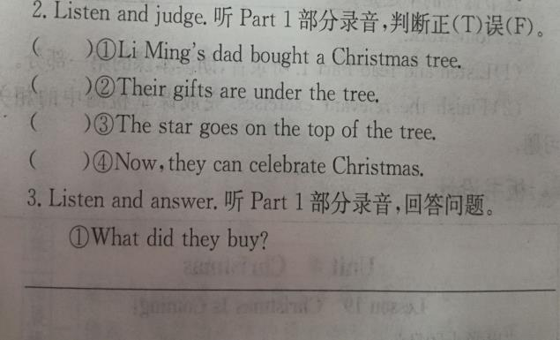
Practice
1
F
T
T
T
2
They bought a Christmas tree.
on the tree
on the tree
under the tree
on top of the tree

Slide 8
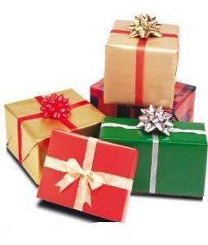
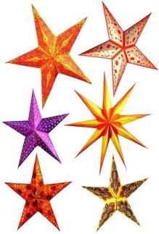
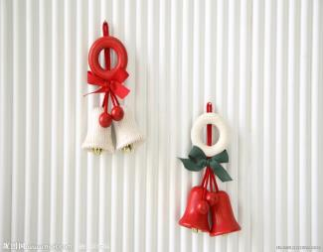
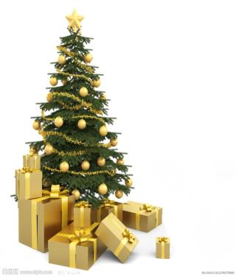
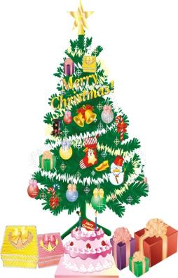
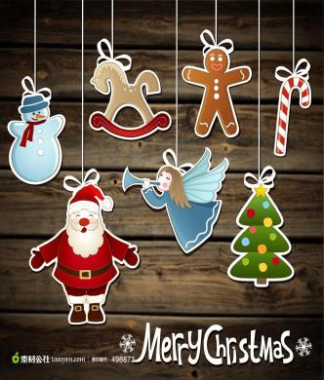
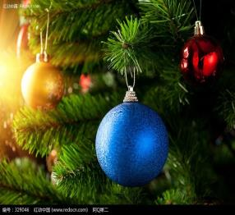
Practice
Put up your Christmas tree.
Christmas things
bells
stars
gifts
lights
Christmas trees

Slide 9
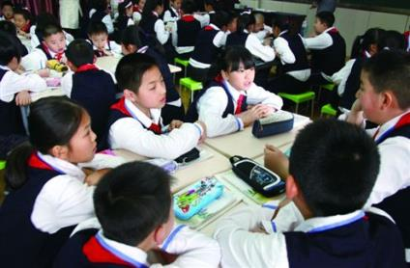
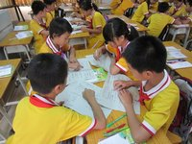
Consolidation
What did you do last Christmas?
What are you going to do next Christmas?

Slide 10
Consolidation
 | How to do?
Jenny’s Christmas
Your last Christmas
Your next Christmas

Slide 11
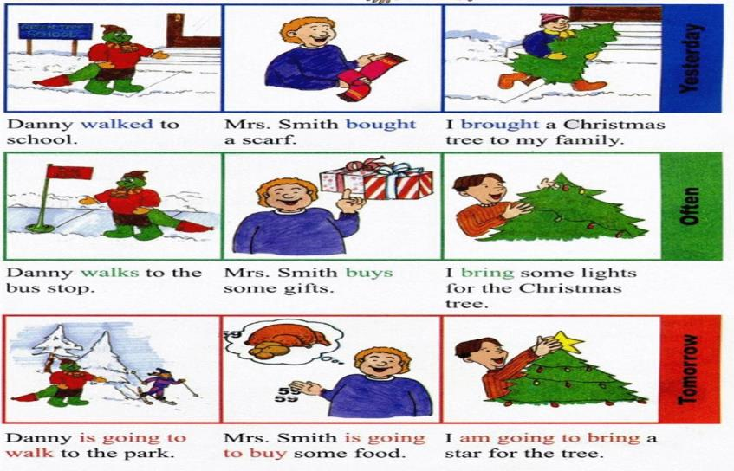
Consolidation
感知一般过去时，现在时，将来时

Slide 12
Consolidation
我的昨天，今天，和明天
 | Yesterday | Today | Tomorrow
Me

Slide 13
Summing up
1.Words:
tomorrow, put…on…, put…under….等。
2. Sentences:
It’s fun to do…
3.
这节课我的收获是：_____________
这节课我的不足是：_____________

Slide 14
Homework
1.听录音，朗读本课的第一部分
2.课后查找一些关于中西文化差异的其他信息

