Slide 1
Unit5 What colour is it?
人教精通版三年级上册
WWW.PPT818.COM

Slide 2
Review
Game
What’s missing?
white
brown
purple
black

Slide 3
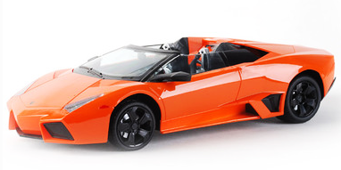
Presentation
Just learn
orange

Slide 4
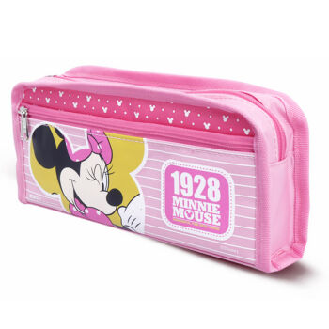
Presentation
Just learn
pink

Slide 5
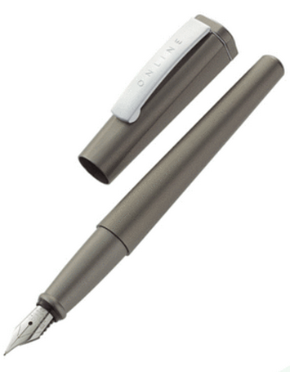
Presentation
Just learn
grey

Slide 6
Practice
Game 1
大小声
pink
orange
grey

Slide 7
Practice
Game 2
Quick response
PPT模板：www.1ppt.com/moban/ PPT素材：www.1ppt.com/sucai/
PPT背景：www.1ppt.com/beijing/ PPT图表：www.1ppt.com/tubiao/
PPT下载：www.1ppt.com/xiazai/ PPT教程： www.1ppt.com/powerpoint/
资料下载：www.1ppt.com/ziliao/ 范文下载：www.1ppt.com/fanwen/
试卷下载：www.1ppt.com/shiti/ 教案下载：www.1ppt.com/jiaoan/
PPT论坛：www.1ppt.cn PPT课件：www.1ppt.com/kejian/
语文课件：www.1ppt.com/kejian/yuwen/ 数学课件：www.1ppt.com/kejian/shuxue/
英语课件：www.1ppt.com/kejian/yingyu/ 美术课件：www.1ppt.com/kejian/meishu/
科学课件：www.1ppt.com/kejian/kexue/ 物理课件：www.1ppt.com/kejian/wuli/
化学课件：www.1ppt.com/kejian/huaxue/ 生物课件：www.1ppt.com/kejian/shengwu/
地理课件：www.1ppt.com/kejian/dili/ 历史课件：www.1ppt.com/kejian/lishi/

Slide 8
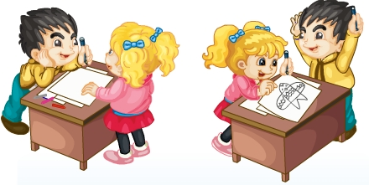
Presentation
Listen and say
Listen! What are they talking about?

Slide 9
Presentation
Listen and imitate
Colour it pink, orange and grey.
Let’s draw a kite.
OK!
All right!

Slide 10
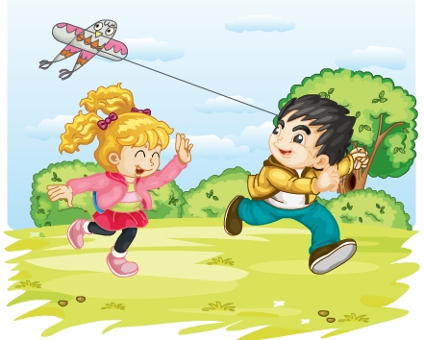
Presentation
Listen and imitate
Let’s fly it.
Great!

Slide 11
Show time
两人一组试着练习对话并表演，其他同学评价。
 | 模仿录音中的语音语调，有感情地朗读。
 | 可以脱离课本，适当改动其中部分，语音地道。
 | 适当添加内容，意思完整，有创新，表演生动。
Good
Great
Excellent

Slide 12
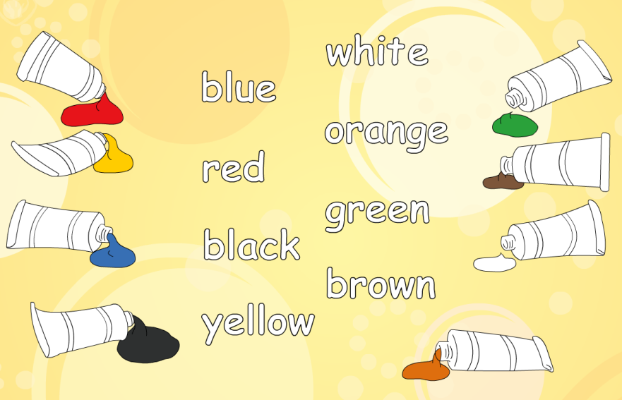
Look and match
答案

Slide 13
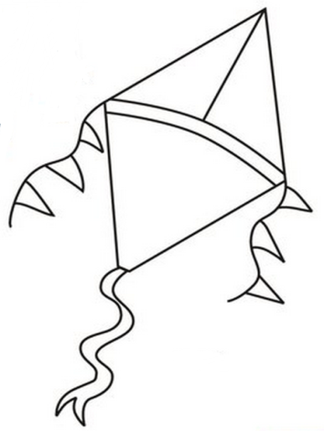
Practice
活动1
Draw and colour
Draw a kite and colour it orange, blue and red.

Slide 14
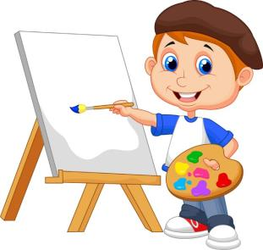
Practice
活动2
I say and you do
Draw a pen and colour it blue.

Slide 15
Practice
Let’s sing

Slide 16
Summary
本课学习的颜色类单词有:
pink
orange
grey

Slide 17
Homework
1.跟读Just talk部分的课文录音，并注意语音、语调。
2.发挥你的想象力，画一个风筝，然后给它涂上你喜欢的颜色。
3.预习Lesson30。
Close

