Slide 1
Unit 4 Topic 3
What time is it now?
Section A
WWW.PPT818.COM
Notes:
1

Slide 2
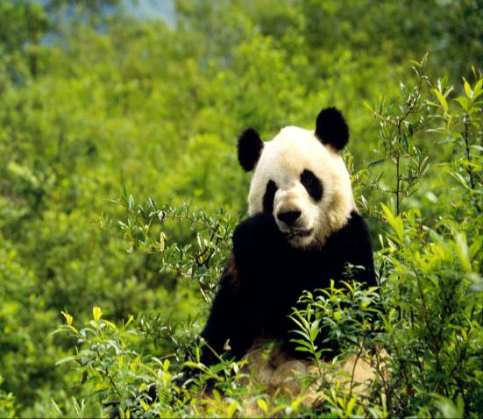
What is the animal?
Game!
panda

Slide 3
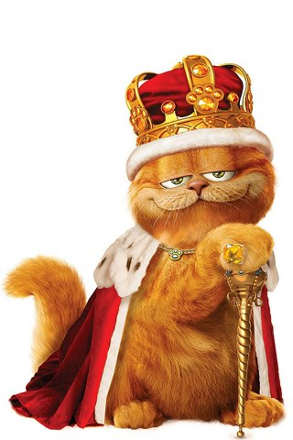
What is the animal?
Game!
cats

Slide 4
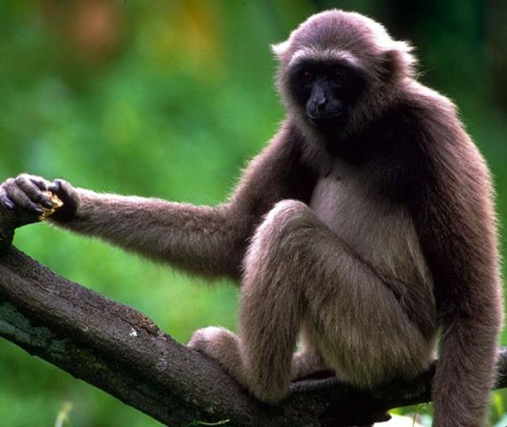
What is the animal?
Game!
monkey

Slide 5
What is the animal?
Game!
lion

Slide 6
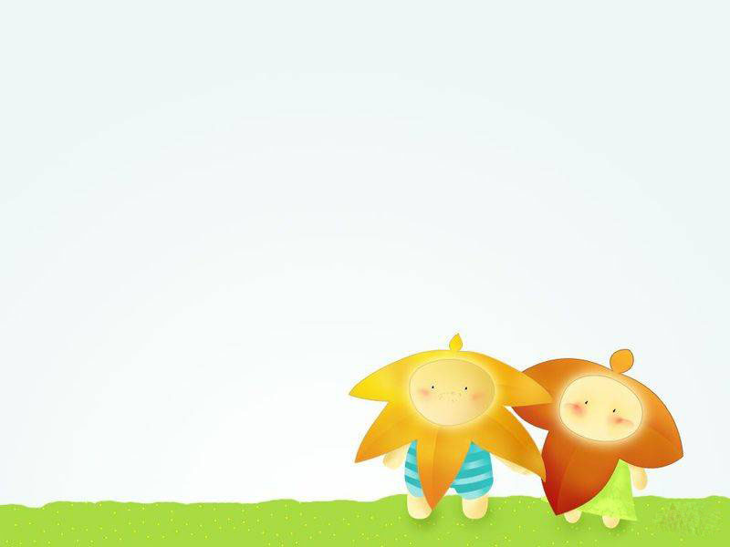
What are the animals?
Game!
How many elephants are there in the picture?
elephants

Slide 7
What are the animal?
Game!
How many animals are there?
tigers

Slide 8
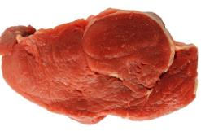
tiger
Meat is the tiger’s favorite food.

Slide 9
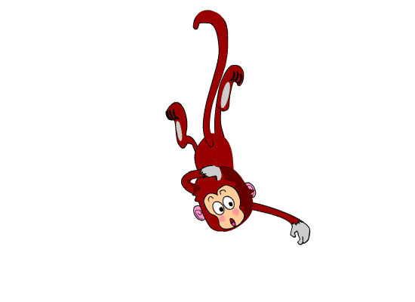
monkey
The monkey likes bananas.

Slide 10
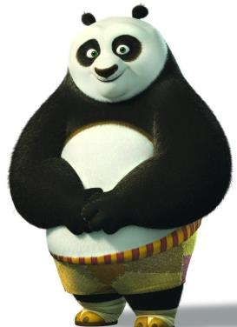
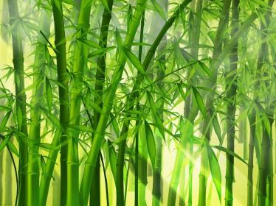
panda
Bamboo is the panda’s favorite food./
The panda likes bamboo.

Slide 11
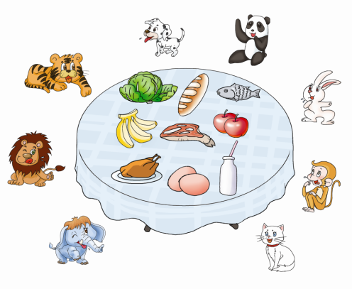
Group work
Do you know these animals? Write down their names and talk about their favorite food.
Example:
A: I think meat is the tiger’s favorite food.
B: I think the rabbit likes …
C: …

Slide 12
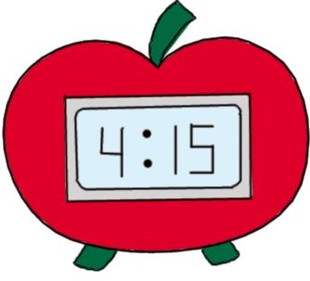
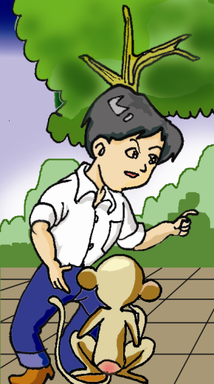
11:30
It’s half past eleven.
It’s time to go home.
Kangkang meets Baby Monkey
on his way home in the afternoon.
在他回家的路上

Slide 13
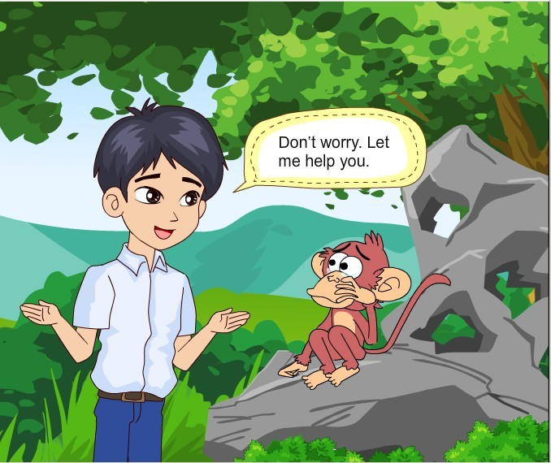
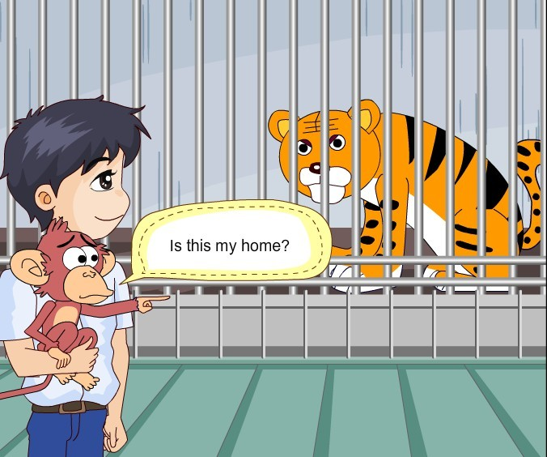
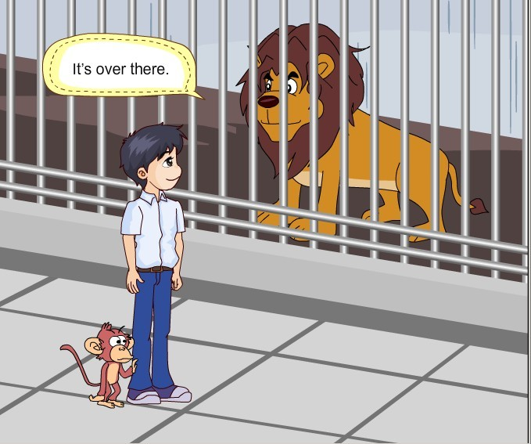
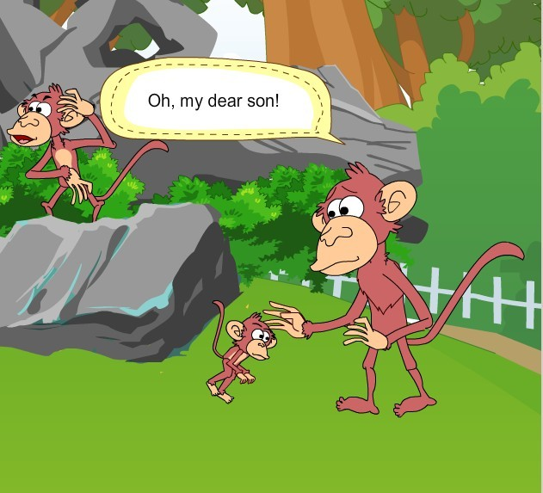
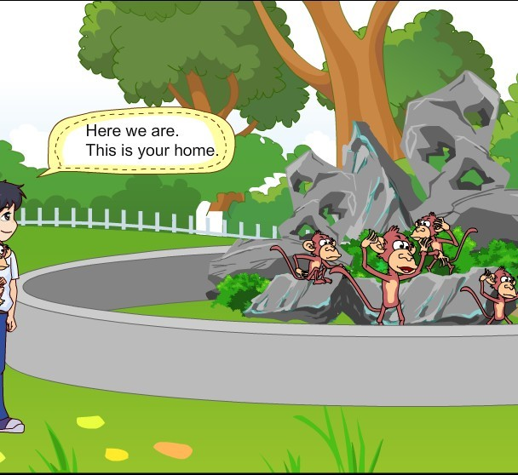
1a Look, listen and say

Slide 14
1. What’s wrong with Baby Monkey?
2. Does Kangkang help him find his
home?
Listen to 1a and answer:
He can’t find his way home.
Yes, he does.

Slide 15
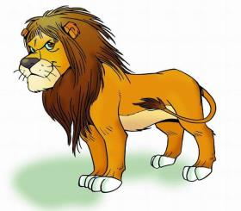
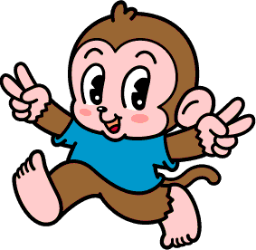
1b Act out 1a!
What’s wrong with you?
I can’t find my way home.
Here we are.
It’s very kind of you.
Thank you for your help.
Group work

Slide 16
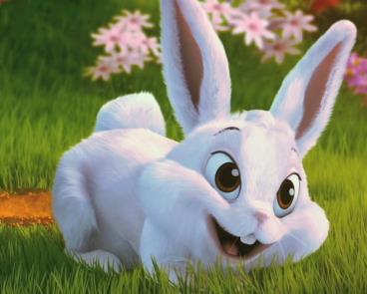
Project: Guess the animals!
I’m white. I have red eyes,
a short tail and long ears.
I like vegetables.
Who am I
rabbit

Slide 17
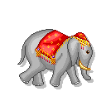
Project: Guess the animals!
He has a long nose. He has
two large ears like fans. His
legs are like pillars(柱子). His
tail is like a pigtail.
Who is he
elephant

Slide 18
Written work
Write a short passage about your favorite animal.
The following information in the table may help you.
Name | dog, panda, monkey…
Color | white, black, brown…
Size | small, big, short…
Food | meat, vegetable, banana…
Reason | cute, strong, kind…

Slide 19
Summary
on one’s way home
on one’s way to + 名词
What’s wrong with you?
It’s very kind of you.
Thank you for your help.

Slide 20
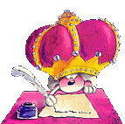
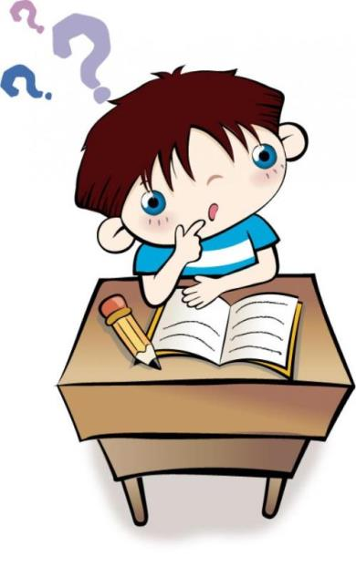
用所学知识，写一篇描述自
己最喜爱的动物的短文。然
后读给同伴听，让他猜猜你
最喜爱的动物是什么？

