Slide 1
Unit 3 Teenage problems
Reading
WWW.PPT818.COM

Slide 2
课前自主预习
单词闯关 | 1.除……外；只有________ 2．几乎不________ 3．友谊________ 4．清单________ 5．怀疑________ 6．值得；值……钱________
but
hardly
friendship
list
doubt
imagine

Slide 3
单词闯关 | 7．想象，设想________ 8．原因________ 9.严格的，严厉的________ 10．课业__________
worth
cause
strict
schoolwork

Slide 4
单词闯关 | 11．选择n. ________→vt. ________ 12．醒着的adj. ________→唤醒，醒来vt. & vi. ________ 13．建议n. ________→vt. ________ 14．价值n. ________→宝贵的；贵重的adj.________
choice
choose
awake
wake
suggestion
suggest
value
valuable

Slide 5
短语互译 | 1.处理，对付______________ 2．熬夜______________ 3．值得做某事______________ 4．对某人要求严格______________ 5．算出；解决______________
deal with
stay up
be worth doing sth
be strict with sb
work out

Slide 6
对……狂热
短语互译 | 6.be crazy about ______________ 7．get into trouble ______________ 8．worry about ______________ 9．stay out late ______________ 10．hear from ______________
陷入麻烦
担心
在外面待到很晚
收到……的来信

Slide 7
句型在线 | 1.然后有时我发现第二天很难保持清醒。 Then I sometimes _____________ to __________ the next day. 2．每天我都有很多家庭作业，我别无选择，只能去做。 I have a lot of homework every day, and I___________________.
find it hard
stay awake
have no choice but to do it

Slide 8
句型在线 | 3．我常常怀疑花这么多时间做家庭作业是否值得。 I often ________________ it is ________________ so much time ________ homework. 4．然后我遇到了麻烦，因为我的父母不允许我下午六点以后在外面玩。 Then I ______________________ because my parents do not _____________________ outside after 6 p．m.
doubt whether
worth spending
on
get into trouble
allow me to play

Slide 9
课文初探 | 根据课文内容，判断正(T)误(F)。 ( )1.Millie and Simon are both Grade 9 students. ( )2.Millie and Simon both like football best. ( )3.Millie and Simon spend much time on their homework. ( )4.Millie and Simon both feel angry with their parents. ( )5.Millie and Simon both hope to get some advice from Mr Friend.
T
F
F
F
T

Slide 10
课堂互动探究
词汇点睛
●1 deal vi. 处理
[观察] I have a problem, and I do not know how I should deal with it.
我有一个问题，而且我不知道怎样处理它。
I don't know how they deal with the problem.
＝I don't know what they do with the problem.
我不知道他们如何处理这个问题。

Slide 11
[探究] deal常与介词with连用，意为“对付，处理”，相当于 do with。但do with常与________搭配，deal with常与________搭配。
what
how

Slide 12
活学活用
1．2017·无锡 Quite a lot of teenagers have no idea how
to ________ (处理) with stress.
deal

Slide 13
●2 awake adj. 醒着的
[观察] They aren't awake yet.他们还没醒。
The noise was keeping everyone awake.
喧闹声吵得大家都睡不着。
Are you fully awake to the danger you're facing?
你充分意识到自己所面临的危险了吗？

Slide 14
[探究] awake作形容词时，可作表语、宾语补足语、后置定语，不能作前置定语。be awake to sth意为“________________________”。
察觉到某事，意识到某事

Slide 15
2．2017·常州 To complete the work, he drank some coffee
to keep himself ________(wake)．
awake

Slide 16
●3 hardly adv. 几乎不
[观察] I hardly have any spare time for my hobbies.
我几乎没有空闲时间顾及我的爱好。

Slide 17
[探究] (1)hardly意为“几乎不”，表示否定意义，因此不能同not或其他否定词连用，但可与ever, any连用。
(2)在含有hardly的反意疑问句中，附加疑问部分要用肯定形式。
He can hardly understand it, can he?
他几乎不懂，是吗？

Slide 18
3．2016·襄阳 —Can you catch what the speaker is saying,
Tina?
—Sorry. He speaks so fast that I can ______ understand
him.
A．nearly B．hardly
C．probably D．exactly
B

Slide 19
●4 suggestion n. 建议
[观察] Can you offer me some suggestions?
你能给我提供一些建议吗？
[探究] suggestion是可数名词，它的动词形式为________。
suggest

Slide 20
[辨析] suggestion与advice
(1)suggestion是可数名词，可以直接与数词搭配。
a suggestion 一条建议
two suggestions 两条建议
(2)advice是________名词，不可以直接与数词搭配，常用于“…piece(s) of advice”结构。
a piece of advice一条建议 two pieces of advice两条建议
不可数

Slide 21
4．2017·达州 —Could you please offer me some______ in my
research?
—Yes, sure.
A．idea
B．message
C．suggestion
D．advice
D

Slide 22
●5 hear from sb 收到某人的来信
[观察] I hope to hear from you soon.
我希望很快收到你的来信。
[探究] hear from sb表示“收到某人的来信”，和
get/receive a letter from sb 同义。

Slide 23
5．2017·铁岭你昨天收到她的来信了吗？
Did you ______________________________________
her yesterday?
hear from/get a letter from/receive a letter from

Slide 24
●6 cause n. 原因
[观察] However, my love of football has become the cause of my
problem.
然而，我对足球的热爱已经成为我的问题的原因。
What you did will cause more trouble.
你所做的将导致更多的麻烦。

Slide 25
[探究] cause 作名词时，意为“__________”。它还可作动词，意
为“____________”。
原因
引起，使发生

Slide 26
6 .2017·包头 Actually, there are many accidents
________(cause) by carelessness every year.
caused

Slide 27
●7 strict adj. 严格的，严厉的
[观察] I do not understand why they are so strict with me.
我不明白他们为什么对我如此严格。
We should be strict in our work.
对工作我们应该严格要求。
[探究] be strict ________ sb意为“对某人要求严格”；be
strict ________ sth意为“在某事上要求严格”。
with
in

Slide 28
C
7．My English teacher Sara is always strict ________ us
________ our studies.
A．in; with
B．at; about
C．with; in
D．about; in

Slide 29
●8 work out 算出；解决
[观察] Can you work out this problem?
你能解答出这道题吗？
The Maths problems are not very difficult. I think you can work
them out. 这些数学题不是很难，我认为你能解答出来。

Slide 30
[探究] work out为动副结构短语，意为“算出；解决”
当宾语是名词时 | 宾语可位于work和out之间，还可位于work out之后。
当宾语是代词时 | 宾语只能位于________________。
work和out之间

Slide 31
8．2017·锦州We all want to know who can ________ the Physics problem. You know, it's very difficult.
A．work out B．take out
C．set out D．look out
A
【解析】：考查动词短语辨析。句意：我们都想知道谁能解出这道物理题。你知道的，它很难。work out意为“解出，算出”；take out意为“拿出，取出”；set out意为“出发，动身”；look out意为“当心”。故选A。

Slide 32
句型透视
●1 I have a lot of homework every day, and I have no choice but to do it.
每天我都有很多家庭作业，我别无选择，只能去做。
[探究] have no choice but to do sth意为“别无选择，只能做某事”。

Slide 33
[拓展] “别无选择，只能做某事”还可以用“can do nothing but do sth”结构表示。
His mum is out. He has no choice but to look after his little sister at home.＝His mum is out. He can do nothing but look after his little sister at home. 他妈妈出去了，他别无选择，只能在家照看妹妹。

Slide 34
活学活用
B
1．I have no choice but________ what you're saying.
A．believe
B．to believe
C．believing
D．believed

Slide 35
●2 I often doubt whether it is worth spending so much time on
homework.
我常常怀疑花这么多时间做家庭作业是否值得。

Slide 36
[探究] (1)doubt可作动词或名词，意为“怀疑”。
I doubt whether he can arrive here on time.
我怀疑他是否能准时到达这里。
There is no doubt that you can solve the problem by yourself.
毫无疑问，你能独自解决这个问题。
(2)_____________意为“值得做某事”。This book is well worth reading.这本书很值得一读。
be worth doing sth

Slide 37
[拓展] 在肯定句中，doubt后面常接if/whether引导的从句；在否定句中，doubt后面常接that引导的从句。
We never doubt that Tom is honest. 我们从不怀疑汤姆的诚实。

Slide 38
2．(1)2017·眉山改编毫无疑问，母爱是世界上最伟大的爱。
________________， the greatest love in the world is the love of a mother.
(2)2017·恩施改编电视节目《最强大脑》很值得一看。
The TV programme Super Brain is well______________．
Without doubt
worth watching

Slide 39
●3 Then I get into trouble because my parents do not allow me to play outside after 6 p．m.
然后我遇到了麻烦，因为我的父母不允许我下午六点以后在外面玩。

Slide 40
[探究]（1）trouble 通常作不可数名词，意为“问题；苦恼”。
_________________ | 意为“遇到麻烦；陷入麻烦”，表示短暂性动作。
_________________ | 意为“处于困境中”，表示状态。
_________________ | 意为“做某事遇到麻烦”。
get into trouble
in trouble
have trouble

Slide 41
Jack has been in trouble for a long time.杰克陷入困境很久了。
You could ask the teacher for help when you have trouble (in)
learning English.当你学英语遇到困难的时候，你可以向老师寻
求帮助。

Slide 42
(2) allow sb to do sth 意为“允许某人做某事”，其被动语态为
______________________，意为“某人被允许做某事”。
Children under 18 are not allowed to go into the Internet bars.
18岁以下的孩子不允许进入网吧。
worth watching

Slide 43
3．(1)根据汉语意思完成句子
①小心，否则你会陷入麻烦。
Be careful, or you'll ____________________．
②你在学习汉语方面有困难吗？
Do you ____________________________ Chinese?
get into trouble
have trouble (in) learning
【解析】考查含情态动词的被动语态。句意：青少年可以被允许自己做决定。含情态动词的被动语态的结构：情态动词＋be＋过去分词。故选A。

Slide 44
(2)单项选择
2017·岳阳改编 Teen­agers ________ decide for themselves.
A．may be allowed to B．may are allowed to
C．may be allow to D．may are allow to
A

Slide 45
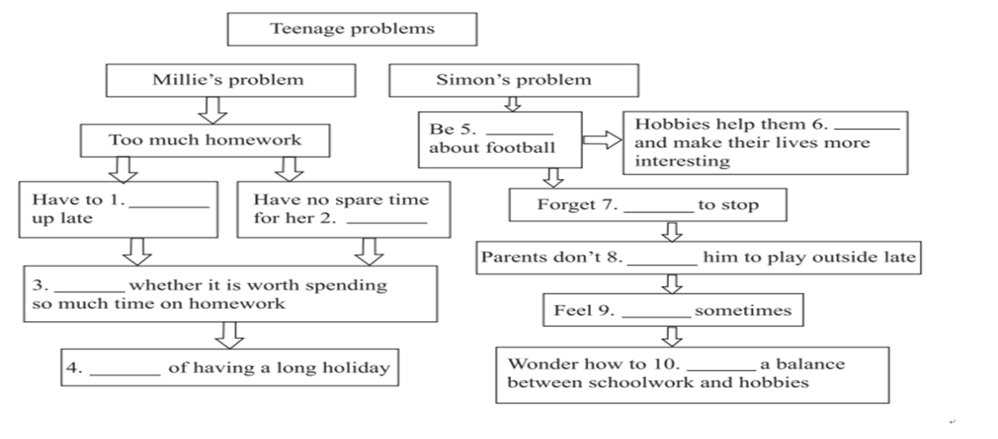
课文回顾
crazy
relax
stay
when
hobbies
allow
Doubt
angry
Dream
achieve

