Slide 1
Unit 4 Lesson 24
Danny's Surprise Cake
WWW.PPT818.COM

Slide 2
Warm-up
What a special cake!

Slide 3
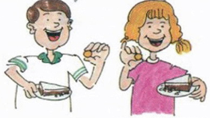
Story time
Fast reading
How many surprises are there in Danny's cake?
Two.
What're the surprises in Danny's cake?
It has no sugar and every cake has a dollar in it.

Slide 4
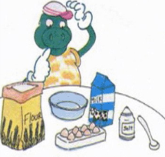
Story time
Intensive reading
Why does Danny make a cake?
He makes the cake for the class party.
What does Danny need for the cake?
Flour, eggs, water, milk, salt and a spoon.

Slide 5
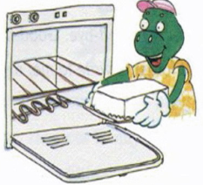
Story time
Intensive reading
Does Danny make a picture on the cake?
Yes, he does.
Why does Danny walk slowly to school ?
Because the cake is heavy.

Slide 6
Story time
Intensive reading
Who brings the ice cream ?
Mr. Wood.
Does Jenny bring any cookies?
Yes, she does.
What does every cookie look like?
Every cookie looks like a student in the class.

Slide 7
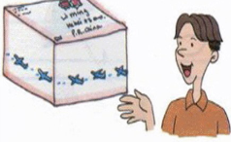
Story time
Intensive reading
Who send a piece of cake to Li Ming?
Mr. Wood.
Does Li Ming get a letter too?
Yes, he does.

Slide 8
Story time
Intensive reading
What can you learn from the story?
Everyone likes a surprise.
We should do everything carefully.

Slide 9
Read the story again and check the words you meet.
sugar send
slowly special
piece address

Slide 10
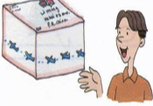
Retell and act the story
Say something about the pictures.

Slide 11
Summary and evaluation
What have you learned in this class?
A excellent B good C adequate D need improvement
内容 | 学生自评 | 小组互评
我能认真听老师讲课，听同学发言
遇到我会回答的问题主动举手了
活动中坚持使用英语来交际
我能积极参与小组讨论活动，能与他人合作。

Slide 12
Homework
Try to retell the story.

