Slide 1
人教精通版三年级上册
Look at my nose
WWW.PPT818.COM

Slide 2
Review
Let’s sing

Slide 3
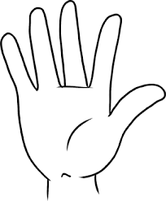
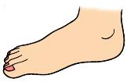
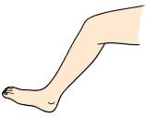
Review
Look and match
head
arm
leg
neck
foot
knee
hand

Slide 4
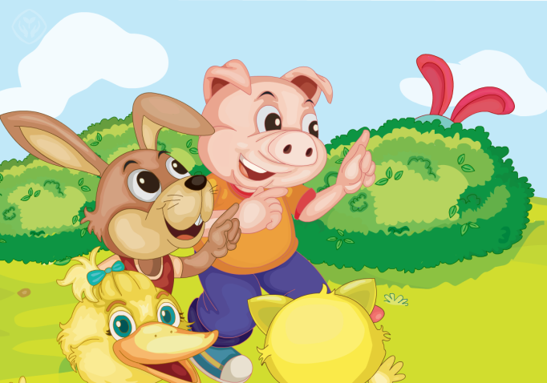
Presentation
Fun story
Read and act.

Slide 5
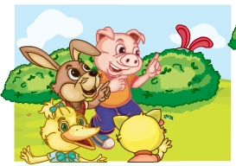
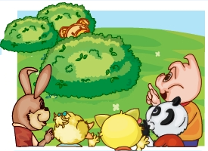
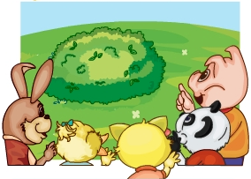
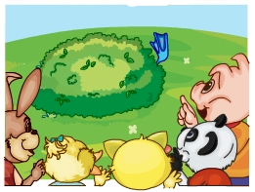
Presentation
Listen and repeat
Look at the ears!
A rabbit!
Look at the nose!
A pig!
Look at the hand!
A panda!
Look at the foot!
A duck!

Slide 6
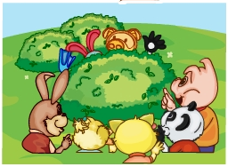
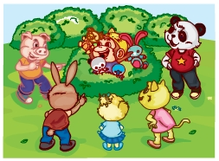
Presentation
Listen and repeat
Look! The foot, nose, ears …
Oh, look! A monkey!

Slide 7
Practice
Let’s read
1
2
3
Read together.
(齐读)
Read in roles.
（分角色读）
Read in groups.
(分组读）

Slide 8
Show time
小组合作，试着练习对话并表演，其他同学评价。
 | 模仿录音中的语音语调，有感情地朗读。
 | 可以脱离课本，适当改动其中部分，语音地道。
 | 适当添加内容，意思完整，有创新，表演生动。
Good
Great
Excellent

Slide 9
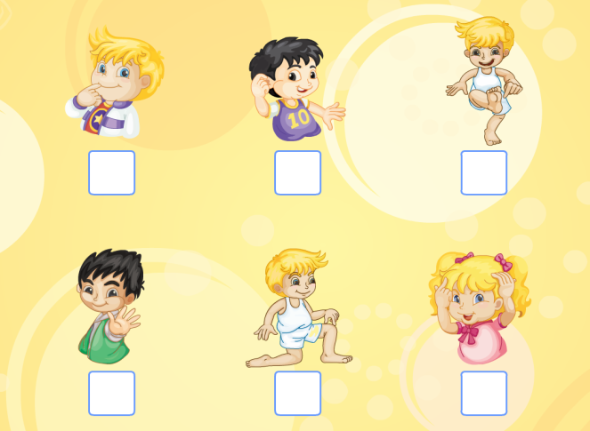
Presentation
Let’s check
Listen and number.

Slide 10
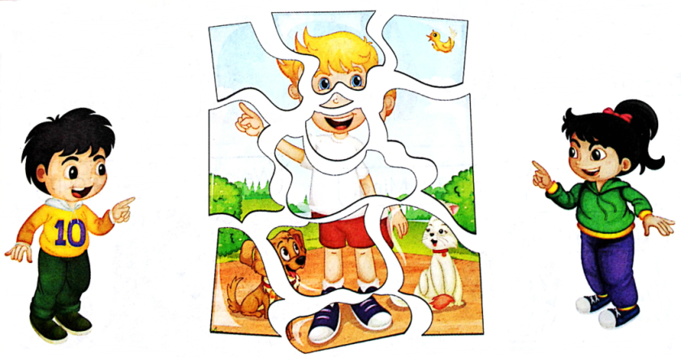
Presentation
Let’s think
Look and say.
Look at the land.
Look at the head.

Slide 11
Practice
Game 1
Choose and say
1
2
nose
eye
3
4
face
head
5
6
7
8
ear
neck
arm
hand
9
10
11
12
leg
knee
foot
mouth

Slide 12
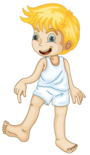
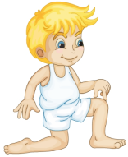
Practice
Point and say
Game 2

Slide 13
Consolidation
Listen and number the pictures.
4
1
5
3
6
2

Slide 14
Homework
1. 观看或跟读Fun story部分的课文动画或录音，并注意语音、语调。
2.复习本单元所有的单词，并读给你的父母听。
3. 预习Lesson 19。
Close

