Slide 1
人教精通版四年级上册
This is my new friend
WWW.PPT818.COM

Slide 2
Let’s chant
Peter, Peter. I am Peter.
I’m from England. How about you?
Jim, Jim. I am Jim.
I’m from America. How about you?
Gao Wei, Gao Wei. I am Gao Wei.
I’m from China, China, China, China!

Slide 3
Hello, Kate! Nice to meet you!
I’m Kate. I’m from America.

Slide 4
Let’s play 听音乐，传单词
游戏规则：音乐响起开始传卡片，音乐停止时，拿到卡片的同学到前面扮演卡片上的人物，做自我介绍：I’m…, I’m from…

Slide 5
Hello! I’m Orchid(兰花) . I’m from Singapore.

Slide 6
Singapore
I’m from Singapore.

Slide 7
Hello! I’m Maple Leaf(枫叶) .
I’m from Canada.

Slide 8
Canada
I’m from Canada.

Slide 9
friends
We are good friends.

Slide 10
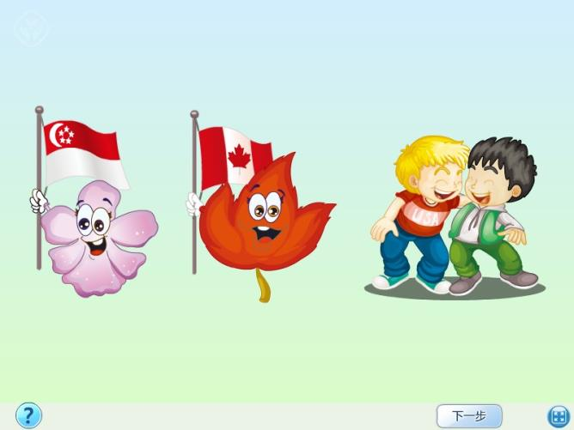

Slide 11
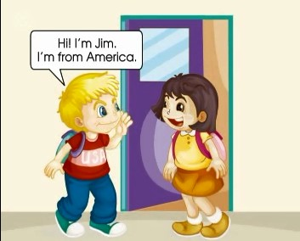
观看动画，回答问题:
Who are the children?
Where are the children?
What are they talking about?

Slide 12
We’re good friends! Yeah!

Slide 13
good

Slide 14
Practice
Role play
四人一组分角色表演对话，询问别人来自哪里。
用到的句型：
Where are you from?
I’m from+地点.

Slide 16
Let’s play接龙游戏
游戏规则：以小组为单位，组长将不同国籍的卡片发到每个组员手里，不互相询问图片内容。从组长开始进行，I’m from…Where are you from?组员依次快速说出自己的国籍，并继续往下询问。

