Slide 1
Unit 2 How often do you exercise?
Section A (Grammar Focus - 3c)
WWW.PPT818.COM

Slide 2
Read Grammar Focus and then finish the exercise.
________________________________ 你周末通常干什么？ | I _______ (总是) _________ ( 锻炼 ).
What do they do ________________ ( 在周末 )? | _____________________________.( 他们经常帮着做家务。)
What ______ she do on weekends? | _____________________________ ( 她有时去购物。)
_______________________________ ( 你多久看一次电影？) | ________________________________ ( 我大概一个月看一次电影。）
_____________________________ ( 他多久看一次电视？） | _____________________________ ( 他几乎不看电视。)
_____________________________ ( 你去购物吗？) | _____________________________ ( 不，我从来不去购物。)
What do you usually do on weekends?
always exercise
on weekends
They often help with housework
She sometimes goes shopping.
does
How often do you go to the movies?
I go to the movies maybe once a month.
How often does he watch TV?
He hardly ever watches TV.
Do you go shopping?
No, I never go shopping.

Slide 3
3a. Complete the questions with do or does. Then match the questions and answers.
1. How often _______ he play soccer?
2. _____ you drink milk?
3. How often ____ they stay up late?
4. _______ Sue eat a healthy breakfast?
5. How often ____ you eat apples?
6. ____ your parents play sports?
a. Yes. She usually does.
b. Hardly ever. I don't like them.
c. He plays at least twice a week.
d. No, they don't. They are too busy.
e. Never. They always go to bed early.
f. Yes, I do. Every day.
does
Do
do
Does
do
Do

Slide 4
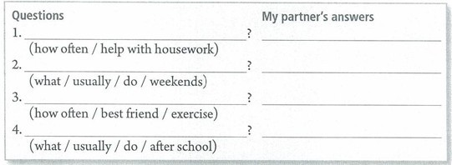
3b. Use the words given to write questions. Then ask and answer them with a partner.
How often do you help with housework
What do you usually do on weekends
How often does your best friend exercise
What do you usually do after school

Slide 5
3c. What can you do to improve your English? Add more things to the chart. Then ask your classmatesa the questions and find the best English students.
How often do you...... | Names | Frequency
read English book? | Lin Ying | twice a week
watch English movies
every day
listen to English songs
hardly ever
write English dairies
......
practice conversations with friends
......

Slide 6
小结训练
( )1. Li Lei works in Enland. He comes to China _____.
A. three time a year B. three times a year
C. three times year D. three time year
( )2. Hias grandmother is well because she often _____.
A. exercises B. smokes C. sleeps D. sings
( )3. --- _____ do they play football?
--- Every week.
A. How soon B. How often C. How many D. How long
4. usually, soccer, play, I (.)
______________________________________________
5. often, Katrina, does, TV, watch, How (?)
______________________________________________
6. do, you, What, usually, weekends, on do (?)
______________________________________________
B
A
B
I usually play soccer.
How often does Katrina watch TV?
What do you usually do on weekends?

