Slide 1
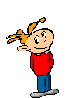
Unit 12 Put it on the desk.
WWW.PPT818.COM

Slide 2
Let's chant !
Little boy, little boy.
Do you have a toy?
Yes, I have a dog.
It’s in my box.
And I have a cat.
It’s in my bag.
Put it on the desk.

Slide 3
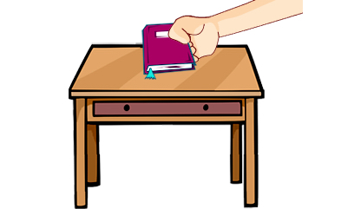
put

Slide 4
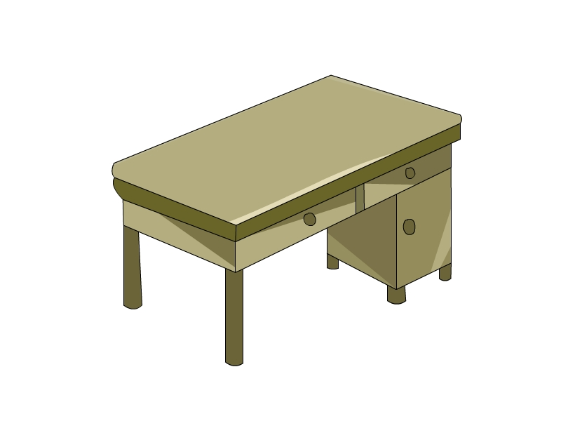
It’s a desk.

Slide 5
Put the book on the desk.

Slide 6
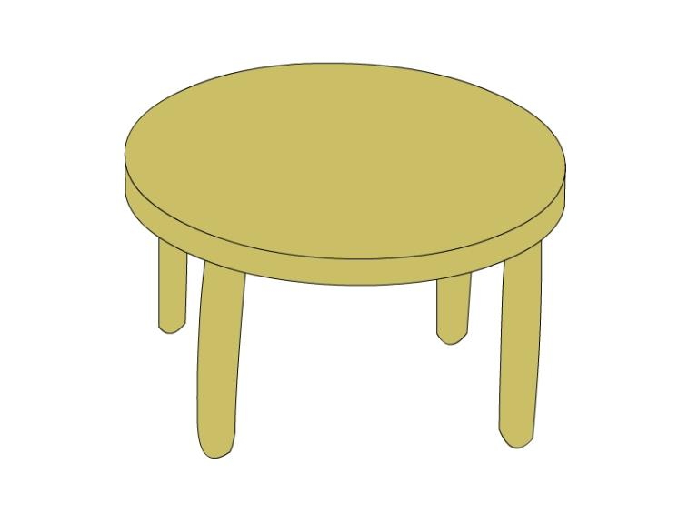
It’s a table.

Slide 7
Put the ball under the table.

Slide 8
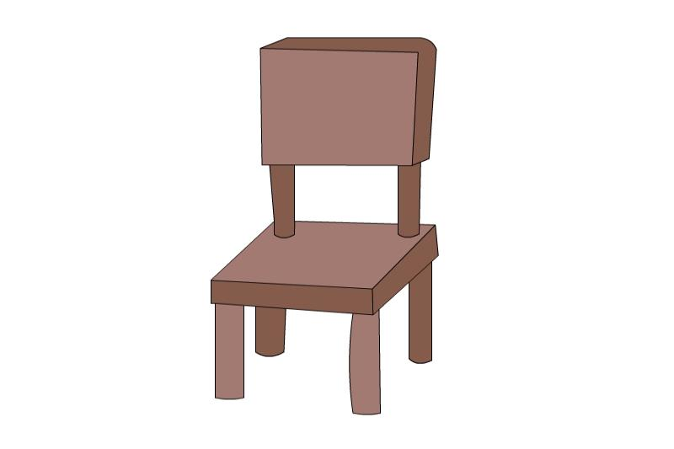
It’s a chair.

Slide 9
Put the ball on the chair.

Slide 10
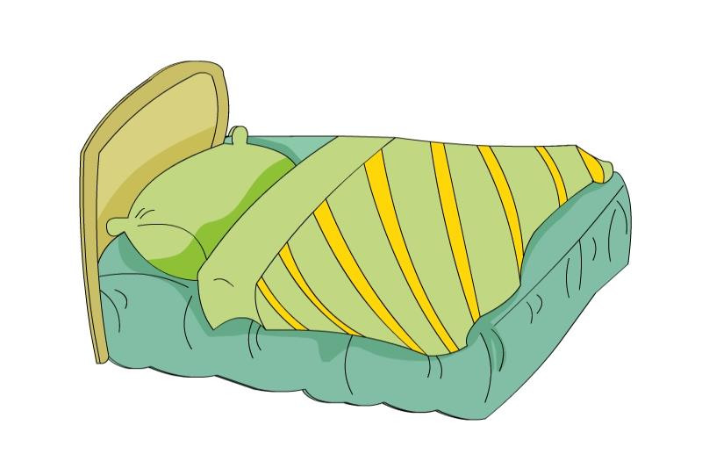
It’s a bed.

Slide 11
Put the bear on the bed.

Slide 12
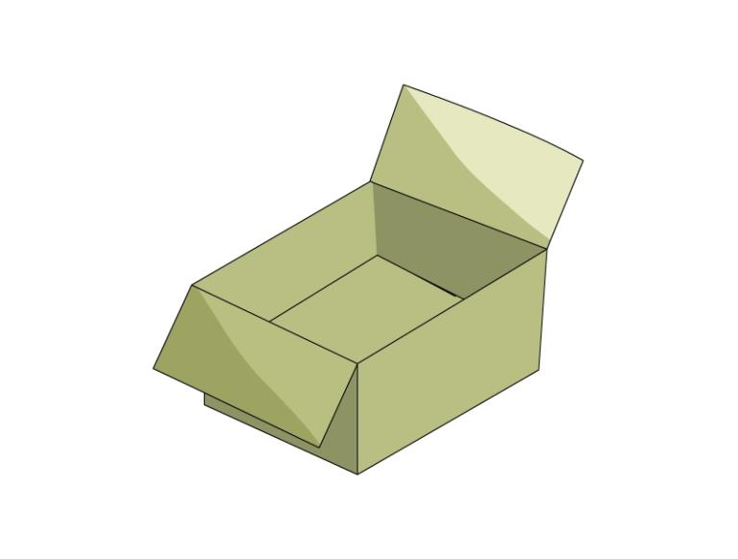
It’s a box.

Slide 13
Put the ball in the box.

Slide 14
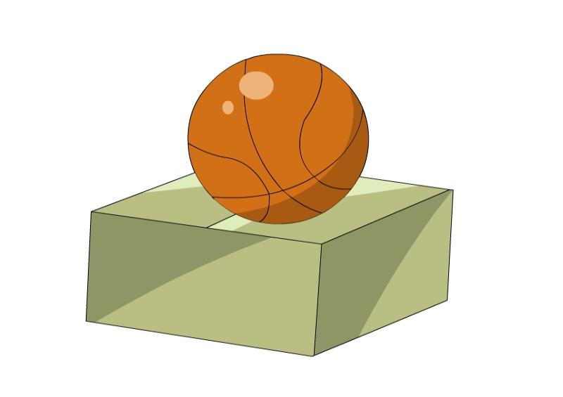
The ball is on the box.

Slide 15
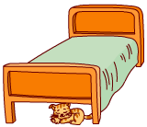
The cat is under the bed.

Slide 16
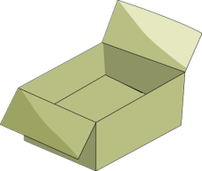
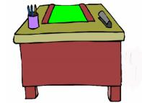
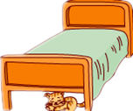
in, in, in the box .
on, on, on the desk.
under,under,under the bed.

Slide 17
方位介词in,on,under
里面,上面 in 和on ,
under 就在正下方。

Slide 18
Listen and do !(你说我做)
Put your….on/ in/ under the….

Slide 19
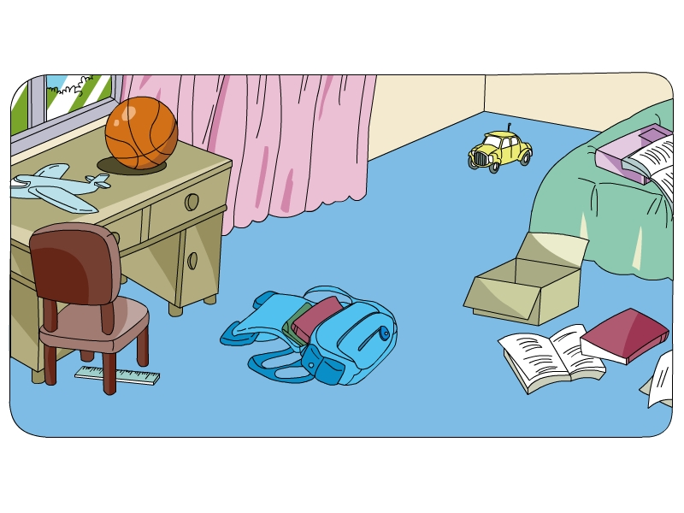
This is Jiamin’s room.
It’s very messy( 乱).
你能给Jiamin什么建议吗?

Slide 20
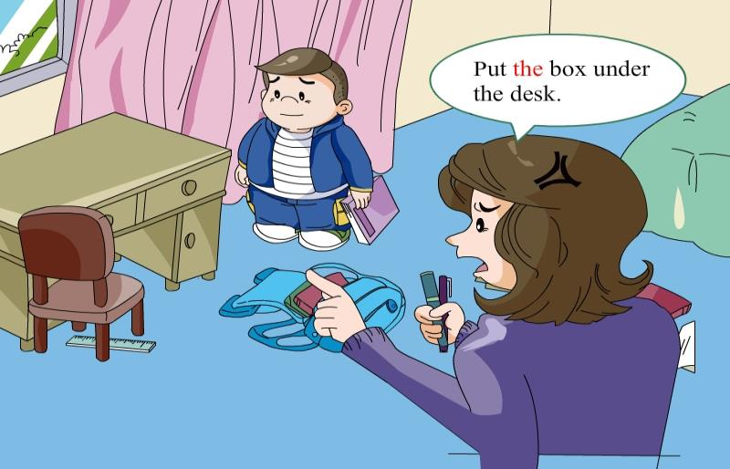
看看Jiamin妈妈给他什么建议!

Slide 21
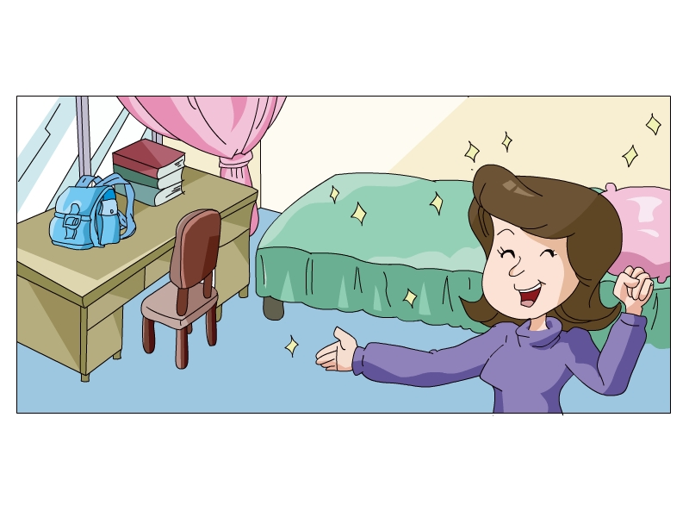
Now Jiamin’s room is tidy.

Slide 22
(on, Put, tidy, bed, the, OK.)
the
A: Put your toys in _____ box.
B: ______, Mum.
A: _____ your books ____ the desk.
B: Yes, Mum.
A: And put the box under the ____.
Your room is _____.
OK
Put
on
bed
tidy

