Slide 1
Unit 9
What does he look like?
Section B 第1课时
WWW.PPT818.COM

Slide 2
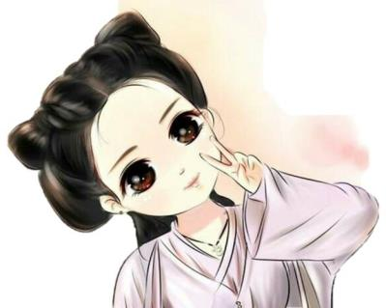
Lead-in
What does she look like?
She has a ________ face.
round

Slide 3
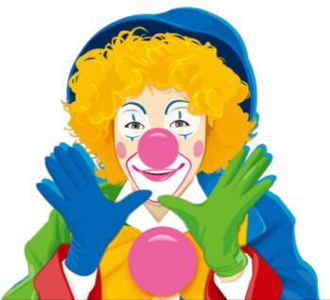
What does he look like?
big
He has a ________ nose.

Slide 4
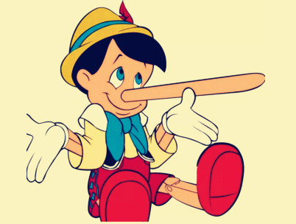
He has a very long nose, who is he?

Slide 5
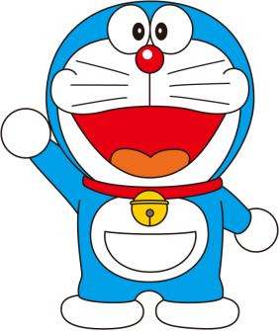
He has a round face, and he has a red nose. His mouth is big. Who is he?

Slide 6
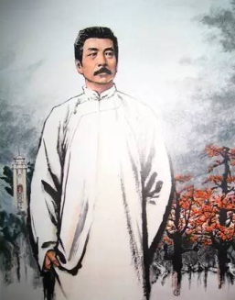
Do you know him?
a writer
short, black hair
a mustache
胡子；须状物
medium height
wears a white coat
His thoughts have great effect
Lu Xun（鲁迅先生）

Slide 7
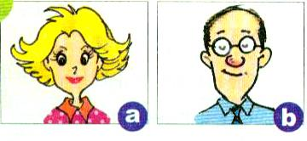
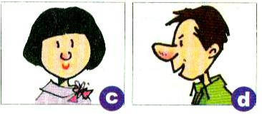
1a
Match the words with the pictures.
a
1. a big nose ____ 2. blonde hair ____ 3. a small mouth __
4. glasses ____ 5. a round face ____ 6. big eyes ____
7. black hair ____ 8. a long face ____
d
c
b
c
a
b, c
b

Slide 8
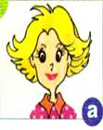
Try to describe the people in the pictures.
Key words:
short curly blonde hair
round face
small mouth
big eyes
beautiful (漂亮的).

Slide 9
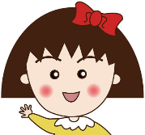
Make sentences about famous people. Fill in the blanks.
1b
1. Jackie Chan has black hair.
2. __________ has a round face.
Xiao wanzi

Slide 10
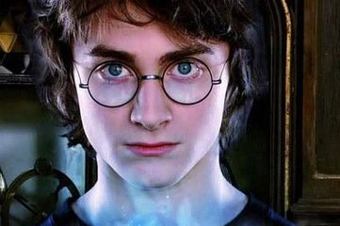
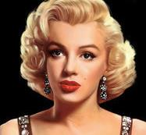
3. ____________ wears glasses.
4. _______________ has blonde hair.
Harry Potter
Marilyn Monroe
玛丽莲·梦露

Slide 11
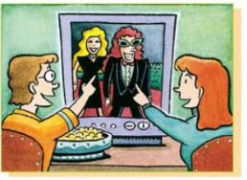
1c
Listen and write Johnny Dean’s and Tina Brown’s jobs in the chart.
 | Johnny Dean | Tina Brown
job
movie actress
singer

Slide 12
Listen again. What do Johnny and Tina look like? Complete the chart in 1c.
1d
 | Johnny Dean | Tina Brown
Looks like
really tall, really thin, curly hair, funny glasses
long blonde hair, medium height,
beautiful

Slide 13
Listen again and fill in the blanks.
Laura: Don’t you love Johnny Dean, Bob?
Bob: Johnny...?
Laura: Dean. The singer.
Bob: I don’t know. What does he _________?
Laura: He’s really ____and really ____. And he
has __________. And he has funny
__________. Look, there he is.
Bob: Oh yeah, I see him.
look like
tall
thin
curly hair
glasses

Slide 14
Laura: Here come the movie actors.
Bob: Oh, wow!
Laura: Who’s your favorite actress?
Bob: I like that woman with ______________ .
Laura: Is she tall or short?
Bob: She’s ________________.
Laura: Oh, Tina Brown?
Bob: Yeah. I think she’s really cool. She’s very
__________ and a great actress.
long blonde hair
of medium height
beautiful

Slide 15
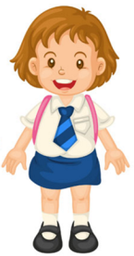
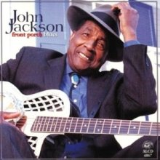
Describe what your favorite singer or athlete looks like.
1e
My favorite singer is John Jackson. He’s tall and thin. He has short curly brown hair.

Slide 16
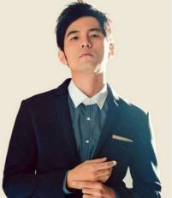
for example
My favorite singer is Jay Chou. He is of medium height and build. He has short black hair. He has small eyes. He’s really handsome.

Slide 17
Exercise
1. She always _____ sports shoes.
A. puts on B. wears C. in
2. I have long black hair, but my mother has _____ hair.
A. long curly brown B. brown curly long
C. curly long black
3. My father is _____ short.
A. a lot B. small C. a little

Slide 18
4. — I can’t see things there clearly.
— You can wear your _____.
A. glasses B. sweater C. hat D. glass
5. Does Mary have long _____ short hair?
A. with B. or C. and D. but
6. — What is your new friend like?
— She is _____ shy.
A. kinds of B. a little C. a little of D. a lot of

Slide 19
根据汉语提示补全句子。
1. Daming often _______ _______ _______ _______ (去
看电影) with his friends at the weekend.
2. They will meet _______ _______ _______ (在……前
面)the school gate tomorrow morning.
3. Lily _______ _______ (看起来像) Lucy and they
nearly look the same.
goes to the movies
in front of
looks like

