Slide 1
陕旅版四年级上册
Unit5 Our School 第4课时
WWW.PPT818.COM

Slide 2
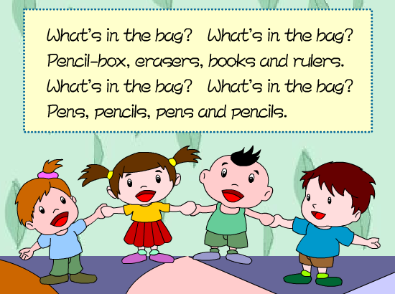
歌曲欣赏：What’s in the bag?

Slide 3
Review
问别人学校有什么设施时，用句型：
Is there a…?
回答用：Yes, there is. / No, there isn’t.
当问的东西不是一个时，则用：
Are there…?
回答用：Yes, there are. / No, there aren’t.

Slide 4
询问某处有某物用句型：
What’s in…?
回答用：
There is…/ There are…

Slide 5
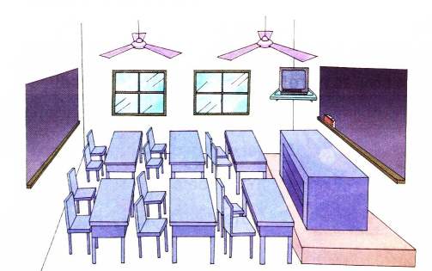
Ask and answer

Slide 6
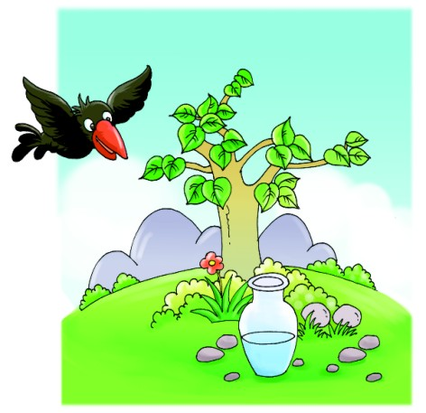
Read a story
Water! Water! Is there any water in it?

Slide 7
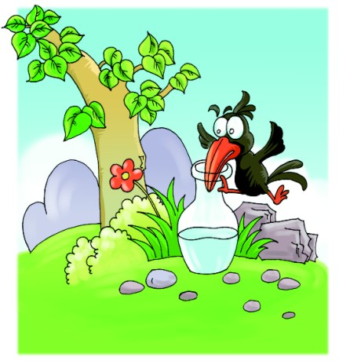
Read a story
Oh, yes! There is a little water in it. But I can’t have it. How can I have it? How can I have it?

Slide 8
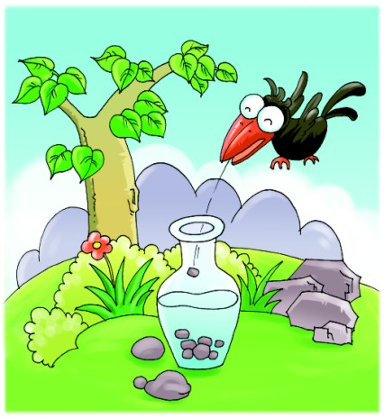
Read a story
Ha! Ha! There are some stones here!

Slide 9
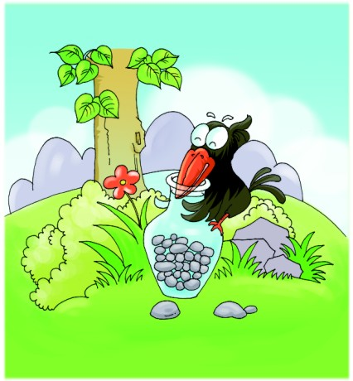
Read a story
Aha! Now I can have it! How nice!

Slide 10
Look, read and write
B
D
C
A

Slide 11
Look and write
classroom
playground
Garden
toilet
school gate

