Slide 1
Unit 10
I’d like some noodles.
R 七年级下册
第2课时
WWW.PPT818.COM

Slide 2
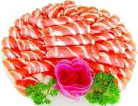
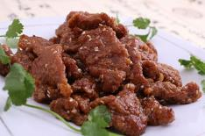
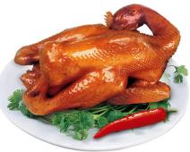
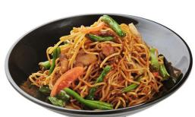
Lead-in
mutton
beef
chicken
noodles

Slide 3
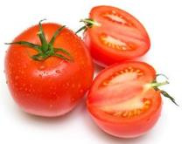
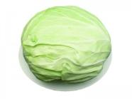
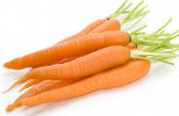
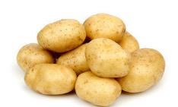
cabbage
tomatoes
carrots
potatoes

Slide 4
What kind of food would you like?
I’d like beef / mutton....

Slide 5
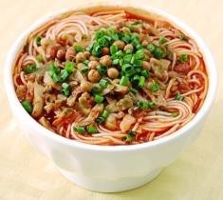
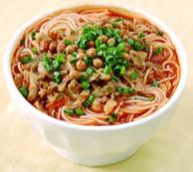
What size would you like?
I’d like a small/ medium/ large bowl of noodles.

Slide 6
Grammar
Focus
What kind of noodles would you like? | I'd like beef noodles, please.
What size would you like? | I'd like a large bowl, please.
Would you like a large bowl? | Yes, please.
Is there any meat in the tomato and egg soup? | No, there isn't any. / No, there's no meat.

Slide 7
I’d ＝ I would
She’d ＝She would
Countable nouns | Uncountable nouns | Countable and uncountable nouns
bowls, apples, carrots, oranges, strawberries | beef, meat, milk, mutton, water | chicken, salad, ice-cream, cabbage

Slide 8
would like 的常用句型
Would you like + some +名词/代词？
常用于征求对方的意见。注意此句中的some不用改为any。
回答：Yes, please. / No, thanks.
Would you like + to do sth.？
表示向对方有礼貌地提出建议或发出邀请。
回答：Yes，I’d love/like to.或 I’d love/like to, but …

Slide 9
拓展：would like 与 feel like都表示“想要……”，但两者后面所接动词短语的形式不同，would like接动词不定式，feel like接动词 -ing形式。
例句：
Would you like to go to the zoo? 你想去动物园吗？
I don’t feel like doing anything. I feel very tired.
我什么都不想做，我很累。

Slide 10
可数名词与不可数名词
1. 定义：
可数名词：
1.指可以计数的事物的名词。
2.有单、复数形式之分。
3.可以直接用不定冠词a/an或具体的数词如one, two,
three等来修饰。

Slide 11
不可数名词：
1. 指不可以计数的事物的名词。
2. 没有复数形式，但有量的变化。
3. 不能使用不定冠词或数词直接修饰，如要表示确切
数量时，要用“数量词+of+不可数名词”结构。

Slide 12
2. 常见可数名词和不可数名词的分类
可 数 名 词 | 个体名词 | 用来指单个人或单个事物的名词 | car 汽车 student学生 computer 电脑 desk 桌子
 | 集体名词 | 用来指一群人或一些事物总称的名词 | army 军队 family 家庭 police 警察 class 班级

Slide 13
不 可 数 名 词 | 物质名词 | 用来指无法分为个体的物质、材料的名词 | water 水 tea 茶 bread 面包 air 空气
 | 抽象名词 | 用来指人或事物的品质、情感、状态、动作等抽象概念的名词 | love 爱 health 健康 time 时间happiness 幸福

Slide 14
3. 既可作可数名词也可作不可数名词的词
有些名词既可作可数名词，也可作不可数名词，但意义上有很大区别。
a glass 一个玻璃杯
a chicken 一只鸡
a fish 一条鱼
a room 一个房间
an orange 一个橙子
glass 玻璃
chicken 鸡肉
fish 鱼肉
room 空间
orange 橙汁

Slide 15
注意：
可数名词单数或不可数名词作主语时，谓语动词用单数；可数名词复数作主语时，谓语动词用复数形式。
例句：
Water is important to us.
A girl is reading in the library.
Two girls are reading in the library.

Slide 16
3a
Complete the conversation below.
a. What kind of noodles do you have?
b. Oh, a medium bowl, please.
c. OK, I’d like the mutton noodles then.
d. I’d like some noodles, please.
e. What sizes do you have?
f. Are there any vegetables in the mutton noodles?

Slide 17
May I have your order? _____
2. What kind of noodles would you like? _____
3. We have beef, chicken, mutton, cabbage, potato, tomato … _____
4. Yes, there are some carrots. _____
5. Sure. What size would you like? _____
6. We have large, medium and small bowls. _____
d
a
f
c
e
b

Slide 18
3b
Write questions and answers using the words in brackets.
What kind of noodles would you like? (kind)
____________________________
(chicken / beef / tomatoes)
I’d like chicken noodles.

Slide 19
2. _________________________________ (size)
_________________________________ (medium)
3. _______________________________________
(any/cabbage/beef noodles)
____________________ (no)
What size would you like?
I’d like a medium bowl , please.
Is there any cabbage in the beef noodles?
No, there isn’t any.

Slide 20
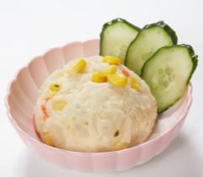
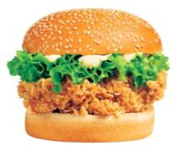
Work in small groups. Who would like the food below? Write their names on the cards above the food.
3c
hamburger
potato salad

Slide 21
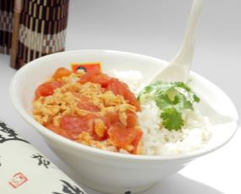
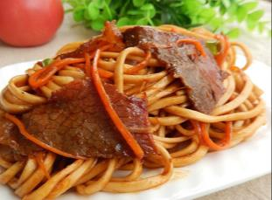
tomato and egg rice
beef and
carrot noodles

Slide 22
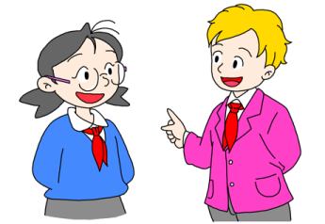
I’d like beef noodles with carrots.
Anna, what would you like to eat?

Slide 23
John, what would you like to eat?
I’d like hamburgers.

Slide 24
Exercise
根据汉语意思完成句子。
1.我想预定一个大比萨饼。
I ________ like ________ order a large pizza.
2.你想要什么种类的面条？
What _______ ________ noodles would you like?
3.你想要一大碗牛肉馅的饺子吗？
Would you like a large _________ ________ beef
dumplings?
would to
kind of
bowl of

Slide 25
单项选择。
A
Linda has bought a large house _______ a swimming pool.
A. with B.in C. on D. from
2. —Your tea smells great!
—It’s from India. Would you like ______?
A. it B. this C. some D. little
C

Slide 26
3. There are fifty ________ in our school. They are all
friendly to us.
woman teachers B. women teacher
C. woman teacher D. women teachers
D
4. —Would you like some ________?
—No, thanks. I’m not hungry at all.
water B. soup C. bread
C

Slide 27
5. —What would you like ________ for your mom on
Mother’s Day?
—A dress.
buy B. buying C. to buy D. buys
C
D
6. My father bought two ________ when he came back
from Guilin.
A. milk B. bread C. watch D. dictionaries

